Slide 1
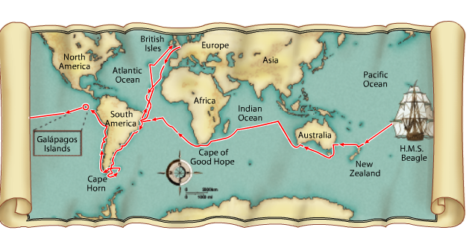
Darwin’s Theory of Natural Selection Darwin Presents his Case Chapter 15-3
Image from: Biology by Miller and Levine; Prentice Hall Publishing©2006

Slide 2
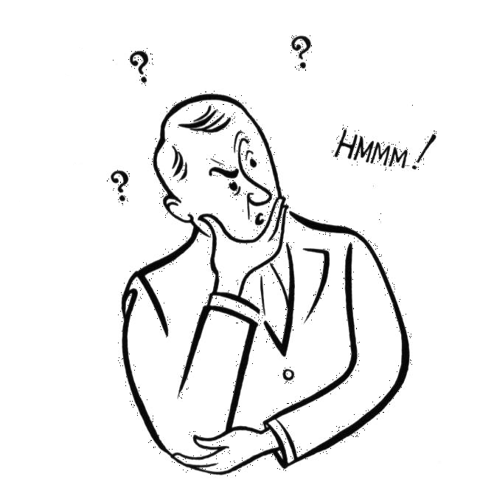
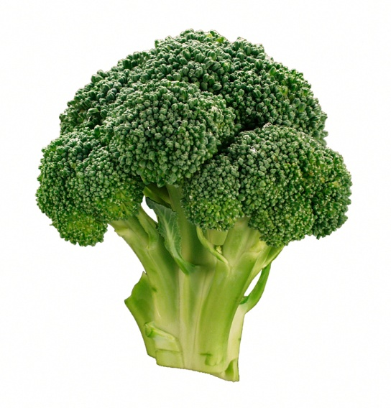
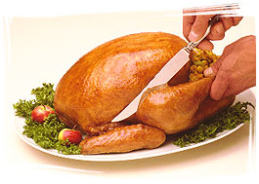
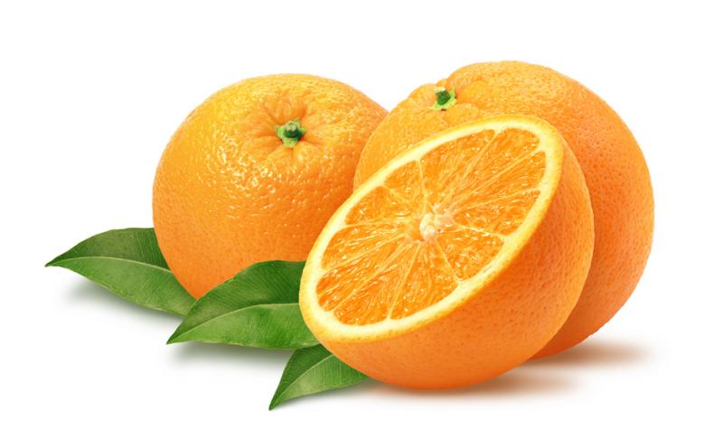
http://groups.wfu.edu/ModelUN/images/Cover/Oranges.jpg
http://www.fx.clemson.edu/~ablank/126436919.Broccoli.jpg
http://www.butterball.com/en/images/plan_n_prep/preparing/carving1.jpg
What do oranges, broccoli and
Butterball turkeys have to do
with EVOLUTION?
(Answers to come in this slide show!)
THINK ABOUT IT

Slide 3
After Darwin returned to England in 1836
he filled notebooks with his ideas
about _____________ and the process
that he would later call _______.
He did not rush to publish his ideas
because they ________ with the
fundamental scientific ______ of his
day.
He asked his wife to publish
his ideas when he ___.
species diversity
natural selection
disagreed
beliefs
died
http://www.elsie.brandeis.edu/images/journals.gif

Slide 4
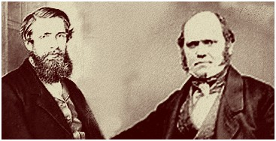
In 1858 another naturalist,
_________________, wrote an
essay describing his work in _______ that
summarized the same ideas _____ had
been thinking about for 25 years!
Alfred Russel Wallace
Malaysia
Darwin
http://www.thesecondevolution.com/wallace&darwin.jpg

Slide 5
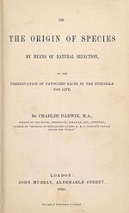
Suddenly Darwin had incentive to publish
the results of his work!
In 1859
____________________
presented _______
and proposed a
________ for evolution
that he called
__________________
On the Origin of Species
evidence
mechanism
NATURAL SELECTION
http://www.loc.gov/exhibits/world/images/s125.jpg

Slide 6
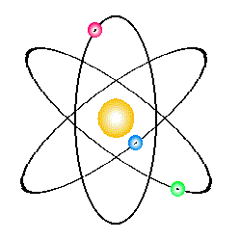
Isn’t evolution just a theory?
A theory is a ____________, _______, explanation of phenomena that have occurred in the natural world, like the theory of __________________, ________, and _____________.
well-supported
testable
gravitational attraction
cell theory
atomic theory
http://www.avgoe.de/StarChild/DOCS/STARCH00/questions/apple_falling.gif
http://sixthsense.osfc.ac.uk/chemistry/atomic_structure2/atom.gif

Slide 7
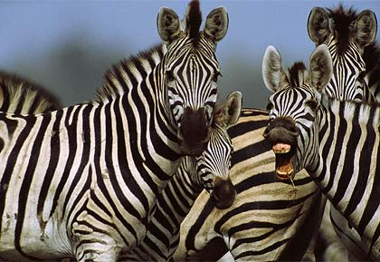
WHAT IS DARWIN’S THEORY?
_________________ is found
naturally in all populations
GENETIC VARIATION
http://www3.nationalgeographic.com/animals/images/primary/zebra-herd.jpg

Slide 8
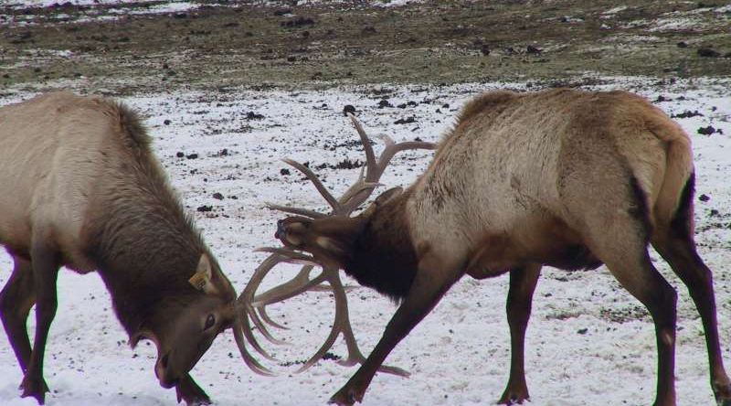
WHAT IS DARWIN’S THEORY?
______________________
means that members of each species
must ________ for food, space, and
other __________.
STRUGGLE FOR EXISTANCE
COMPETE
RESOURCES
http://www.wasatchcomputers.net/gallery/elk_fight.jpg

Slide 9
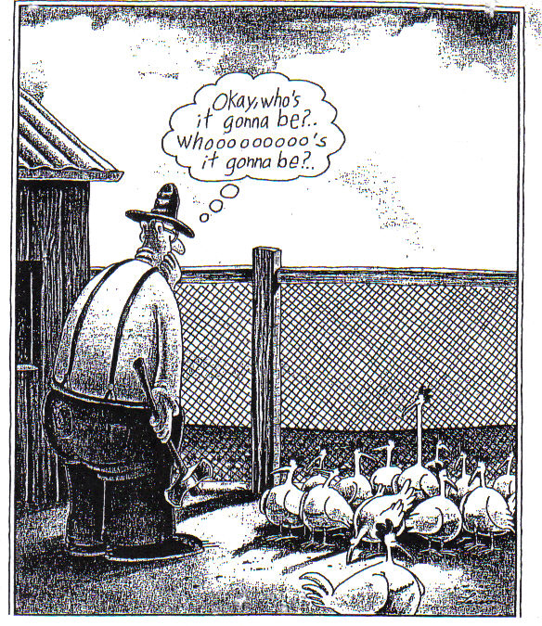
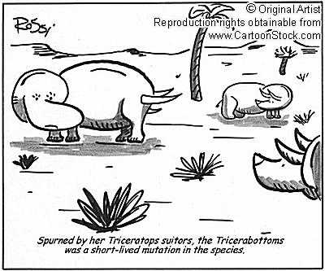
WHAT IS DARWIN’S THEORY?
Some organisms in a ________
are ________ to survive.
population
less likely
http://www.cartoonstock.com/newscartoons/cartoonists/rrs/lowres/rrsn69l.jpg

Slide 10
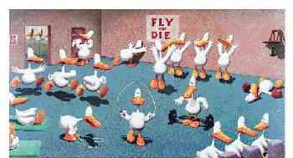
WHAT IS DARWIN’S THEORY?
_____________________ organisms which are better adapted to the environment will ______ and ________, passing on their _____.
SURVIVAL OF THE FITTEST
survive
reproduce
genes
http://www.poster.net/bedard/bed202.jpg

Slide 11
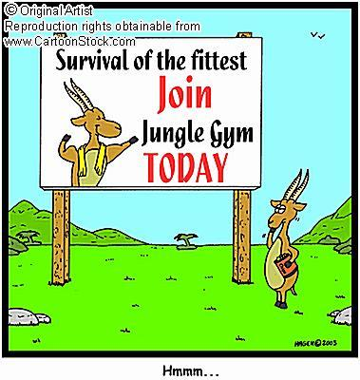
VOCAB
Ability of an individual to ______
____________ in its specific
environment
= ______
http://www.cartoonstock.com/newscartoons/cartoonists/cga/lowres/cgan170l.jpg
survive
and reproduce
fitness

Slide 12
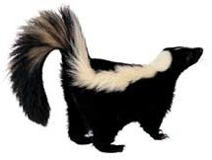
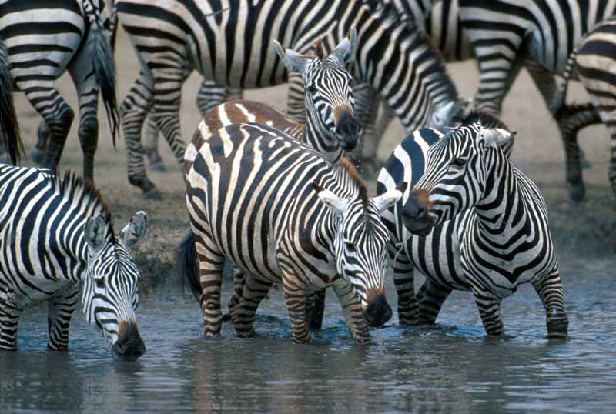
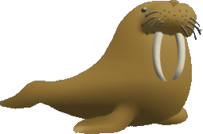
VOCAB
Any ___________________ that
increases an organism’s ______________
= _____________
inherited characteristic
chance of survival
ADAPTATION
http://www.wildlife-traps.com/skunks.html
http://www.atomtigerzoo.com/photos/images/20060421233733_duckfeet.jpg
http://www.3kitty.org/travelrama/Photos/123-21-4x6.jpg

Slide 13
WHAT IS DARWIN’S THEORY?
Over time, natural selection
results in ________ in the
inherited characteristics of a
__________.
These changes ______ a
species’ _____ in its environment.
CHANGES
POPULATION
increase
fitness
How Does Evolution Really Work?

Slide 14
WHAT IS DARWIN’S THEORY?
DESCENT WITH MODIFICATION
____________________________
suggests that each species has
___________, with ________,
from other species over time.
This idea suggests that all living
species are ____________________,
and that all species, living and extinct,
share a _________________.
DESCENDED
CHANGES
RELATED TO EACH OTHER
COMMON ANCESTOR

Slide 15
EVIDENCE OF EVOLUTION:
________________
________________
3. _______________
4. _______________
5. _______________
6. _______________
7. _______________
Artificial selection
Fossil record
Geographic Distribution
Homologous structures
Embryology
DNA
See Natural selection happen

Slide 16
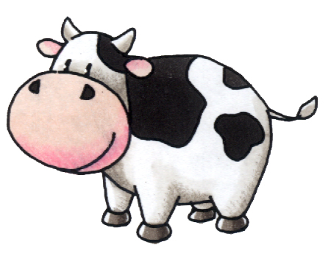
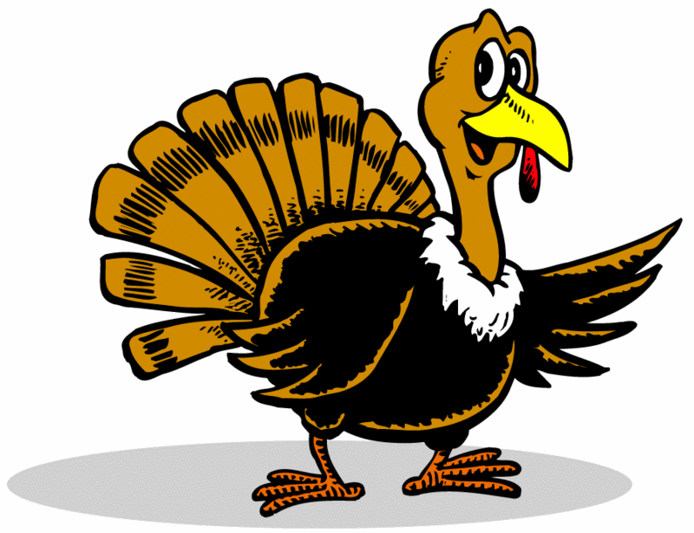
ARTIFICIAL SELECTION WORKS
In artificial selection, ____________
provides the _________ through
_________ and _________________
and ______________ those traits that they find ______.
NATURE
variation
mutation sexual reproduction
humans select
useful
EX: We have selected for and bred cows to produce more milk, turkeys with more breast meat, etc.
http://www.pp3moo.com/hm2cow.jpg
http://lazerbrody.typepad.com/photos/uncategorized/turkey.gif

Slide 17
Breeds of Dogs
Chihuahua – bred from Techichi of Mexico
by Mayans, had religious significance
Saint Bernard – bred by monks around 1050 A.D.
to rescue travelers of mountain passes in the
Swiss Alps between Italy and Switzerland
Irish Wolfhound – bred in Ireland to
hunt wolves and elk
Dachshund – bred in Germany as early
as the 15th century to hunt badgers
SLIDE FROM: BIOLOGY by Miller and Levine; Prentice Hall Publishing©2006

Slide 18
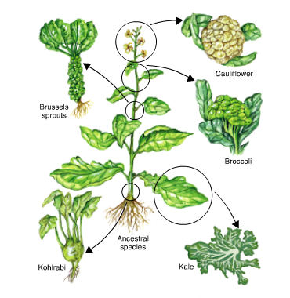
____________________________
ARTIFICIAL SELECTION WORKS
BIOLOGY by Miller and Levine; Prentice Hall Publishing©2006

Slide 19
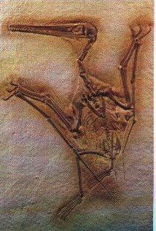
How Do We Know Evolution Happens?
2. The Fossil Record –
______ are the _______
_________________
found in layers of rock
in the Earth.
Fossils
remains
of ancient organisms

Slide 20
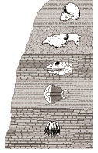
How Do We Know Evolution Happens?
The layers of rock tell the history of the
_____, while the _____ found within
the rock tell a history of ___.
The fossils are thought
to be the ________ as
the rock they
are found in.
Earth
fossils
life
same age

Slide 21
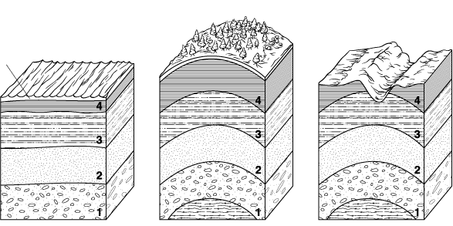
Movement of Earth’s Crust
Section 15-2
Earthquakes and volcanoes
cause uplifting of the layers of the
Earth, taking the fossils along
Sea level
Fossils of
marine
fish found
on the
mountain-
sides of
southwest
Wyoming,
which at
one time
was
covered
by an
inland sea
Fish die in
the ocean
and are
covered in
sediment.
Over time
and under
increasing
pressure,
the remains
becomes
fossilized
Sedimentary rocks form in horizontal layers.
When part of Earth’s crust is compressed, a bend in a rock forms, tilting the rock layers.
As the surface erodes due to water, wind, waves, or glaciers, the older rock surface is exposed.

Slide 22
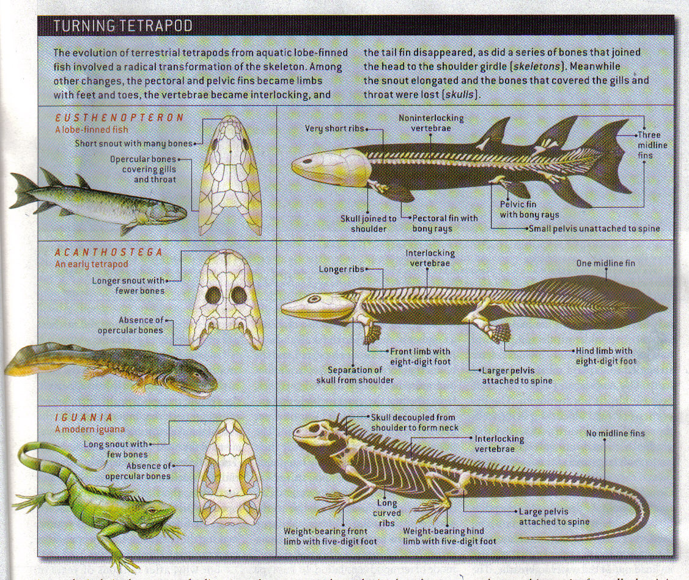
TRANSITIONAL FOSSILS HAVE BEEN FOUND
Scientific American; Dec 2005; Vol 293; p100-107

Slide 23
If Darwin’s theory is correct you would expect to find ____________ yet _______________ living in a
_________ region as they spread into nearby habitats and evolve.
closely related
different species
geographic
That’s EXACTLY what we do see!

Slide 24
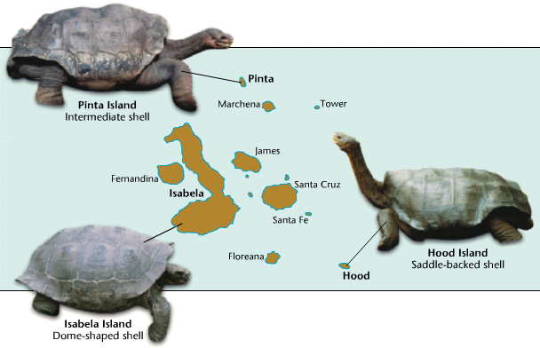
http://www.newtonswindow.com/problem-solving.htm
REMEMBER THE GALAPAGOS TORTOISES
Intermediate vegetation Intermediate necks
Little vegetation Long necks
Image from: BIOLOGY by Miller and Levine; Prentice Hall Publisher©2006
Lots of vegetation Short necks
Tortoises adapted to different habitats as they
spread from the mainland to the different islands.
= DIVERGENT EVOLUTION = ADAPTIVE RADIATION

Slide 25
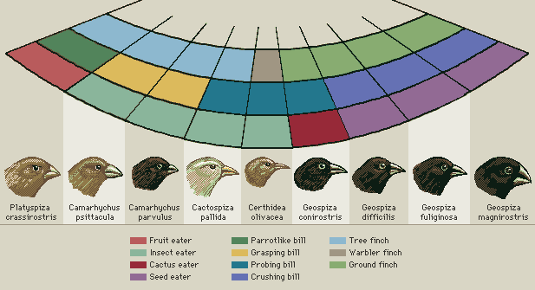
http://images.encarta.msn.com/xrefmedia/aencmed/targets/illus/ilt/T014608A.gif
GALAPAGOS FINCHES
The _____ of Galapagos finches have
______ to eating a _____ of _____.
beaks
adapted
variety
foods

Slide 26
If Darwin’s theory is correct you would also expect to find _______________ living in ________ geographic regions
but similar habitats becoming ________ as they adapt to ______________.
different species
far apart
more alike
similar ecosystems
That’s EXACTLY what we do see!

Slide 27
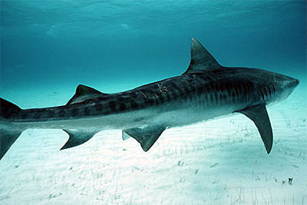
http://www.flmnh.ufl.edu/fish/gallery/descript/TigerShark/scars.JPG
http://news.bbc.co.uk/2/shared/spl/hi/guides/456900/456973/html/nn1page1.stm
Whales and sharks have a _____ body design
even though they are very _______ organisms
(one is a fish; the other, a mammal)
because they have _________________ to living in a _____ environment.
similar
different
independently adapted
similar
= CONVERGENT EVOLUTION

Slide 28
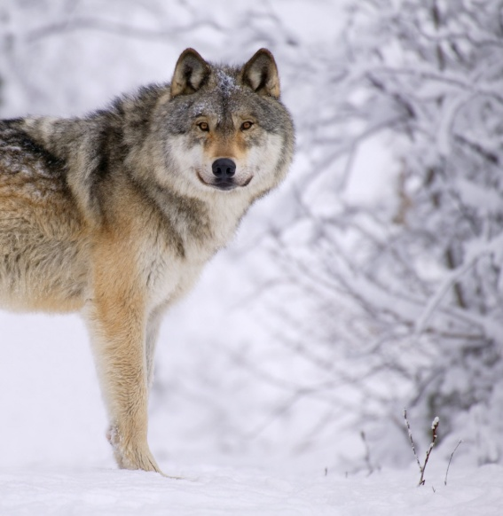
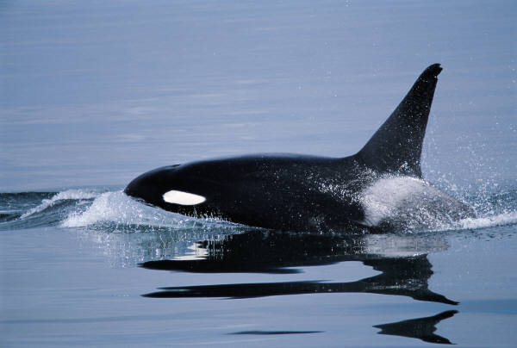
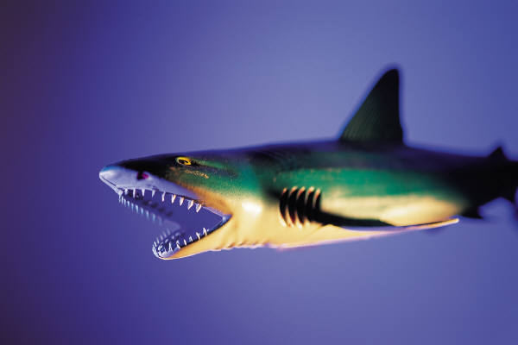
Whales are closely related to wolves, but don’t look or act much like them
= divergent evolution
Conclusion:
The pressure of
the environment
drives evolution
Whales are distantly related
to sharks, but look and act more
like them =
convergent evolution

Slide 29
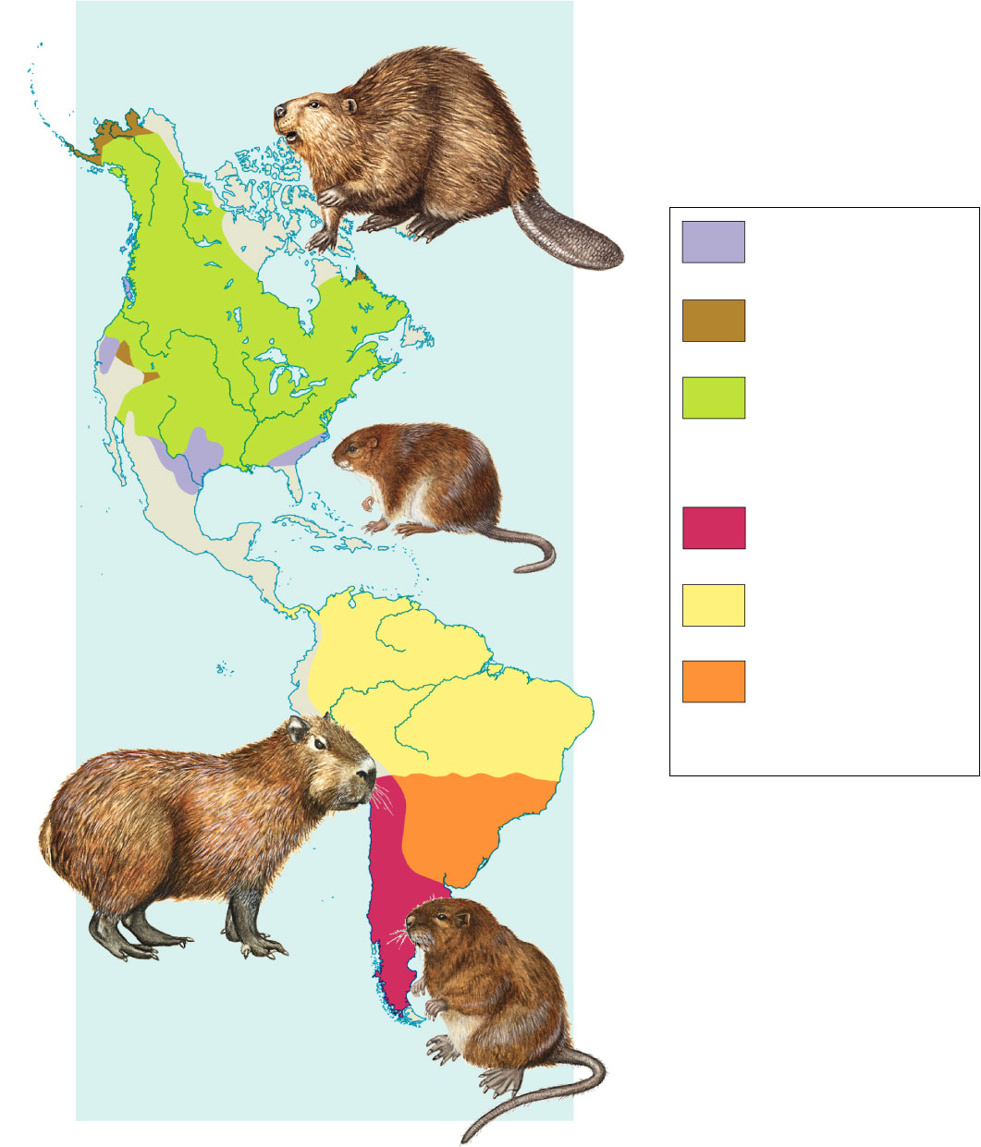
Figure 15–14 Geographic Distribution of Living Species
Section 15-3
Differences
between
_____________
muskrat
and coypu
show _________
evolution, while
similarities
between
______________
capybara
and coypu show
___________
evolution.
Beaver
closely-related
Beaver and capybara
are ______________
_______ living in very ________ environments,
while beaver and musk-rat are _______________
_______ living in a
______ environment.
Differences between
beaver and capybara
show _________
evolution, while
similarities
between beaver and
muskrat show __________ evolution.
closely-related
species
Beaver
Muskrat
Beaver and Muskrat
Coypu
Capybara
Coypu and Capybara
divergent
different
NORTH AMERICA
Muskrat
distantly-related
distantly-related
species
similar
convergent
SOUTH AMERICA
Capybara
divergent
convergent
Coypu

Slide 30
4. _____________________
HOMOLOGOUS Structures
Image from: http://www.angelfire.com/ab7/evolution12/evolutionclues.html

Slide 31
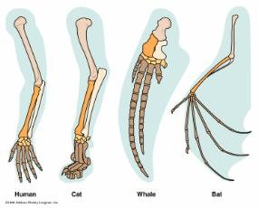
4. Homologous Body Structures –
Structures, like the limbs of vertebrates, look very _______,
but are made from the
__________, because
they are made from
the same clump of
_____________ cells
in the _______.
different
same bones
undifferentiated
embryo
Image from: http://www.angelfire.com/ab7/evolution12/evolutionclues.html

Slide 32
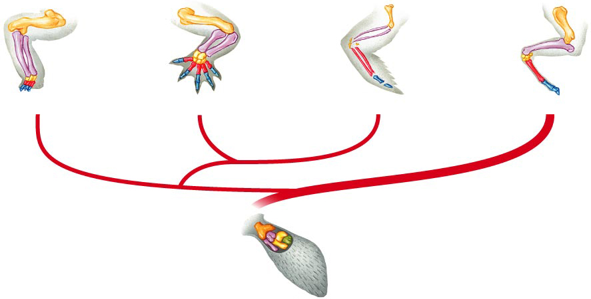
Figure 15–15 Homologous Body Structures
Section 15-3
Turtle
Alligator
Bird
Mammal
Ancient lobe-finned fish

Slide 33
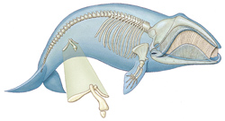
4. Homologous Body Structures –
Some _______________________
are _______ and have no useful
function even though they are still present, like ________in whales and boa constrictors, or a ____ and, until recently, ________________in humans.
homologous body structures
vestigial
hipbones
tail
cecum (appendix)
http://www.txtwriter.com/backgrounders/Evolution/EVpage12.html

Slide 34
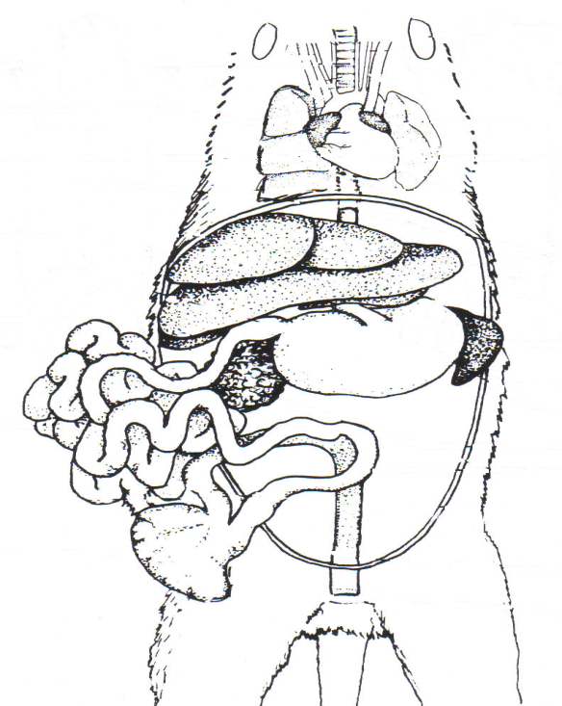
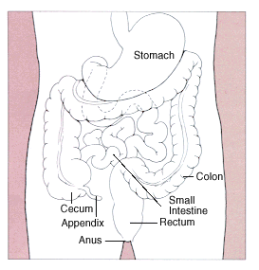
Most mammals have a pouch between their small and large intestine that contains bacteria to digest plants called a _____.
cecum
In humans the cecum
is shrunken and unused.
It is our _________
appendix
NEW RESEARCH shows the appendix DOES provide a function: recolonizing the body
With bacteria after illness!!
http://www.medicalgeo.com/images/appendix.gif

Slide 35
Why grow a tail and then lose it?
HUMAN EMBRYO
_________________
_________________
_________________
has a tail at 4 weeks
Tail disappears at
about 8 weeks
tail
http://www.suite101.com/files/topics/6234/files/tail_HumanTail.gif

Slide 36
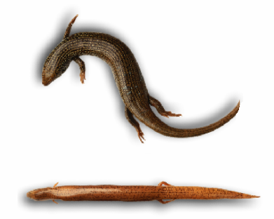
Skinks are a type of lizard. In some species, legs have become so small they _______
______ in walking.
no longer
function
Why would an organism possess organs ___ ________________?
with
little or no function
One explanation:
The ________ is present to make the organ, but
_________________ through ______________.
If the organ is not vital to survival, then
natural selection would not cause its elimination.
gene code
function has been lost
change over time
http://www.medicalgeo.com/images/appendix.gif

Slide 37
5. _____________________
________ of many animals with back-
bones are very similar.
Similarities in Embryology
Embryos
Image from: http://calspace.ucsd.edu/virtualmuseum/litu/03_3.shtml

Slide 38
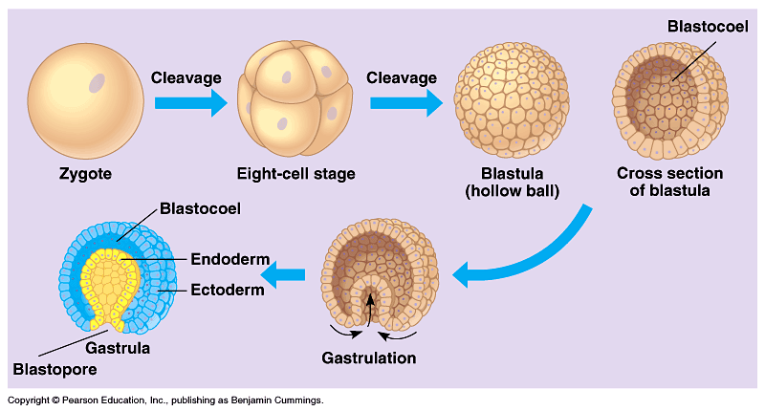
It is clear that the same groups of _____________ cells develop in the same order to produce the same tissues and organs of all vertebrates, suggesting that they all _______ from a _______________.
undifferentiated
evolved
common ancestor
Image from: http://io.uwinnipeg.ca/~simmons/16cm05/1116/16anim3.htm

Slide 39
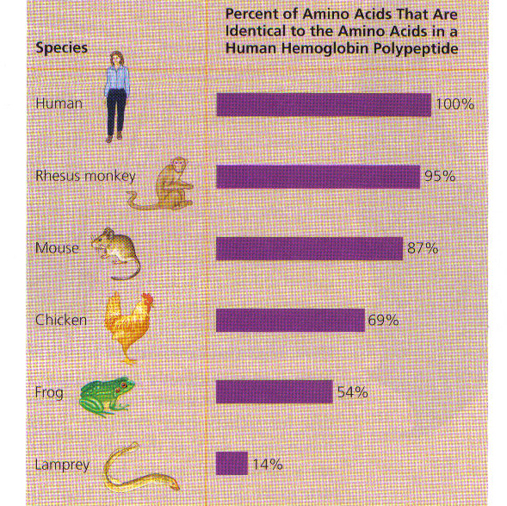
Similarities in DNA
6. _______________
Similarities in ____ and ________ sequences
suggest
relatedness
DNA
PROTEIN
Image from: BIOLOGY AP EDITION by Campbell and Reece; Prentice Hall Publishing©2005

Slide 40
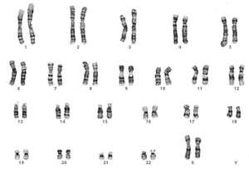
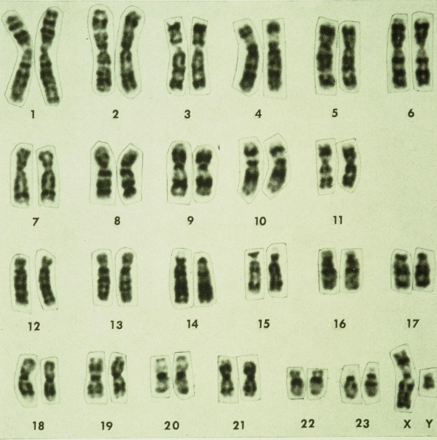
Human- 46 chromosomes Chimpanzee- 48 chromosomes
karyotypes
Similar _________ suggest an ___________________.
evolutionary relationship
Human: http://www.nationmaster.com/wikimir/images/upload.wikimedia.org/wikipedia/en/thumb/1/18/300px-Human_karyogram.png
Chimpanzee: Middle School Life Science , published by Kendall/Hunt.

Slide 41
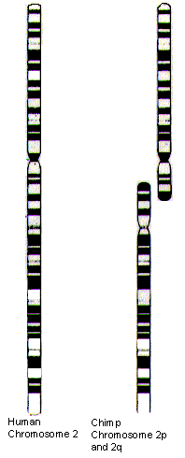
1. ________________________
BANDING PATTERN MATCHES
If you take the two smaller chromosomes apes have that we don’t, and place them end to end, the ______ _______________ to the #2 human chromosome __ ________________.
banding
pattern is identical
we
have that they don’t
http://www.evolutionpages.com/chromosome_2.htm

Slide 42
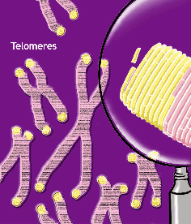
2. ____________________
TELOMERES IN MIDDLE
Chromosomes have special sequences called _______ at their ends to protect the strands during replication.
telomeres
http://joannenova.com.au/Speaking/Morslids.html

Slide 43
2. TELOMERES IN MIDDLE
→
Telomere sequences are found __________ and _____________________ of human chromosome #2 suggesting it was made by _____ two other chromosomes together.
at the ends
ALSO IN THE MIDDLE
→
fusing
→
http://www.evolutionpages.com/chromosome_2.htm

Slide 44
3. _________________
EXTRA CENTROMERE
Chromosome #2 has a second __________ _____________ region
INACTIVE
CENTROMERE
→
http://www.evolutionpages.com/chromosome_2.htm

Slide 45
http://groups.wfu.edu/ModelUN/images/Cover/Oranges.jpg
http://www.fx.clemson.edu/~ablank/126436919.Broccoli.jpg
http://www.butterball.com/en/images/plan_n_prep/preparing/carving1.jpg
What do oranges, broccoli and
Butterball turkeys have to do
with EVOLUTION?
(Answers to come in this slide show!)
THINK ABOUT IT

Slide 46
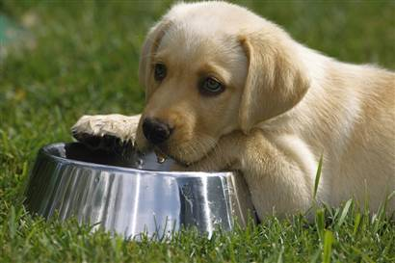
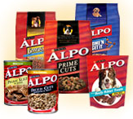
Did you ever wonder why dogs and cats don’t need to eat ________, but
_______?
fresh fruit
YOU DO
http://www.naturescornermagazine.com/NaturesBlog/images/dog%20care%20in%20summer.jpg
http://www.alpo.com/where.aspx

Slide 47
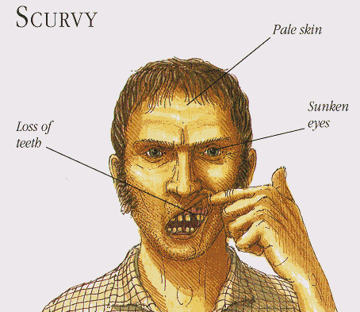
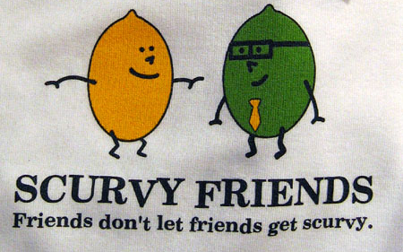
Fish, amphibians, reptiles, and most mammals can make their own _________, but humans need to eat fresh fruit or they end up with ________.
VITAMIN C
SCURVY
http://www.med.uc.edu/departme/cellbiol/Image7.gif
http://www.rachelleb.com/images/2005_02_22/scurvy.jpg

Slide 48
Human DNA contains the gene that codes for the enzyme to make vitamin C, but it is ________________.
Guess what other group of organisms lack the ability to make their own Vitamin C?
NONFUNCTIONAL
PRIMATES…
which includes
chimpanzees, orangutans,
gorillas, and other apes.
http://groups.wfu.edu/ModelUN/images/Cover/Oranges.jpg

Slide 49
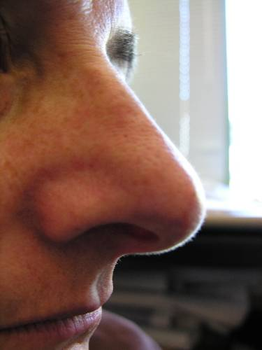
Humans have many other nonfunctional vestigial genes called ________________.
EX: Humans have more than 99 different odor receptor genes, but more than 70% of them are ___________.
PSEUDOGENES
nonfunctional
http://www.animationplayhouse.com/new/dogs2.html
http://unraveling.typepad.com/photos/uncategorized/nose_1.jpg

Slide 50
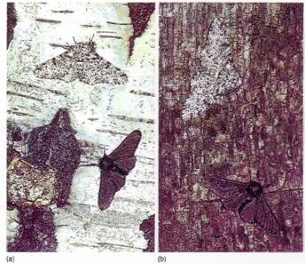
WHY DOES EVOLUTION MATTER NOW?
Can see Natural selection happen
7.____________________________
EX: Peppered Moths
Typica
There is a natural variation in populations of peppered moths.
________________
___________________
Carbonaria
Typica form - lighter
Carbonaria form - darker
http://www.hipusa.com/eTools/webmd/A-Z_Encyclopedia/tuberculosis.jpg
http://www.hhmi.org/askascientist/images/hiv.gif

Slide 51
The ___________ form was the predominant form in England _____________________________.
Around the middle of the 19th century the ______ form began to appear. It was first reported in 1848. By 1895 98% of the moths in Manchester were the ____ variety.
In recent years, the burning of
cleaner fuels and Clean Air
regulations has reduced the
pollution there and the
______ colored moths
have increased in numbers.
light colored
prior to the Industrial Revolution
darker
dark
lighter
http://www.hipusa.com/eTools/webmd/A-Z_Encyclopedia/tuberculosis.jpg

Slide 52
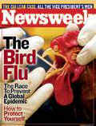
7.____________________________
EX: Changes in disease-causing microbes that produce new organisms and __________.
_______
___
__________________________
Can see Natural selection happen
new diseases
Bird flu
http://www.hhmi.org/askascientist/images/hiv.gif
HIV
Antibiotic-resistant tuberculosis
http://www.hipusa.com/eTools/webmd/A-Z_Encyclopedia/tuberculosis.jpg

Slide 53
Should the Use of Antibiotics Be Restricted?
Read the Issues in Biology article on
p. 403 in your text. Then watch the
video Why Does Evolution Matter Now?
and discuss the question: Should the
use of antibiotics be restricted?

Slide 54
PBS EVOLUTION VIDEO CLIPS
Isn’t Evolution Just a Theory?
QuickTime
Who was Charles Darwin?
QuickTime
How Do we Know Evolution Happens?
QuickTime
How Does Evolution Really Work?
QuickTime |
Why Does Evolution Matter Now?
QuickTime
Why is Evolution Controversial Anyway?
QuickTime

