Slide 1
Section Outline
Section 16-1
EVOLUTION OF POPULATIONS Genes and Variation 16–1

Slide 2
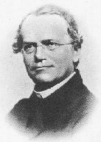
http://www.answers.com/topic/gregor-mendel
When Darwin developed his
theory of evolution, he didn’t
know how ____________
worked.
Mendel’s work on ______________ was published during Darwin’s lifetime, but ________________ as important until __________________.
HEREDITY
inheritance in peas
NOT recognized
decades later

Slide 3
GAPS IN DARWIN’S THINKING:
How do heritable traits pass from one generation to the next?
How does variation in the population appear?

Slide 4
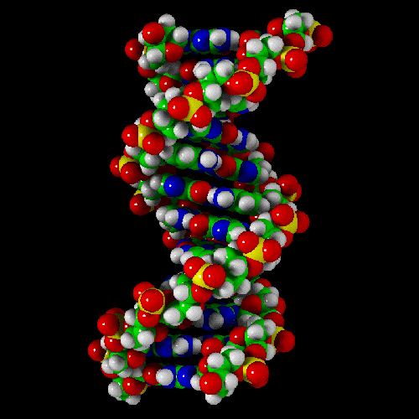
TODAY we can understand how evolution works better than Darwin ever could because of our knowledge about
____________ and ________
genes
DNA

Slide 5
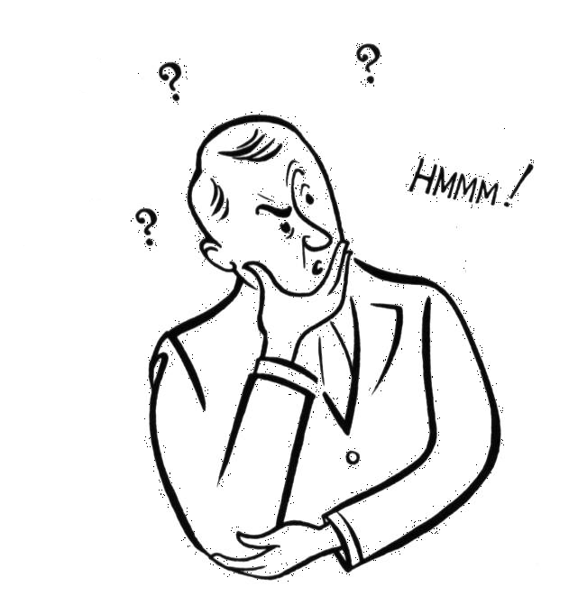
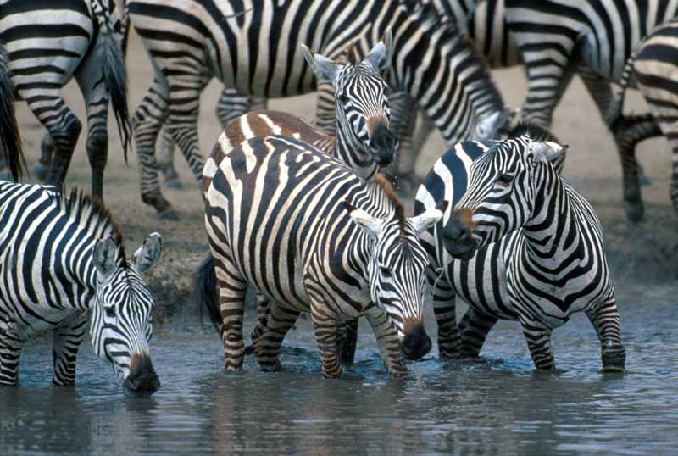
http://www.millan.net
REMEMBER !
POPULATION
A _______________ is a
group of individuals of the same species that can interbreed and produce fertile offspring.
http://www.3kitty.org/travelrama/Photos/123-21-4x6.jpg

Slide 6
Because members of a population interbreed, they share a common group of genes called a ___________
A gene pool consists of ____________ present in a population, including all the different _________.
GENE POOL
ALL the genes
alleles

Slide 7
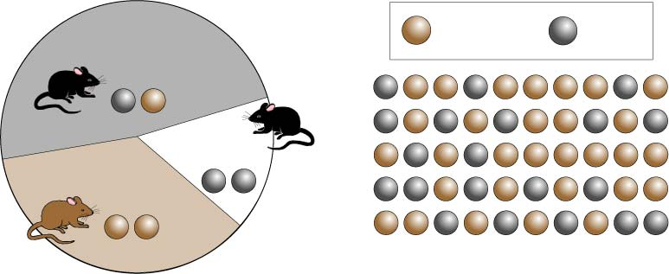
The ____________________ is the number of times that an allele occurs in the gene pool compared to the occurrence of other alleles in the gene pool.
relative frequency
Sample Population
Frequency of Alleles
allele for brown fur
allele for black fur
48% heterozygous black
16% homozygous black
36% homozygous brown
Image from BIOLOGY by Miller and Levine; Prentice Hall Publishing ©2006

Slide 8
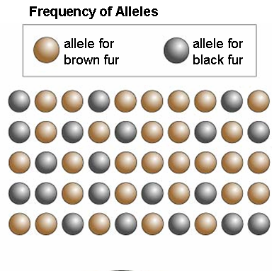
RELATIVE FREQUENCY is often expressed as a __________________.
EX: In this population Dominant B allele (black) = 40% Recessive b allele (brown) = 60%
percentage
Image from BIOLOGY by Miller and Levine; Prentice Hall Publishing ©2006

Slide 9
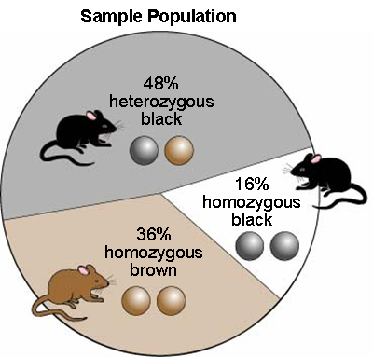
NOTHING
RELATIVE FREQUENCY has _________ to do with whether an allele is
______________ or _____________
In this population, the recessive allele is more frequent.
DOMINANT RECESSIVE
Image from BIOLOGY by Miller and Levine; Prentice Hall Publishing ©2006

Slide 10
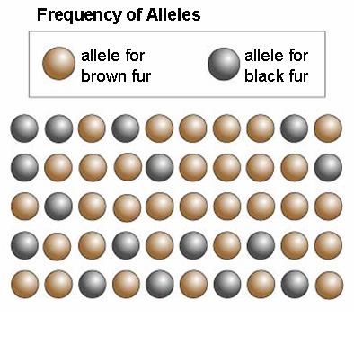
IN GENETIC TERMS
__________________
is any change in the relative frequency of alleles in a population
If the relative frequency of the B allele in this mouse population changed over time to 30%, the population is evolving.
EVOLUTION
Image from BIOLOGY by Miller and Levine; Prentice Hall Publishing ©2006

Slide 11
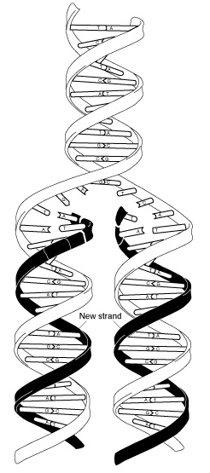
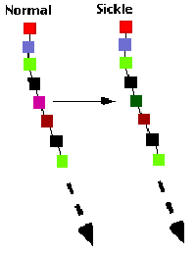
BIOLOGISTS can now explain how the
_____________ that DARWIN saw is produced!
A __________ is any change in a
a sequence of _______
SOURCES OF MUTATIONS: __________________________
_____________________
__________________
variation
mutation
DNA
Mistakes in replication
Chemicals
Radiation
http://sickle.bwh.harvard.edu/scd_background.html

Slide 12
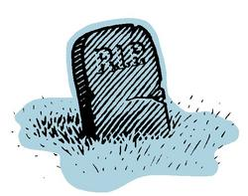
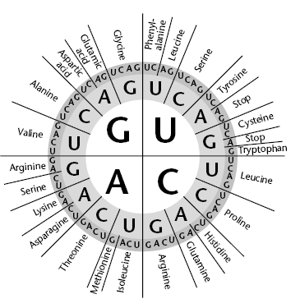
Many mutations are ___________ and result in death.
Some mutations are ____________ and DON’T affect and organism’s ______________
at all.
LETHAL
http://thinksmart.typepad.com/headsup_on_organizational/RIP-thumb.jpg
silent
PHENOTYPE
EX: Changing the code from GGA to GGU
doesn’t change the
amino acid used
Image from: BIOLOGY by Miller and Levine; Prentice Hall Publishers©2006

Slide 13
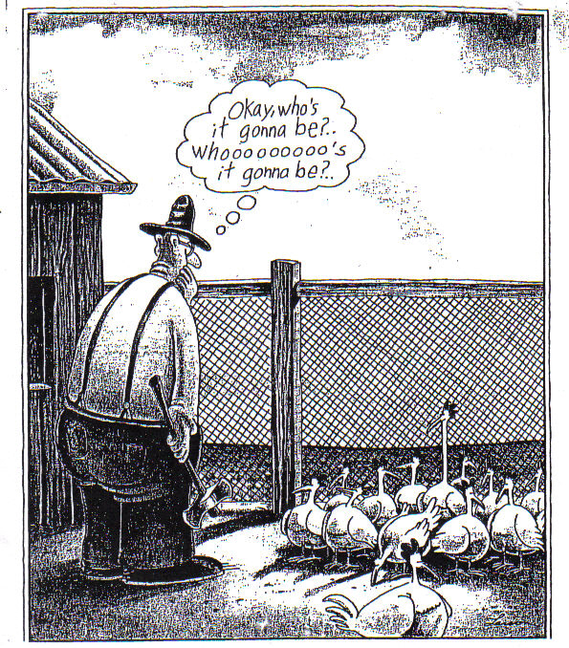
Mutations that change phenotype can affect an organism’s ____________
(ability to survive and reproduce)
fitness

Slide 14
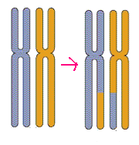
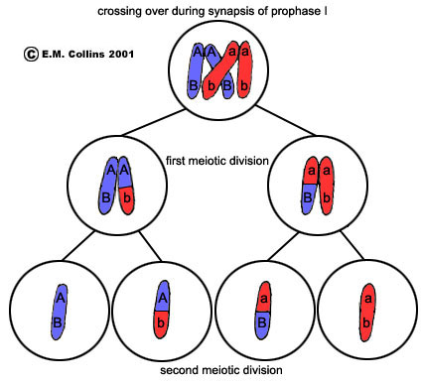
http://www.emc.maricopa.edu/faculty/farabee/BIOBK/Crossover.gif
http://waynesword.palomar.edu/lmexer2a.htm
REMEMBER !
MEIOSIS
GENE SHUFFLING during _________
_____________
_______________
___________________
Crossing over
Segregation
Independent Assortment
RESULT IN GENETIC RECOMBINATION

Slide 15
_______________________IS THE MAJOR SOURCE OF VARIATION IN POPULATIONS, but it does _______
change the __________________ of
alleles in population!
SEXUAL REPRODUCTION
NOT
relative frequency
Shuffling a deck of cards
can shuffle to produce
many different hands,
but doesn’t change the
number of kings or
queens in the deck.
http://www.magicbob2000.com/resources/Svengali%20cards.jpg

Slide 16
____________________ during
__________ of _______ is a lot like
shuffling a deck of cards. There are
always 52 cards, and the _________
of you being dealt any one card is
always the same.
Independent assortment
Anaphase I
meiosis
probability
http://www.magicbob2000.com/resources/Svengali%20cards.jpg

Slide 17
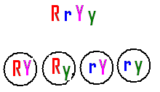
independent assortment
During ____________________,
there are 23 ___________ “cards” that
can be “shuffled” and “dealt” in
_________ combinations! Also,
sometimes the “cards” you are dealt
are brand-new and unique due to
___________.
chromosome
8.4 million
crossing over

Slide 18
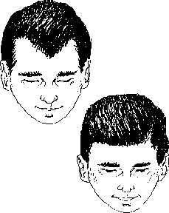
The number of _______________ produced for a given trait depends on the number of ______
that control that trait.
PHENOTYPES
GENES
EX: Widow’s peak
No widow’s peak
Single gene traits result in
only _______phenotypes.
TWO

Slide 19
In real populations, phenotypic ratios are determined not only by which allele is _____________, but by _______________ of the allele in the population
DOMINANT
FREQUENCY
Presence of widow’s
peak in population
can be less common even if it is
DOMINANT!

Slide 20
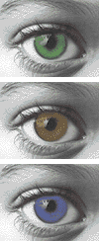
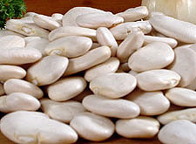
POLYGENIC
_______________ traits are controlled by two or
more genes.
A bell shaped curve is
typical of polygenic traits
Graph from BIOLOGY by Miller and Levine; Prentice Hall Publshing©2006

Slide 21
EVOLUTION OF POPULATIONS Evolution as Genetic Change
16–2

Slide 22
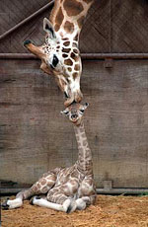
Each time an organism reproduces,
it passes its genes on to the next
generation.
So __________
= success in passing on genes
FITNESS
http://www.cleanfunny.com/pics/animal-giraffe-mother-baby-kiss-kissing.jpg

Slide 23
NATURAL SELECTION
____________________ on
single-gene frequencies can lead to changes in ____________________ and thus to EVOLUTON
ALLELE FREQUENCIES
EX: A population of normally brown lizards. Mutations produce new color choices.
If red lizards are more visible to predators, they might be less likely to survive.
Bird image from: http://www.germanlis.com/creatures/TN_bird_eating_fish.JPG
Chart from BIOLOGY by Miller and Levine; Prentice Hall Publishing ©2006

Slide 24
Black lizards absorb more heat to warm up faster on cold days so they can move faster to get food and avoid predators. The allele for black may increase in frequency.
Chart from BIOLOGY by Miller and Levine; Prentice Hall Publishing ©2006

Slide 25
When traits are controlled by _______ than one gene, the effects are more complex.
Remember ______________ traits show a bell-curve distribution
more
POLYGENIC
Graph from BIOLOGY by Miller and Levine; Prentice Hall Publshing©2006

Slide 26
FITNESS
The ___________ of individuals near each other will not be very different, but fitness may vary from one end of curve to the other.
Where fitness varies,
________________
can act!
NATURAL SELECTION
Graph from BIOLOGY by Miller and Levine; Prentice Hall Publshing©2006

Slide 27
Natural selection can affect the
distribution of phenotypes in 3 ways:
______________________
______________________
______________________
DIRECTIONAL selection
STABILIZING selection
DISRUPTIVE selection

Slide 28
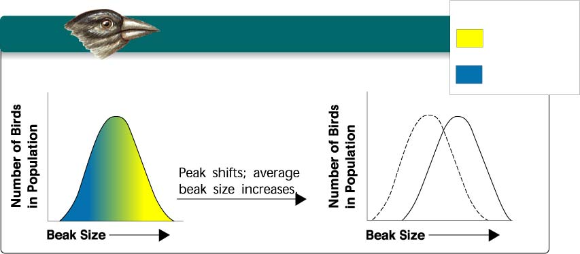
Graph from BIOLOGY by Miller and Levine; Prentice Hall Publshing©2006
DIRECTIONAL SELECTION
KEY
Low mortality,
high fitness
High mortality,
low fitness
Food becomes scarce.
Individuals at _____________ of the curve
have higher fitness than individuals in
middle or at other end.
Graph shifts as some individuals fail to survive at one end
and succeed and reproduce at other
ONE END

Slide 29
EXAMPLE OF DIRECTIONAL SELECTION
Beak size varies in a population
Birds with bigger beaks can feed
more easily on harder, thicker
shelled seeds.
Suppose a food shortage causes small and medium size seeds to
run low.
Birds with bigger beaks would be
selected for and increase in numbers
in population.
http://www.animalbehavior.org/ABS/Stars/ONI/Podos_-_finch_graphic.jpg

Slide 30
Graph from BIOLOGY by Miller and Levine; Prentice Hall Publshing©2006
STABILIZING SELECTION
Individuals in _____________ of the curve
have higher fitness than individuals at
either end
Graph stays in same place but narrows as more organisms
in middle are produced.
CENTER

Slide 31
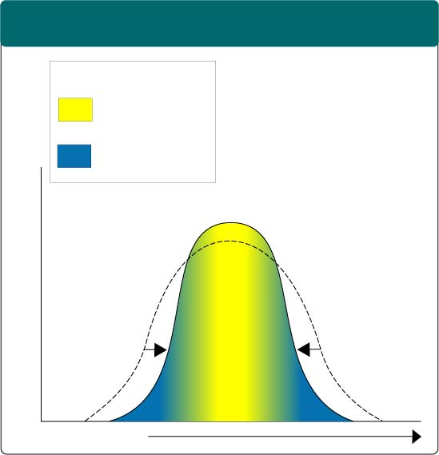
STABILIZING SELECTION
Section 16-2
Male birds use their plumage to attract mates. Male birds in the population with less brilliant and showy plumage are less likely to attract a mate, while male birds with showy plumage are more likely to attract a mate.
Stabilizing Selection
Male birds with
showier, brightly-
colored plumage
also attract
predators, and are
less likely to live
long enough to
find a mate.
The most
fit, then, is the male
bird in the middle--
showy, but not too
showy.
Key
Low mortality, high fitness
High mortality, low fitness
Selection against both extremes keep curve narrow and in same place.
Percentage of Population
Brightness of
Feather Color
Graph from BIOLOGY by Miller and Levine; Prentice Hall Publshing©2006

Slide 32
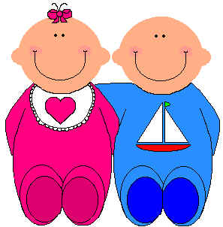
EXAMPLE OF STABILIZING SELECTION
Human babies born with low birth
weight are less likely to survive.
Babies born too large have difficulty being born.
Average size babies are selected for.
http://www.animalbehavior.org/ABS/Stars/ONI/Podos_-_finch_graphic.jpg

Slide 33
Graph from BIOLOGY by Miller and Levine; Prentice Hall Publshing©2006
DISRUPTIVE SELECTION
EXTREMES
Individuals at _____________ of the curve
have higher fitness than individuals in middle.
Can cause graph to split into two.
Selection creates __________________PHENOTYPES
TWO DISTINCT

Slide 34
EXAMPLE OF DISRUPTIVE SELECTION
Suppose bird population lives in area
where climate change causes medium
size seeds become scarce while large
and small seeds are still plentiful.
Birds with bigger or smaller beaks
would have greater fitness and the
population may split into TWO
GROUPS. One that eats small
seeds and one that eats large seeds.
http://www.animalbehavior.org/ABS/Stars/ONI/Podos_-_finch_graphic.jpg

Slide 35
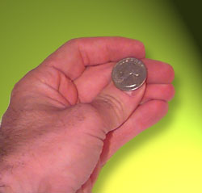
http://www.arborsci.com/CoolStuff/CoinFlip.jpg
Natural selection is NOT the only source of evolutionary change.
REMEMBER ! Genetics is controlled by
_________________
PROBABILITY
The smaller the population . . .
the farther the ________results may be
from the ___________ outcomes.
actual
predicted

Slide 36
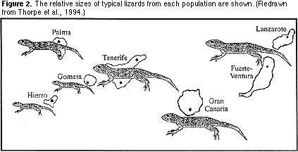
In a small population this random change in allele frequency based on chance is called _________________
GENETIC DRIFT
Genetic drift can occur when
a _______ group
of individuals
colonizes a
_____habitat.
small
new
http://www.ucmp.berkeley.edu/fosrec/Filson.html

Slide 37
Individuals may carry alleles in ______________ relative frequencies than in the larger population.
The population they “found” will be different from the parent population
. . . not through
natural selection
but by _________
different
chance
http://www.ucmp.berkeley.edu/fosrec/Filson.html

Slide 38
A situation in which allele frequencies change as a result of the
migration of a small subgroup of the
population = _________________
FOUNDER EFFECT
Graph from BIOLOGY by Miller and Levine; Prentice Hall Publshing©2006

Slide 39
ARE THERE ANY CONDITIONS IN WHICH EVOLUTION WILL NOT OCCUR?
IS THERE A WAY TO TELL IF THIS IS HAPPENING?
__________________________
HARDY-WEINBERG PRINCIPLE
Graph from BIOLOGY by Miller and Levine; Prentice Hall Publshing©2006

Slide 40
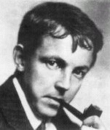
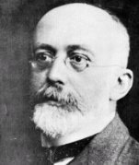
Hardy & Weinberg
Who?
Godfrey Hardy
1877-1947
Wilhelm Weinberg
1862-1937
They developed an equation that predicted the relative frequency of alleles in a population based on the frequency of the phenotypes in a population.

Slide 41
Gene Frequency & the Hardy-Weinberg Equation
The Hardy-Weinberg Equation
p² + 2pq + q² = 1
p² = the frequency of homozygous dominant genotype
2pq = the frequency of heterozygous genotype
q² = the frequency of homozygous recessive genotype

Slide 42
HARDY-WEINBERG PRINCIPLE states that allele frequency in a population will remain __________ unless one or more ________ cause the frequency to __________.
In a situation in which allele frequencies remain constant
( = _________________ )
populations will NOT EVOLVE!
constant
factors
change
Genetic equilibrium

Slide 43
5 CONDITIONS REQUIRED TO
MAINTAIN GENETIC EQUILIBRIUM
FROM GENERATION TO GENERATION
1. _________________________
2. _________________________
3. _________________________
4. _________________________
5. _________________________
Must be random mating
Population must be large
No movement in or out
No mutations
No natural selection

Slide 44
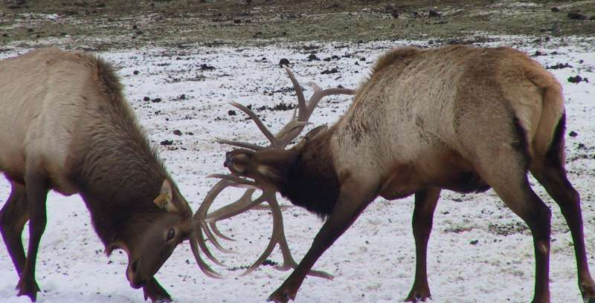
Random mating
In order for ______ ______ to occur,
all members of the population must
have equal opportunity to produce
offspring.
In natural populations, like
____, ______, ___, or _____________,
members compete or even fight for the
opportunity to mate
so mating is _______________
lions
wolves
elk
mountain sheep
NOT RANDOM
http://www.wasatchcomputers.net/gallery/elk_fight.jpg

Slide 45
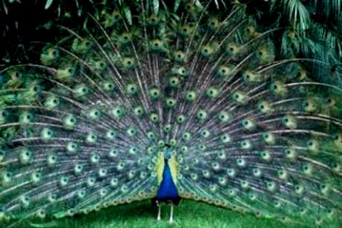
http://ideiasemdesalinho.blogs.sapo.pt/arquivo/Peacock%20with%20its%20tail%20fanned%20out_Tony%20Ruta.jpg
random
Mating in populations is rarely ________
Many species select mates based on
certain _______ such as size or strength.
traits

Slide 46
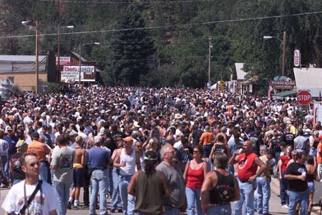
For _______ __________ to occur, a
population must be ________,
so ____________ doesn’t cause
changes in allele frequency by
random chance.
genetic equilibrium
large
genetic drift
http://www.sturgisrallydaily.com/gallery/full/crowd.jpg

Slide 47
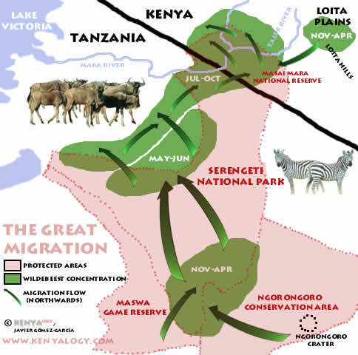
________________ can occur, since
movement in and out of the population
__________ the frequency of ______.
NO MIGRATION
changes
alleles
http://whiteafrican.com/wp-content/Wildebeast%20Migration-East%20Africa.jpg

Slide 48
genetic equilibrium
For _______ __________ to occur,
there must be ____________, which
introduce new ______, and
________________ can take place
which gives any one _________ a
survival advantage over another.
NO mutations
alleles
NO natural selection
phenotype

Slide 49
In some populations, these conditions
may be met or nearly met over long
periods of time, and little or no
________ occurs.
BUT in most populations it is _______
for ____ conditions of Hardy-Weinberg
to be met.
Evolution vs. Genetic Equilibrium
evolution
difficult
ALL
In MOST populations . . .
EVOLUTION happens !

