Slide 1
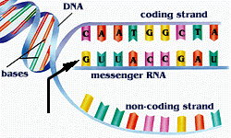
DNA and RNA Chapter 12-1
http://faculty.uca.edu/~johnc/mbi1440.htm
http://www.wappingersschools.org/RCK/staff/teacherhp/johnson/visualvocab/mRNA.gif

Slide 2
GENETIC MATERIAL
In the middle of the 1900’s scientists were asking questions about genes.
What is a gene made of?
How do genes work?
How do genes determine characteristics of organisms?

Slide 3
DO PROTEINS CARRY THE GENETIC CODE?
At the time most scientists believed that _________ had to be the molecules that made up genes.
There were so many different kinds proteins and DNA seemed to be too monotonous . . . repeating the same ___ subunits.
proteins
4

Slide 4
SEE GRIFFITH’s EXPERIMENT
1928 – Frederick Griffith looked at
pneumonia bacteria trying to
figure out what made people die
S (SMOOTH) strain
- killed mice
R (Rough) strain
-mice lived
Images from: http://microvet.arizona.edu/Courses/vsc610/mic205/griffith.jpg

Slide 5
If he heated the LETHAL strain first
_______________
. . . mice lived.
The heat killed bacteria were no longer
LETHAL.
Images from: http://microvet.arizona.edu/Courses/vsc610/mic205/griffith.jpg

Slide 6
Images from: http://microvet.arizona.edu/Courses/vsc610/mic205/griffith.jpg
BUT. . .
If he mixed heat-killed LETHAL bacteria with live harmless bacteria
________________
. . . mice DIED !
When he looked inside dead mice, he found
______________ bacteria!
Somehow the heat killed LETHAL bacteria passed their characteristics to the harmless bacteria.
LIVE LETHAL

Slide 7
See a video clip about GRIFFITH’S EXPERIMENTS (12A)

Slide 8
Griffith called this process __________________ because one strain of bacteria had been changed permanently into another.
But what was the factor that caused the
transformation?
A protein ? A lipid ? A carbohydrate ?
A nucleic acid ?
TRANSFORMATION

Slide 9
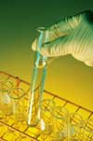
http://en.wikipedia.org/wiki/Oswald_Avery
1944-
Oswald Avery’s team of scientists
repeat Griffith’s experiments
looking for the transforming molecule.
After heat killing the LETHAL
Pneumonia bacteria, he treated them with digestive enzymes that destroy specific kinds of molecules.
If proteins, polysaccharides, lipids, or RNA’s were destroyed .. .
______________________________
Transformation still occurred!
http://cystitis-cystitis.com/Images/testtube.jpg
http://faculty.uca.edu/~johnc/mbi1440.htm

Slide 10
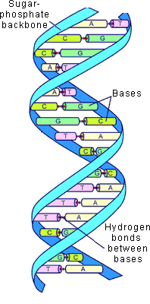
But when they treated the heat-killed
LETHAL bacteria with enzymes to
destroy _____ there was NO
transformation!
. . . the mice lived!
DNA was the molecule
that caused the genetic
change.
DNA
http://web.jjay.cuny.edu/~acarpi/NSC/12-dna.htm

Slide 11
GRIFFITH EXPERIMENT (PNEUMONIA-RAT)
Showed ____________ could be
passed between bacteria & cause a
change.
AVERY EXPERIMENT (Digestive enzymes)
showed that the genetic material
was _____
genetic material
DNA

Slide 12
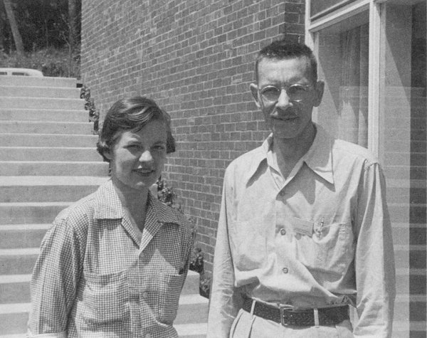
Scientists are skeptical… it takes more than one experiment to convince them.
1952-Alfred Hershey and Martha Chase
experimented with viruses that infect bacteria = _________________
Knew bacteriophages
were made of
________ and _______
bacteriophages
proteins
DNA
Hear about their
cool experiment
http://www.mun.ca/biology/scarr/Chase_&_Hershey_1953.jpg

Slide 13
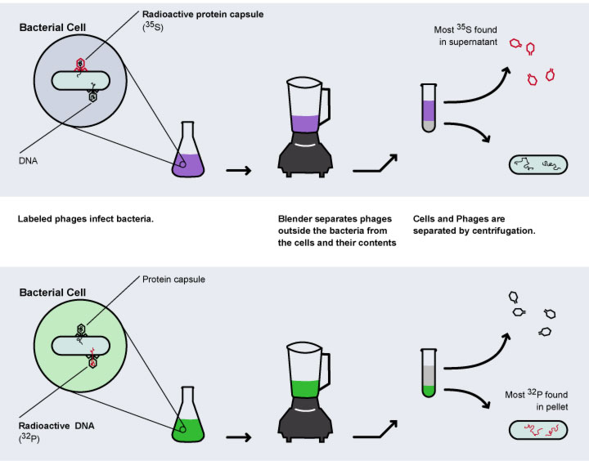
http://www.mun.ca/biology/scarr/hersheychase-experiment.jpg

Slide 14
HERSHEY-CHASE BLENDER EXPERIMENT
only DNA not protein
Showed_______________
entered cell during infection.
Conclusion:
______________in virus was
_____ not protein
Genetic material
DNA

Slide 15
BACTERIAL VIRUSES
http://faculty.uca.edu/~johnc/mbi1440.htm

Slide 16
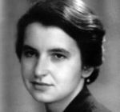
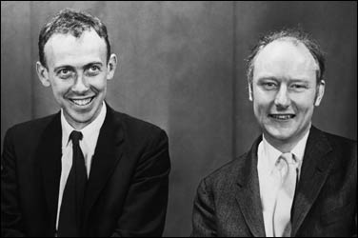
DNA is a DOUBLE HELIX
http://www.time.com/time/time100/scientist/profile/watsoncrick.html
http://en.wikipedia.org/wiki/Rosalind_Franklin
X-ray experiments by Rosalind Franklin
led James Watson and Francis Crick to the
discovery of the structure of DNA in 1953

Slide 17
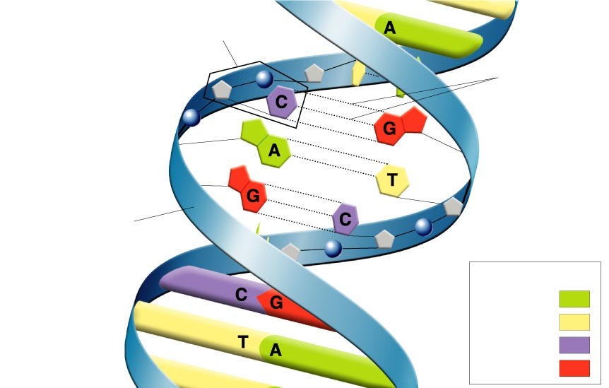
Figure 12–7 Structure of DNA
Section 12-1
Nucleotide
Hydrogen bonds
Sugar-phosphate backbone
Key
Adenine (A)
Thymine (T)
Cytosine (C)
Guanine (G)

Slide 18
NUCLEIC ACIDS are built from subunits called ____________________
NUCLEOTIDES
SUGAR in DNA is
________________
Image by: Riedell
deoxyribose

Slide 19
NITROGEN BASES in DNA
_____________= A
_____________ = G
_____________ = C
______________ = T
ADENINE
GUANINE
CYTOSINE
THYMINE
No URACIL

Slide 20
DEOXYRIBONUCLEIC ACID
DOUBLE
______________ STRANDED
Backbone
(sides of ladder)
made of
_____________
and
_____________
PHOSPHATES
sugars
Image from: http://www.tokyo-med.ac.jp/genet/picts/dna.jpg

Slide 21
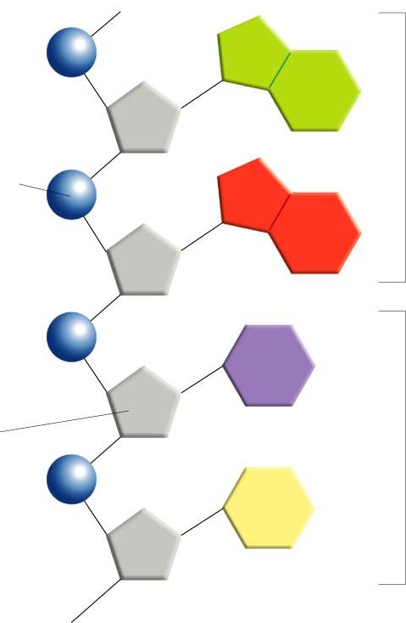
Nitrogen bases =“Steps of ladder”
A
Purines (2 rings)
Phosphate group
G
C
Deoxyribose sugar
Pyrimidines
(1 ring)
T
© Pearson Education Inc, publishing as Pearson Prentice Hall. All rights reserved

Slide 22
CHARGAFF’S RULES
A = T G = C
_________ _________
At time no one knew why…
now we know its because
Adenine always bonds across with____________
Guanine always bonds across with ____________
THYMINE
CYTOSINE
Image from: http://evolution.berkeley.edu/evosite/evo101/images/dna_bases.gif

Slide 23
DOUBLE HELIX
Hydrogen
_____________ bonds
between nitrogen bases hold the two strands together.
Image from: http://evolution.berkeley.edu/evosite/evo101/images/dna_bases.gif

Slide 24
Interest Grabber Answers
1. On a sheet of paper, draw a curving or zig-zagging line that divides the paper into two halves. Vary the bends in the line as you draw it. Without tracing, copy the line on a second sheet of paper.
Hold the papers side by side, and compare the lines. Do they look the same?
3. Now, stack the papers, one on top of the other, and hold the papers up to the light. Are the lines the same?
4. How could you use the original paper to draw exact copies of the line without tracing it?
5. Why is it important that the copies of DNA that are given to new daughter cells be exact copies of the original?
Lines will likely look similar.
Overlaying the papers will show variations in the lines.
Use 1st line as a template to draw the line on another sheet of paper.
Each cell must have the correct DNA, or the cell will not have the correct characteristics.

Slide 25
CHROMOSOMES & DNA REPLICATION 12-2

Slide 26
Chromosome Structure in Prokaryotes
Approximately 5 million base pairs 3,000 genes
Chromosome
E. coli bacterium
Bases on the chromosome
DNA molecule in bacteria is:
______________
______________
Found in __________ (NO nucleus)
SINGLE
CIRCULAR
CYTOPLASM
© Pearson Education Inc, publishing as Pearson Prentice Hall. All rights reserved

Slide 27
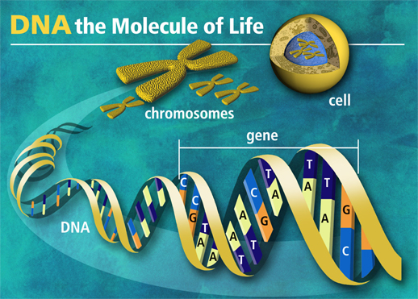
DNA in EUKARYOTES is packaged into chromosomes
http://www.paternityexperts.com/images/DNA-of-life.jpg
Humans have approximately 3 billion base pairs (1 m long)
60,000 to 100,000 genes
If the diameter of the DNA (2 nanometers) was as wide as a fishing line (0.5 millimeters) it might stretch as far as 21.2 km (or 13.6 miles) in length which would all have to be packed into a nucleus, the equivalent size of 25 cm in diameter. That is some packaging!

Slide 28
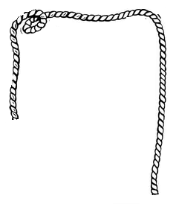
THINK ABOUT IT
How could you get
this piece of
string into the
container?
http://www.artzooks.com/files/3966/AZ533823_320.jpg http://www.mivaroo.com/sites/toyconnection.com/

Slide 29
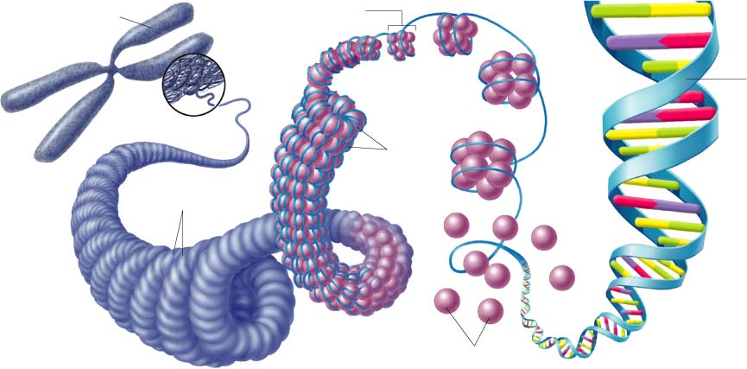
Chromosome Structure of Eukaryotes
Chromosome
© Pearson Education Inc, publishing as Pearson Prentice Hall. All rights reserved
Nucleosome
DNA
double
helix
Coils
Supercoils
DNA is:
______________
______________
Found in __________
Histones
in multiple
chromosome bundles
nucleus

Slide 30
Chromosome Structure of Eukaryotes
© Pearson Education Inc, publishing as Pearson Prentice Hall. All rights reserved
Eukaryotic
chromosomes are
made of
_____ & __________
called ___________
Together the DNA
& histone proteins forms a bead-like structure called a ______________
DNA
double
helix
Nucleosome
DNA
PROTEINS
HISTONES
Histones
NUCLEOSOME

Slide 31
© Pearson Education Inc, publishing as Pearson Prentice Hall. All rights reserved
Chromosome Structure of Eukaryotes
Nucleosome
Chromosome
DNA
double
helix
Coils
Supercoils
Histones
Nucleosomes pack together to form thick coiled fibers. When cell is NOT dividing,
these fibers are spread out in nucleus as ___________. (Allows reading of code)
CHROMATIN

Slide 32
Chromosome Structure of Eukaryotes
Chromosome
© Pearson Education Inc, publishing as Pearson Prentice Hall. All rights reserved
Nucleosome
DNA
double
helix
Coils
Supercoils
Histones
When cell gets ready to divide, the fibers pack even more tightly to form ___________.(Makes it easier to move DNA during mitosis)
chromosomes

Slide 33
HOW IS DNA COPIED?
Image from: http://evolution.berkeley.edu/evosite/evo101/images/dna_bases.gif
The structure of DNA explains how it can be copied.
Each strand has all the info needed to construct
the __________other half.
If strands are separated,
_____________ rules allow
you to fill in the complementary bases.
matching
base-pairing

Slide 34
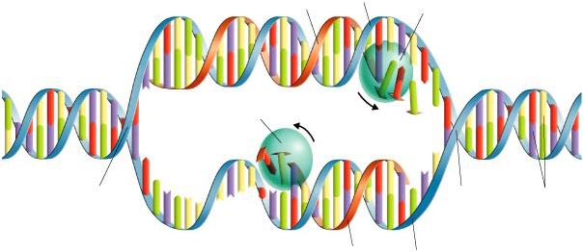
Figure 12–11 DNA Replication
Section 12-2
Original strand
DNA polymerase
New strand
Growth
DNA polymerase
Growth
Replication fork
Replication fork
Nitrogenous bases
New strand
Original strand
Sites where strand separation and
replication occur are called _____________
replication forks

Slide 35
REPLICATION STEPS
Enzymes “unzip” molecule by breaking
_______________ that hold the strands
together and unwind it.
2. _______________ joins nucleotides
using original strand as template and
______________for errors.
3. Copying happens in ________ directions
along the two strands & in __________
places at once.
Hydrogen bonds
DNA polymerase
spell checks
opposite
multiple

Slide 36
REPLICATION
ANIMATION
See a video clip about DNA REPLICATION (12B)

Slide 37
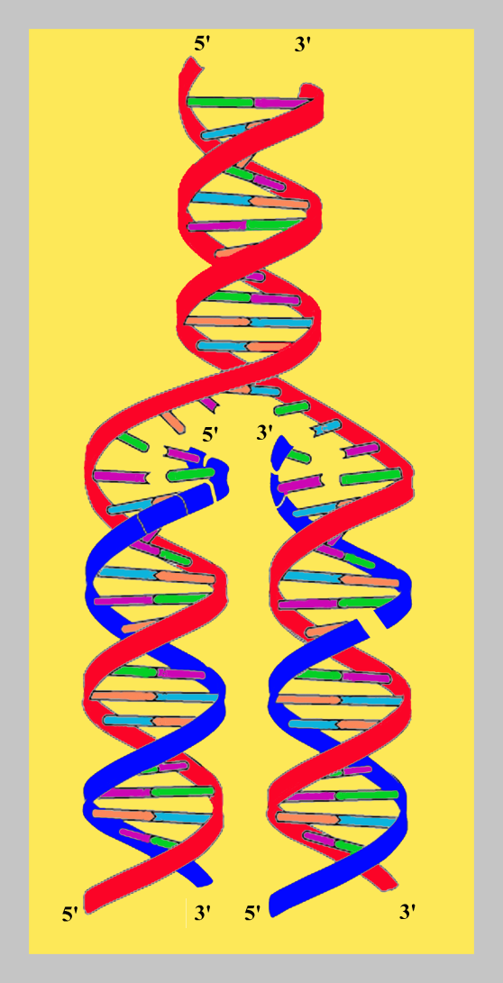
ACTIVITY
BE A DNA MOLECULE

Slide 38
RNA and PROTEIN SYNTHESIS 12-3
© Pearson Education Inc, publishing as Pearson Prentice Hall. All rights reserved

Slide 39
RNA- the Other Nucleic Acid
NUCLEOTIDES
Also made of ___________
Sugar is _______ instead
of deoxyribose.
RNA is _________ stranded
Contains _________ instead
of thymine.
RIBOSE
SINGLE
URACIL
http://images2.clinicaltools.com/images/gene/dna_versus_rna_reversed.jpg

Slide 40
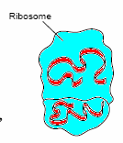
3 KINDS OF RNA HELP WITH INFO TRANSFER FOR PROTEIN SYNTHESIS
RIBOSOMAL
_________________RNA (rRNA)
Combines with proteins to form ribosomes
_________________RNA (tRNA)
Matches m-RNA codon to add correct
amino acids during protein synthesis
_________________RNA (mRNA)
carries code from DNA to ribosomes
TRANSFER
MESSENGER
rRNA and t-RNA images from © Pearson Education Inc, publishing as Pearson Prentice Hall. All rights reserved mRNA image from http://wps.prenhall.com/wps/media/tmp/labeling/1140654_dyn.gif

Slide 41
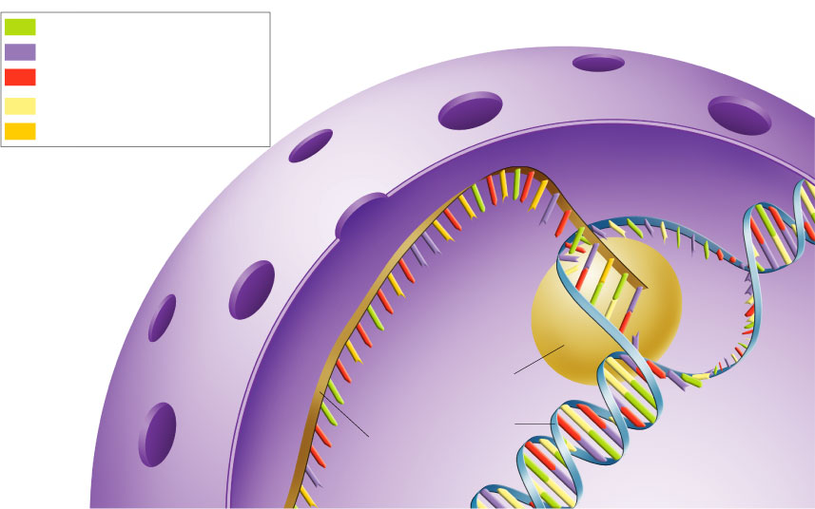
Figure 12–14 Transcription
Section 12-3
Adenine (DNA and RNA)
Cystosine (DNA and RNA)
Guanine(DNA and RNA)
Thymine (DNA only)
Uracil (RNA only)
RNA polymerase
DNA
RNA
RNA POLYMERASE
Enzyme called _____________________
separates strands, then uses one strand
as a template to assemble an RNA copy.

Slide 42
How does RNA POLYMERASE know where a gene starts and stops?
Enzyme binds to places with specific DNA sequences called _______________.
PROMOTERS tell _________________
where to start.
Signals at the end of the gene code cause transcription to _____ .
PROMOTERS
RNA POLYMERASE
stop
http://images2.clinicaltools.com/images/gene/dna_versus_rna_reversed.jpg

Slide 43
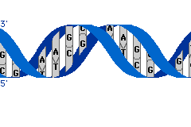
ACTIVITY
TRANSCRIPTION of DNA

Slide 44
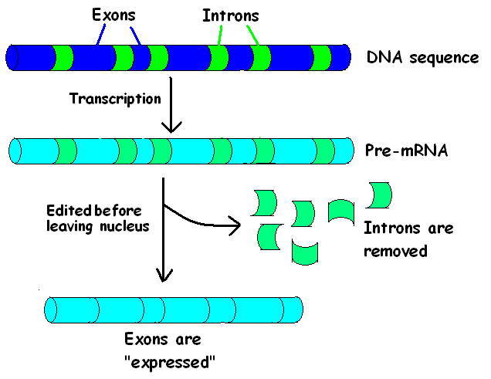
RNA’s require EDITING before use
Image by Riedell

Slide 45
WHY WASTE IT?
Why spend energy making a large RNA
and then throw parts away?
May allow same gene to be used in
different ways in different kinds of cells.
May have a role in evolution… allows small
changes in genes to have a big effect.

Slide 46
MASTER PLAN DNA stays safe in nucleus
© Pearson Education Inc, publishing as Pearson Prentice Hall. All rights reserved
TRANSCRIPTION (DNA→ RNA)
& PROCESSING takes place in nucleus
TRANSLATION (RNA→ proteins)
takes place on ribosomes in cytoplasm
“Blueprints” of master plan
are carried to building site
http://www.home-improvement-resource.com/images/architect.jpg

Slide 47
HOW CAN JUST 4 BASES GIVE DIRECTIONS TO MAKE 20 AMINO ACIDS?
Message is read in groups of 3 = _________
UCGCACGGU
UCG-CAC-GGU
CODON
Serine
- Histidine
- Glycine
Codons represent different amino acids

Slide 48
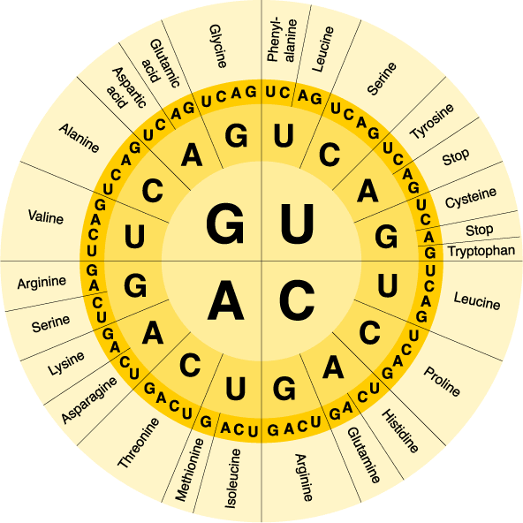
The m-RNA Code
Section 12-3
64 possible codons
Some amino acids have more than one
codon.
START= _______
3 codons for _____
AUG
STOP

Slide 49
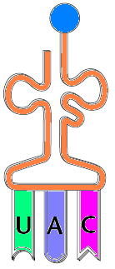
EACH tRNA
carries only
one kind of
_____________
amino acid
ANTICODON
___________
on tRNA
matches up with
________
on mRNA
CODON
Images modified from © Pearson Education Inc, publishing as Pearson Prentice Hall. All rights reserved

Slide 50
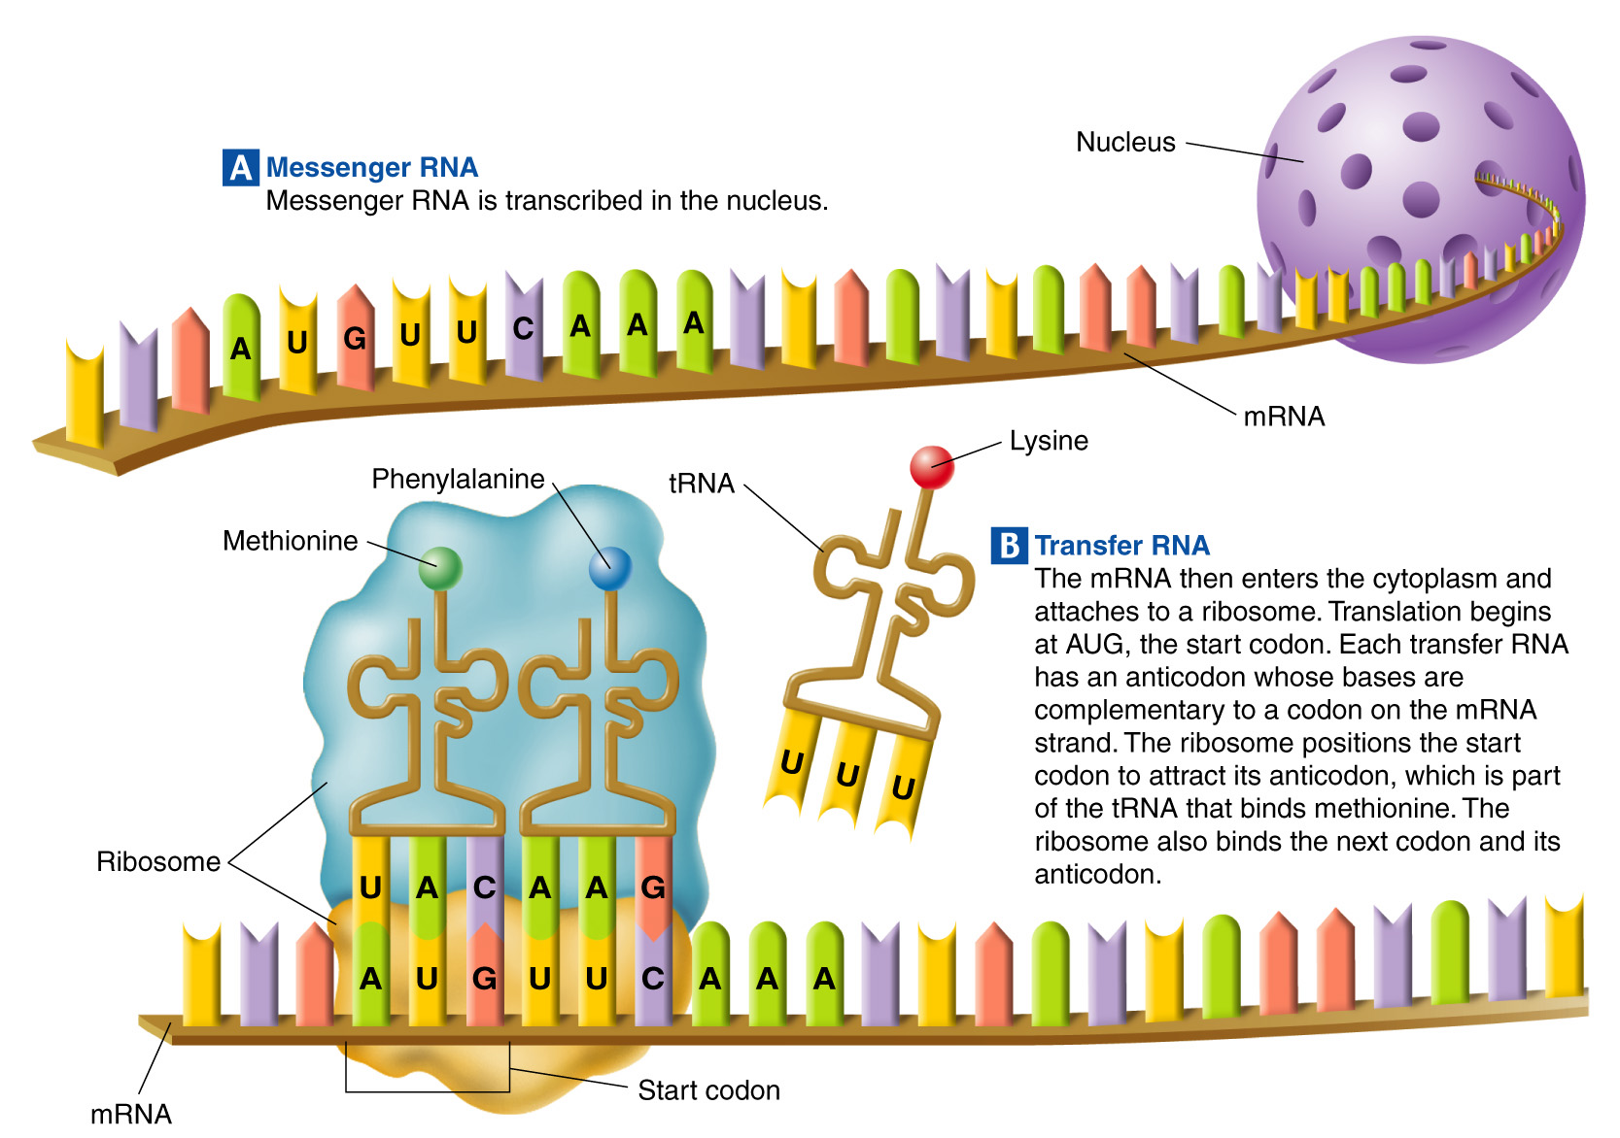
Figure 12–18 Translation
Section 12-3

Slide 51
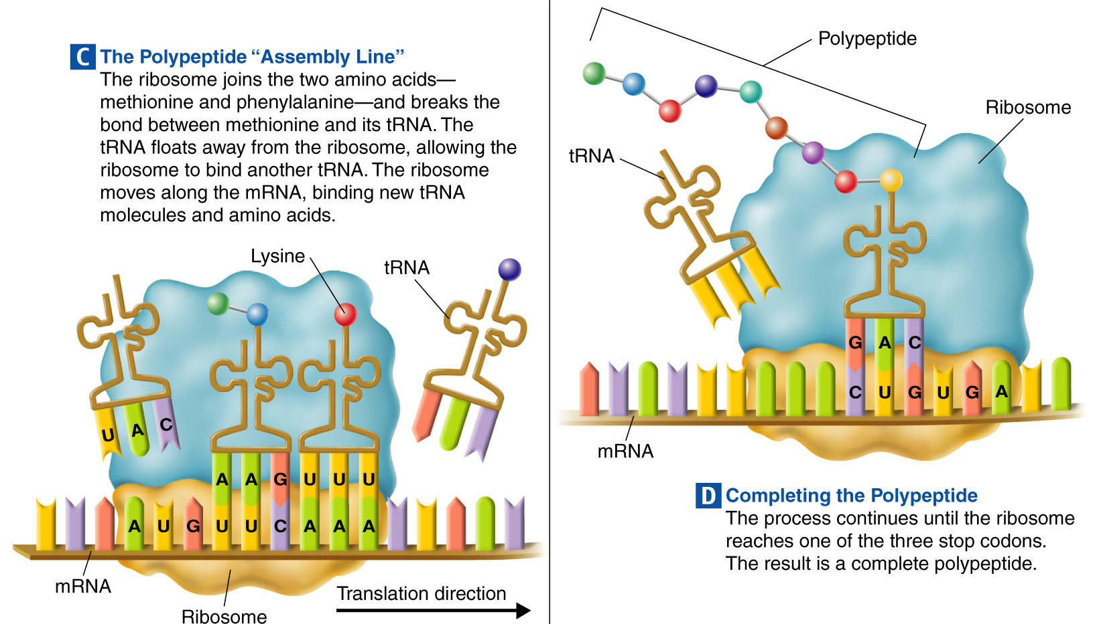
Figure 12–18 Translation (continued)
Section 12-3

Slide 52
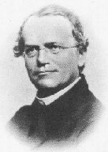
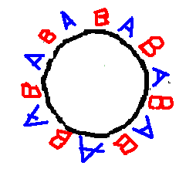
GENES & PROTEINS
Mendel/flower images from: http://www.emc.maricopa.edu/faculty/farabee/BIOBK/BioBookTOC.html Blood cell by Riedell
Proteins are the connection between
the gene code in the DNA and how that
gene is expressed.
A gene that codes for an enzyme (protein)
to make a pigment can control
the color of a flower.
A gene that codes for an enzyme (protein)
adds carbohydrates to glycoproteins to produce your blood type.
Enzymes catalyze and regulate chemical reactions so proteins build and operate all cell components.

Slide 53
REPLICATION
DNA → DNA ____________
DNA → RNA ____________
RNA→ Protein ___________
TRANSCRIPTION
TRANSLATION

Slide 54
Concept Map
Section 12-3
can be
also called
which functions to
also called
which functions to
also called
which functions to
from
to
to make up

Slide 55
Concept Map
Section 12-3
RNA
can be
Messenger RNA
Ribosomal RNA
Transfer RNA
also called
which functions to
also called
which functions to
also called
which functions to
Combine
with proteins
Bring amino acids to ribosome
mRNA
Carry instructions
rRNA
tRNA
from
to
to make up
DNA
Ribosome
Ribosomes

Slide 56
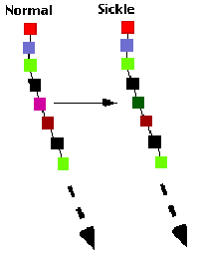
MUTATIONS 12-4

Slide 57
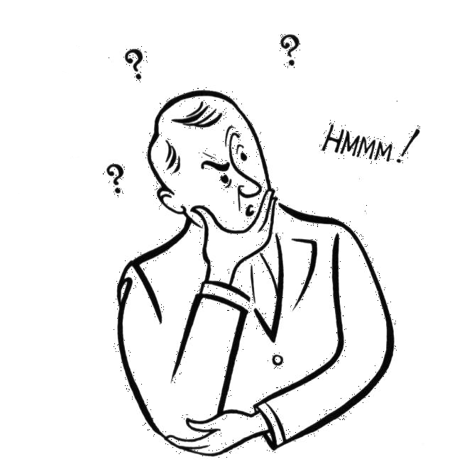
REMEMBER!
_______________ are changes in the genetic material.
MUTATIONS
Mutations can happen when cells make
_____________ in copying their own DNA or be caused by _______________ or
___________ in the enviroment.
mistakes
radiation
chemicals

Slide 58
KINDS OF MUTATIONS
Mutations that produce changes in a single gene = ______________________
Mutations that produce changes in whole chromosomes = _____________________
GENE MUTATIONS
CHROMOSOMAL MUTATIONS

Slide 59
GENE MUTATIONS
Mutations involving ________________
____________ = __________________ because they occur at a single point in the DNA sequence.
TYPES OF POINT MUTATIONS:
_____________________
_____________________
_____________________
One or a few
nucleotides
Point mutation
substitutions
deletions
insertions

Slide 60
SUBSTITUTION
Changes one base for another
A T T C G A G C T
A T T C T A G C T

Slide 61
SICKLE CELL ANEMIA
CAUSE: (autosomal recessive)
A changed to T (glu to val)
gene on chromosome #11
that codes for part of
hemoglobin protein
(carries oxygen in blood)

Slide 62
DELETION
Piece of DNA code for one gene is lost
________________________________________
Image from: http://www.biology-online.org/2/8_mutations.htm

Slide 63
Duchenne Muscular Dystrophy
CAUSE:
(X linked recessive)
DELETION in gene that codes for a muscle protein

Slide 64
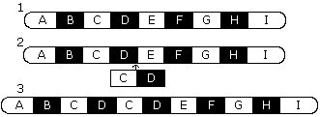
INSERTION
Piece of DNA is copied too many times
Image from: http://www.biology-online.org/2/8_mutations.htm

Slide 65
GENE MUTATIONS
Substitutions usually affect no more than a single ____________, but deletions and insertions can have a more dramatic effect.
Amino acid
IMAGE FROM BIOLOGY by Miller and Levine; Prentice Hall Publishing©2006

Slide 66
FRAME SHIFT MUTATIONS Change multiple bases in code
thefatcatatetherat
____________________
INSERTION
thefatcatateateateatetherat
DELETION
thefatcatatetherat
the fat cat ate the rat
the fat cat ate ate ate ate the rat
the fat ata tet her at

Slide 67
FRAME SHIFTS
Frame shift mutations change every ___________ in the ___________ that follows the shift.
Frame shifts can alter a protein so much it is unable to _____________
Amino acid
protein
function

Slide 68
CHROMOSOMAL MUTATIONS
Mutations involving changes in the _____________ or ______________
of whole chromosomes
TYPES OF CHROMOSOMAL MUTATIONS:
_____________________
_____________________
_____________________
_____________________
Number
structure
deletions
See a Video (deletions & duplications
duplications
inversions
See a Video (inversions & translocations
translocations

Slide 69
DELETION
Piece of chromosome is lost
________________________________________
Image from: http://www.biology-online.org/2/8_mutations.htm

Slide 70
DUPLICATION
Piece of DNA is copied too many times
________________________________________________
Image from: http://www.biology-online.org/2/8_mutations.htm

Slide 71
HUNTINGTON’S
Degenerative brain disorder
Symptoms appear
age 30-40
Lose ability to walk, think, talk, reason
Cause = ADDITION of extra CAG repeats

Slide 72
INVERSION
Segment flips and reads backwards
Image from: http://www.biology-online.org/2/8_mutations.htm

Slide 73
TRANSLOCATION
Segment breaks off and joins a different non-homologous chromosome
Image from: http://www.biology-online.org/2/8_mutations.htm

Slide 74
MUTATIONS
Most mutations are ____________ meaning they have little or no effect on gene ____________.
Mutations that cause ________________ are usually ____________
Harmful mutations are associated with many
________________ and can cause
____________
neutral
function
defective proteins
HARMFUL
genetic disorders
cancer

Slide 75
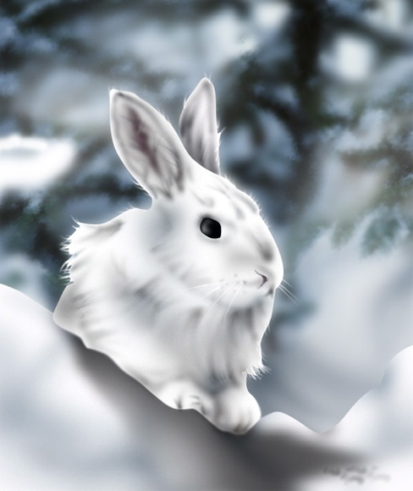
MUTATIONS
Mutations are also a source of
_________________ and can be
_____________
Genetic variability
beneficial
MORE ON THIS 2nd SEMESTER!
Can help an organism
_________________
Provide _________
in population
for ____________
to act upon
Survive and reproduce
variation
natural selection

Slide 76
POLYPLOIDY
Condition in which an organism has extra sets of chromosomes
= _______________
__________ in humans, but beneficial
in some ___________.
Triploid (___) or tetraploid (___) plants are often ________________
than diploid plants.
POLYPLOIDY
LETHAL
plants
3N
4N
larger and stronger

Slide 77
GENE REGULATION 12-5
http://www.awesomebackgrounds.com/s-energy-and-power.htm

Slide 78
Only a fraction of genes in a cell are
expressed (made into RNA) at any given time.
How does the cell decide which will be turned on and which will stay “silent”?
You already know about _____________ regions that show RNA polymerase where to start.
There are other ______________________ that
control whether a gene is ON or OFF.
PROMOTER
REGULATORY SITES

Slide 79
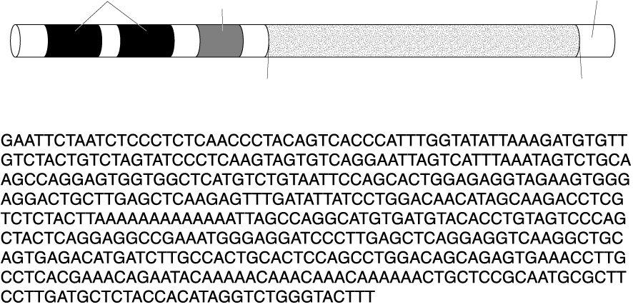
Typical Gene Structure
Section 12-5
Regulatory sites
Promoter (RNA polymerase binding site)
DNA strand
Start transcription
Stop transcription

Slide 80
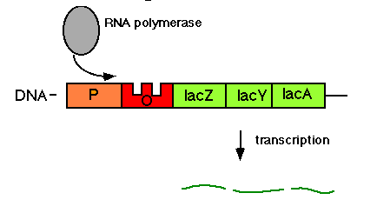
E. Coli lac operon
See a MOVIE choose animation/narrated
Group of genes that operate together are called an ________________
OPERON
Genes code for enzymes needed
to digest lactose sugar.
Only needed if glucose is not available
http://www.life.uiuc.edu/bio100/lectures/s97lects/16GeneControl/lac_operon_ind.GIF

Slide 81
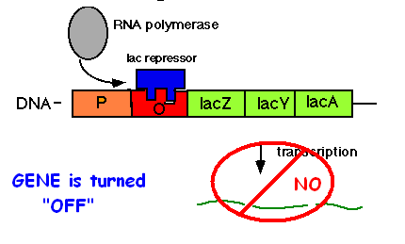
Most of time glucose is available so
lac operon is turned _____ by a
____________ molecule that sits on a
regulatory site next to the promoter
called the ___________
OFF
REPRESSOR
OPERATOR

Slide 82
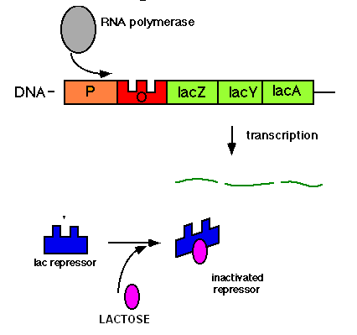
What if there’s NO GLUCOSE?
Cells need to get rid of the repressor
and turn _____the lac genes to digest
lactose instead.
The presence of lactose
causes a change in the
____________ molecule so
so it can’t bind the
operator site.
ON
REPRESSOR
Image modified from: http://www.life.uiuc.edu/bio100/lectures/s97lects/16GeneControl/lac_operon_ind.GIF

Slide 83
Cells turn genes ON & OFF as needed
Many genes are regulated by
_____________ proteins that keep them turned off until needed.
Others use proteins that speed up
_______________ or affect
___________________
REPRESSOR
transcription
protein synthesis

Slide 84
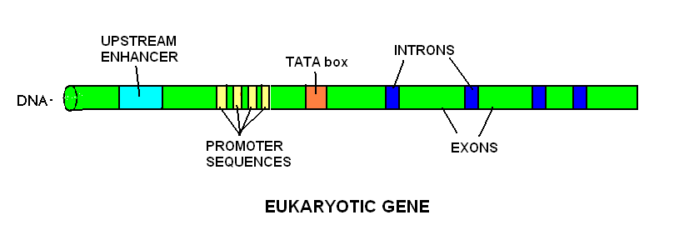
EUKARYOTES are more COMPLEX
Additional regulatory sequences:
1. ___________ regions
upstream from promoters
bind many different regulatory proteins
2. __________ (TATATA or TATAAA)
helps position RNA POLYMERASE
ENHANCER
TATA box
Image by Riedell

Slide 85
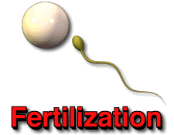
DEVELOPMENT & DIFFERENTIATION
Gene regulation is also important in shaping way organisms develop
How does a zygote become a multi-cellular organism?
How does it know what kind of cell to be?

Slide 86
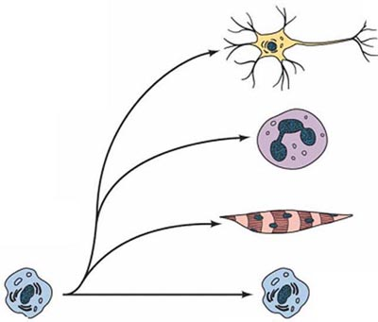
DEVELOPMENT & DIFFERENTIATION
DIFFERENTIATE
Cells ________________ by turning different genes on and off.
BUT… How does a cell know where it is in the body?
and what genes it should turn on?
and when?
http://www.ncu.edu.tw/~ls/graph/faculty_pictures/whole_time/SLC/SLC_lab-1.jpg

Slide 87
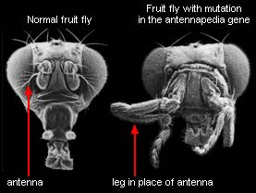
In the 1980s, researchers discovered a series of genes in fruit flies called ___________ These genes control the organization of the developing embryo and tell parts where to grow and when. Mutations to Hox genes can cause a leg to grow where an antenna should sprout.
Hox genes
http://evolution.berkeley.edu/evosite/history/hox.shtml

Slide 88
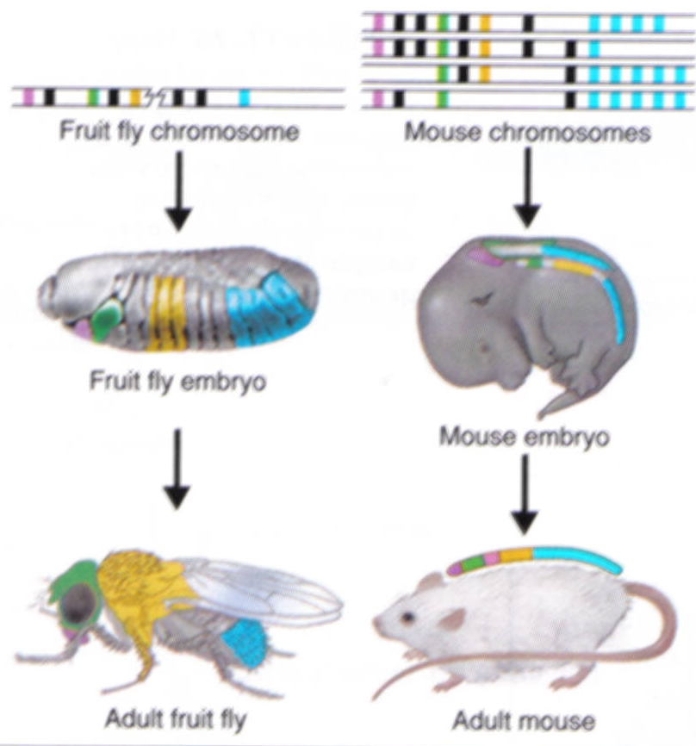
Since that time,
HOX genes with
almost identical
sequences have
been found in a
variety of
organisms
including
____________
HUMANS
© Pearson Education Inc, publishing as Pearson Prentice Hall. All rights reserved

Slide 89
HOX GENES
Similar genes controlling the eyes of insects and our own eyes have also been discovered.
Our version of the gene can be inserted in a fly and still trigger the building of an insect eye!
http://evolution.berkeley.edu/evosite/history/hox.shtml

Slide 90
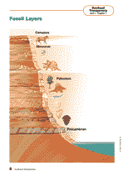
SO WHAT?
The similarities between HOX gene
sequences in very different organisms
and the ability of these genes to trade
places and still function in different
species suggests that these organisms
__________________________
share a common ancestor

