Slide 1
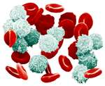
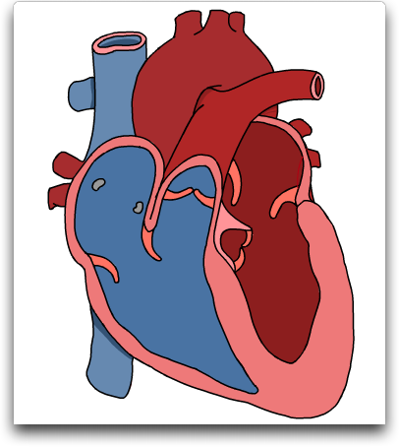
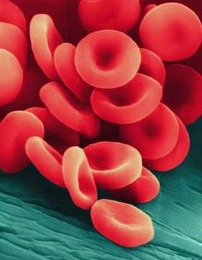
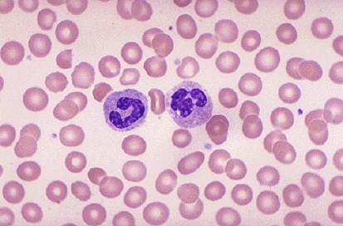
Circulatory System in Animals
Notes:
Take a look at a skeleton and see how well a heart is protected — open heart surgery takes breaking a body to get to the heart.

Slide 2
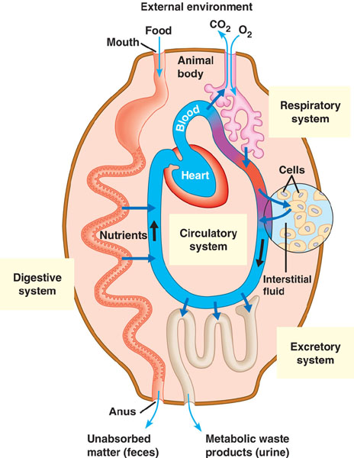
Feeding Energy Needs
Why do we need a circulatory system?
supplies in
fuel (sugars)
digestive system
oxygen
respiratory system
waste out
CO₂
respiratory system
need to pick up & deliver the supplies & wastes around the body
circulatory system

Slide 3
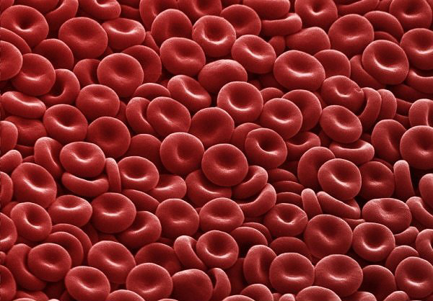
Circulatory System
Organ
heart
Tissues & cells
blood vessels
arteries
veins
capillaries
blood
red blood cells
plasma (liquid)

Slide 4
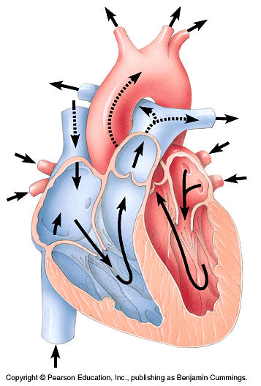
Vertebrate Heart
4-Chambered heart
atria (atrium)
thin wall
collection chamber
receive blood
ventricles
thick wall pump
pump blood out
left atrium
right atrium
right ventricle
left ventricle

Slide 5
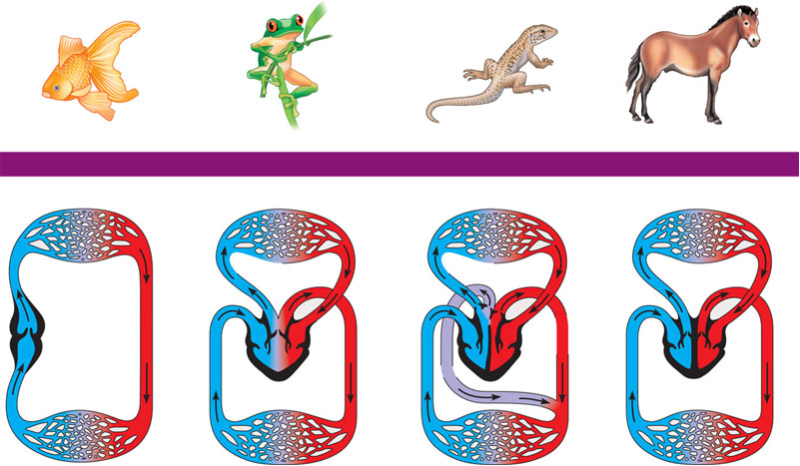
Evolution of circulatory system
Not everyone has a 4-chambered heart
fish
amphibian
reptiles
birds & mammals
2 chamber
3 chamber
3 chamber
4 chamber
V
A
A
A
A
A
A
A
V
V
V
V
V
Notes:
A powerful four–chambered heart was an essential adaptation in support of the endothermic way of life characteristic of mammals and birds. Endotherms use about ten times as much energy as equal–sized ectotherms; therefore, their circulatory systems need to deliver about ten times as much fuel and O2 to their tissues (and remove ten times as much CO2 and other wastes). This large traffic of substances is made possible by separate and independent systemic and pulmonary circulations and by large, powerful hearts that pump the necessary volume of blood. Mammals and birds descended from different reptilian ancestors, and their four–chambered hearts evolved independently—an example of convergent evolution.
Why is it an advantage to get big?
Herbivore: can eat more with bigger gut.
lowers predation
(but will push predators to get bigger as well, although no one east elephant s.)

Slide 6
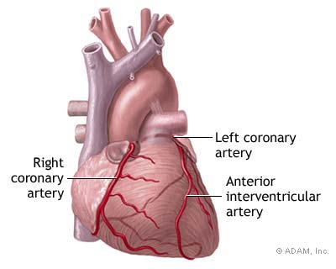
Circulatory System Blood Vessels

Slide 7
Blood vessels
arteries
veins
artery
arterioles
venules
arterioles
capillaries
venules
veins

Slide 8
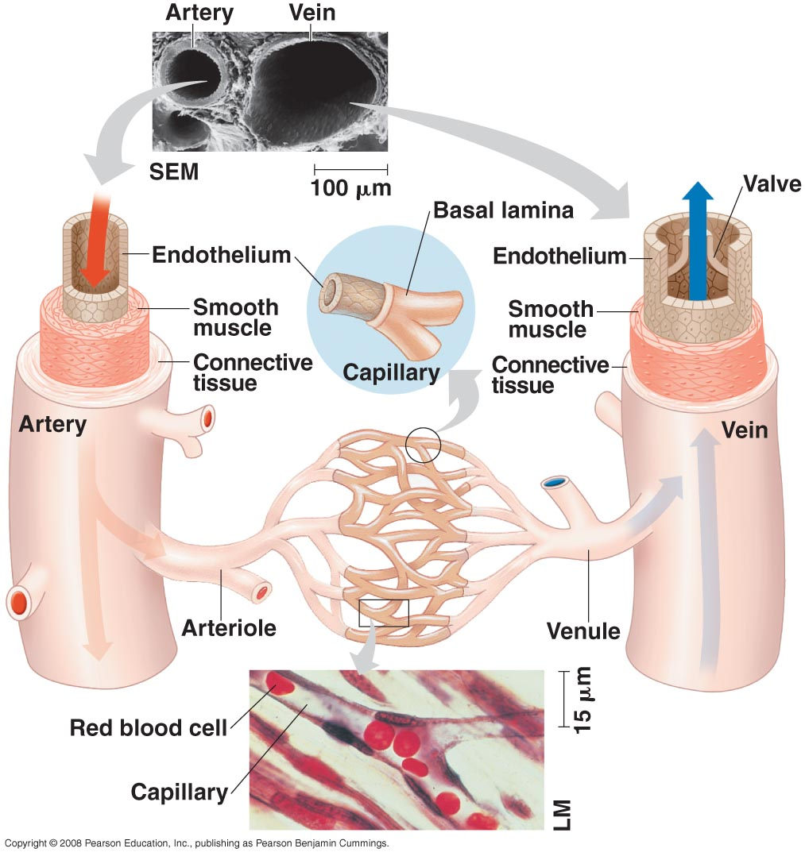
Arteries: Built for their job
Arteries
blood flows away from heart
thicker walls
provide strength for high pressure pumping of blood
elastic & stretchable

Slide 9
Veins: Built for their job
Veins
blood returns back to heart
thinner-walled
blood travels back to heart at low speed & pressure
why low pressure?
far from heart
blood flows because muscles contract when we move
squeeze blood through veins
valves in large veins
in larger veins one-way valves allow blood to flow only toward heart
Blood flows
toward heart
Open valve
Closed valve

Slide 10
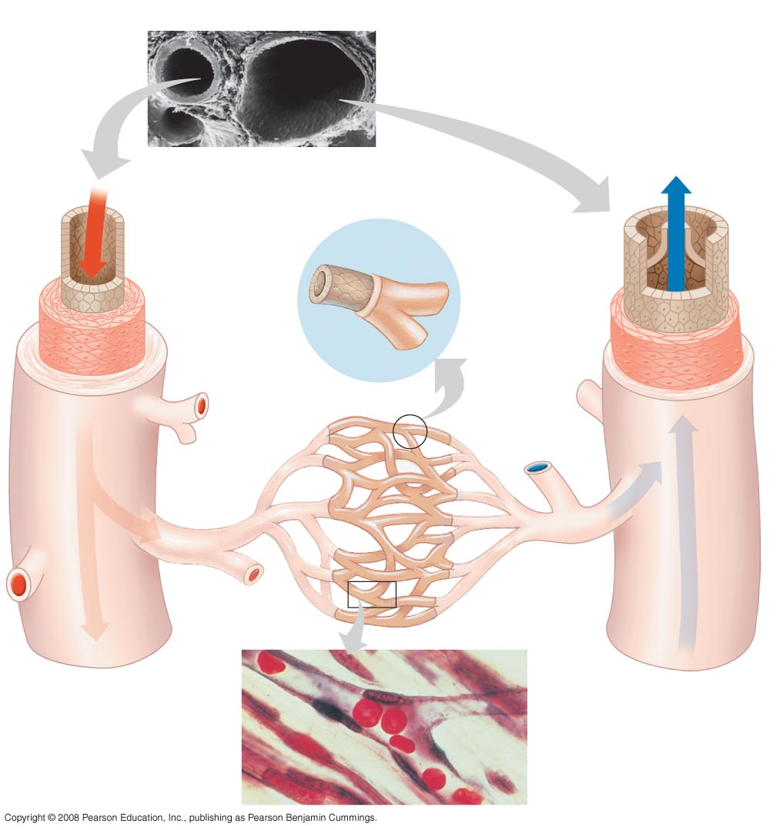
Structure-function relationship
Capillaries
very thin walls
allows diffusion of materials across capillary
O₂, CO₂, H₂O, food, waste
body cell
waste
CO₂
O₂
food

Slide 11
Circulation of Blood
Circulation to lungs
2 part system
Circulation to lungs
blood gets O₂ from lungs
drops off CO₂ to lungs
brings O₂-rich blood from lungs to heart
Circulation to body
pumps O₂-rich blood to body
picks up nutrients from digestive system
collects CO₂ & cell wastes
lungs
heart
body
Circulation to body

Slide 12
Stops along the way…
Lungs
pick up O₂ / clean out CO₂
Small Intestines
pick up nutrients from digested food
Large Intestines
pick up water from digested food
Liver
clean out worn out blood cells

Slide 13
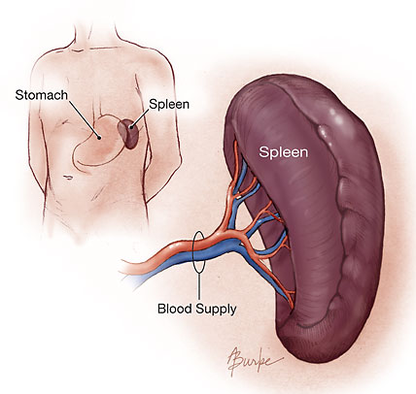
More stops along the way…
Kidneys
filters out cell wastes (urea)
extra salts, sugars & water
Bone
pick up new red blood cells
Spleen
pick up new white blood cells

Slide 14
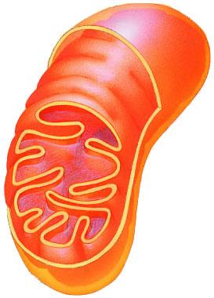
Circulatory System & Homeostasis
ATP
Homeostasis
keeping the internal environment of the body balanced
need to balance food & O₂ in
need to balance energy (ATP) production
need to balance CO₂ & waste out
Exercise
heart beat faster
need more ATP
bring in more O₂ & food; remove more CO₂ & waste out
Disease
poor lung or heart function = heart beat faster
need to work harder to bring in O₂ & food & remove wastes
food
O₂
CO₂
waste

Slide 15
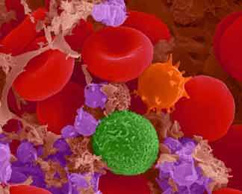
Circulatory System Blood

Slide 16
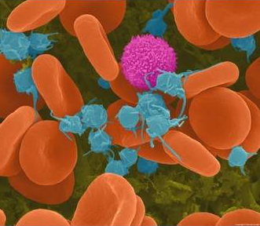
Blood & blood cells
Blood is a tissue of fluid & cells
plasma
liquid part of blood
dissolved salts, sugars, proteins, and more
cells
red blood cells (RBC)
transport O₂ in hemoglobin
white blood cells (WBC)
defense & immunity
platelets
blood clotting

Slide 17
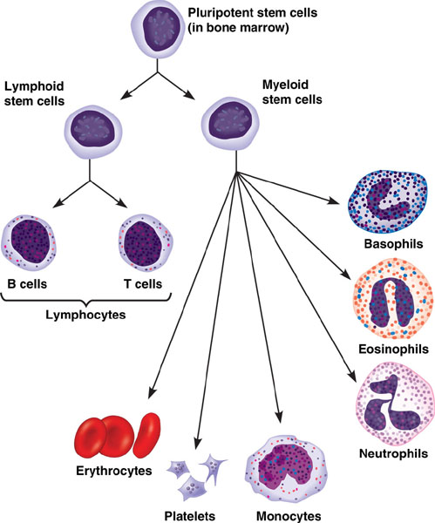
Blood Cell production
ribs, vertebrae, breastbone & pelvis
Stem cells
“parent” cells in bone marrow
develop into all the different types of blood cells
red blood cells
white blood cells
white blood cells
white blood cells
red blood cells
Notes:
Recently, researchers succeeded in isolating pluripotent stem cells and growing these cells in laboratory cultures. Purified pluripotent stem cells may soon provide an effective treatment for a number of human diseases, including leukemia. A person with leukemia has a cancerous line of the stem cells that produce leukocytes. The cancerous stem cells crowd out cells that make erythrocytes and produce an unusually high number of leukocytes, many of which are abnormal. One experimental treatment for leukemia involves removing pluripotent stem cells from a patient, destroying the bone marrow, and restocking it with noncancerous stem cells. As few as 30 of these cells can completely repopulate the bone marrow.

Slide 18
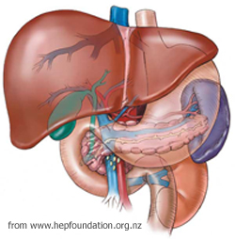
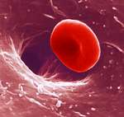
Red blood cells
Small round cells
produced in bone marrow
5 liters of blood in body
5-6 million RBC in drop of human blood
last 3-4 months (120 days)
filtered out by liver
~3 million RBC destroyed each second
Notes:
Enucleated RBC
The nucleus is squeezed out of the cell and is ingested by the macrophage.
Cellular Life Expectancy
Red blood cells usually circulate for only about 3 to 4 months and are then destroyed by phagocytic cells in liver & spleen.
Enzymes digest the old cell’s macromolecules, and the monomers are recycled.
Many of the iron atoms derived from hemoglobin in old red blood cells are built into new hemoglobin molecules. But some are reused in digestive bile.
As adults, we make more than 2 million red blood cells in our bone marrow every second to replace those lost through normal attrition.

Slide 19
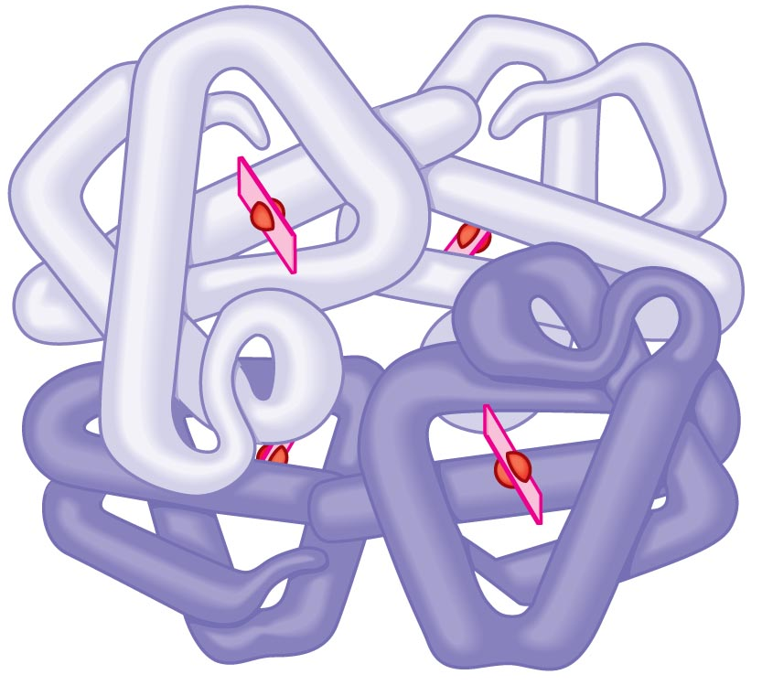
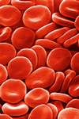
Hemoglobin
Protein which carries O₂
250,000 hemoglobin proteins in one red blood cell
O₂
O₂
O₂
O₂

Slide 20
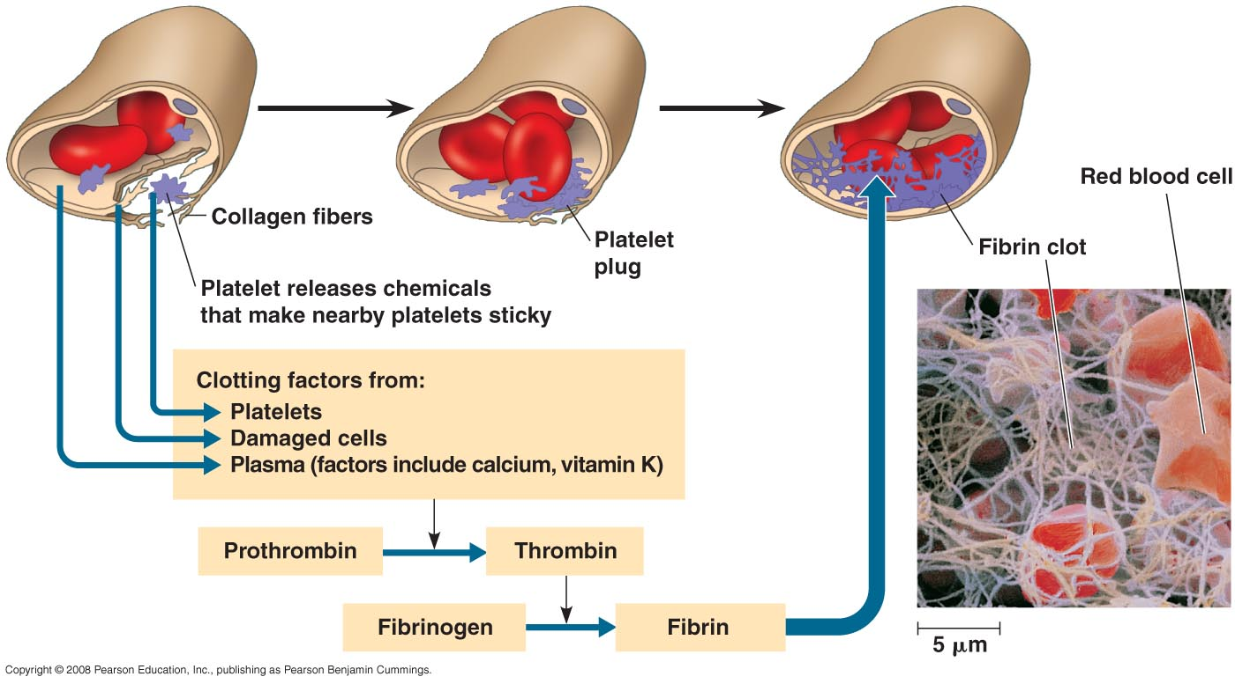
Blood clotting
emergency repair of circulatory system
chemical emergency signals
platelets seal the hole
protein fibers build the clot
Notes:
Inherited defect in any step of the clotting process causes hemophilia, characterized by excessive bleeding from even minor cuts & bruises

Slide 21
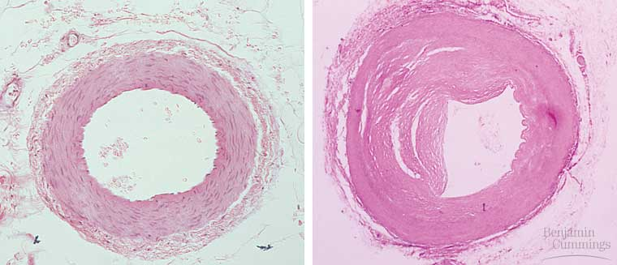
Cardiovascular disease
Atherosclerosis & Arteriosclerosis
deposits inside arteries (plaques)
develop in inner wall of the arteries, narrowing their channel
increase blood pressure
increase risk of heart attack, stroke, kidney damage
normal artery
hardening of arteries

Slide 22
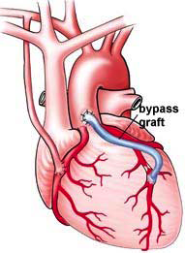
Cardiovascular health
bypass surgery
Risk Factors
genetics
diet
high animal fat and/or sugar
exercise & lifestyle
smoking
lack of exercise

Slide 23
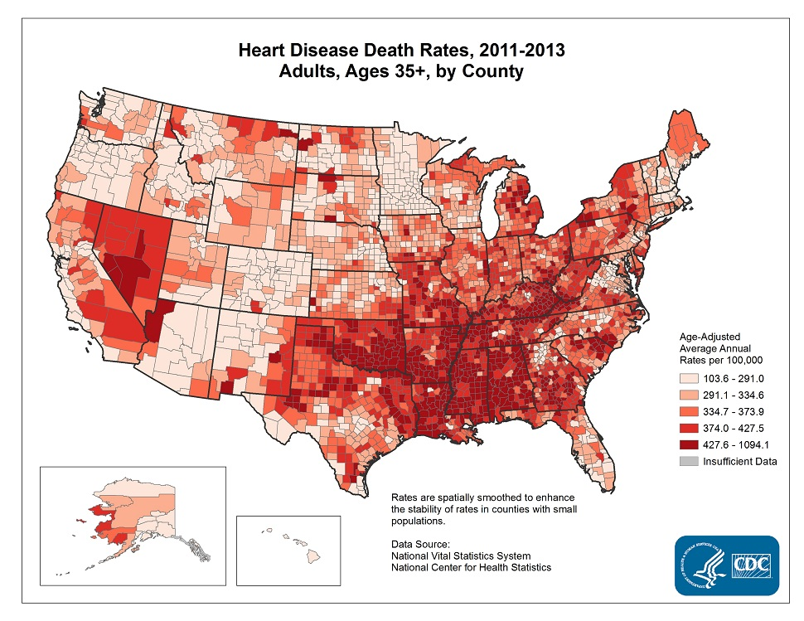
Heart Disease
Heart disease death rates 2011-2013 Adults ages 35 and older
Number 1 cause of death in U.S when combining
all races, both sexes, all ages (CDC)

Slide 24
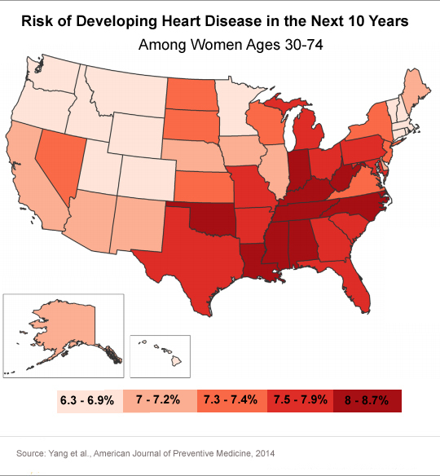
Women & Heart Disease
Death rates for heart disease per 100,000 women, 2014
Risk factors
Smoking
Lack of exercise
High fat diet
Overweight
Heart disease is 3rd leading cause of death among women aged 25–44 years & 2nd leading cause of death among women aged 45–64 years.

