Slide 1
BIOGEOCHEMICAL CYCLES 3-3

Slide 2
ENERGY & MATTER
Energy is not the only thing
that moves through the ecosystem.
Atoms are never destroyed . . . only transformed.
Take a deep breath.
The atoms you just inhaled may have been inhaled by a dinosaur millions of years ago.

Slide 3
4 ATOMS make up 95% of the body in most organisms
CARBON
OXYGEN
HYDROGEN
NITROGEN
The same molecules are passed around
again and again within the biosphere in
___________________________
BIOGEOCHEMICAL CYCLES

Slide 4
WATER CYCLE = ___________________
HYDROLOGIC CYCLE

Slide 5
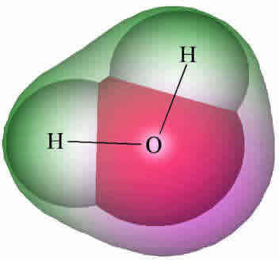
WHY IS WATER IMPORTANT?
Makes up 60-70% of your body
Oxygen and Hydrogen are found in all the ________________________: carbohydrates, proteins,
nucleic acids, lipids
Hydrogen in H₂O supplies
protons (H⁺) & electrons
for_______________
building blocks of cells
photosynthesis

Slide 6
WHY IS WATER IMPORTANT?
SOLVENT
Water is a good _________________
Many molecules dissolve in water so it
provides a place for chemical reactions
to happen
Water doesn’t change temperature easily so it helps with
__________________
HOMEOSTASIS

Slide 7
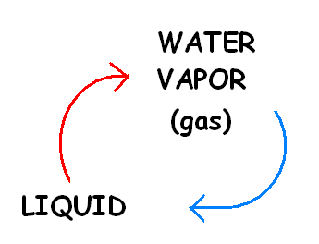
WATER CYCLE
evaporation
condensation

Slide 8
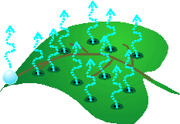
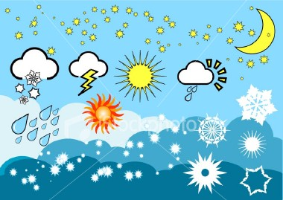
The evaporation of water from the surface of plant leaves
= ________________
TRANSPIRATION
The return of water to the surface in the form of
rain, snow, sleet, hail, etc.
= ____________________
PRECIPITATION

Slide 9
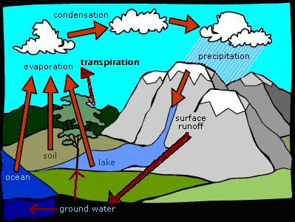
WATER CYCLE

Slide 10
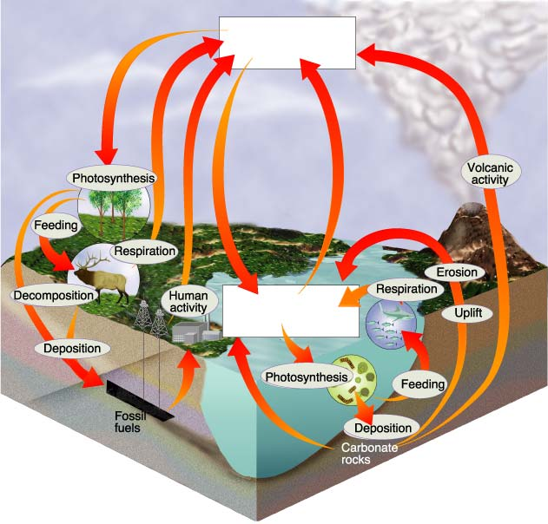
CARBON CYCLE
CO₂ in
atmosphere
CO₂ in
ocean

Slide 11
4 main CARBON reservoirs in BIOSPHERE
In ____________ as CO₂ gas
In _______ as dissolved CO₂ gas
On _______ in organisms, rocks, soil
__________ as coal & petroleum (fossil fuels) and calcium carbonate in rocks
atmosphere
ocean
land
Underground
CO₂ in
atmosphere
CO₂ in
Ocean

Slide 12
Where does CO₂ in atmosphere come from?
CO₂ in
atmosphere
CO₂ in
Ocean
Volcanic activity
________________
______________
_________________
____________ of dead organisms
Human activity (burning fossil fuels)
Cellular respiration
Decomposition

Slide 13
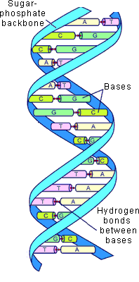
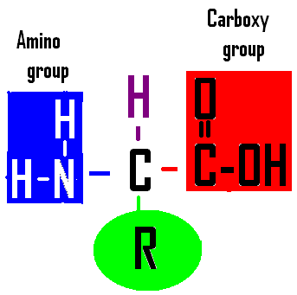
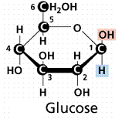
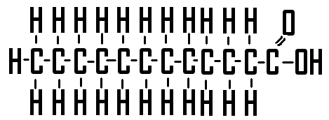
WHY IS CARBON IMPORTANT?
BUILDING BLOCKS
Found in all the _______________ of cells: carbohydrates, proteins,
nucleic acids, lipids

Slide 14
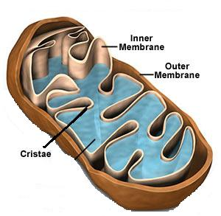
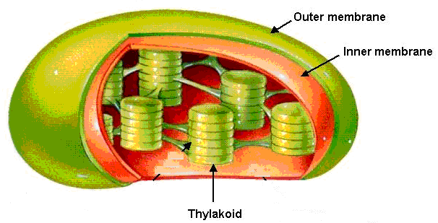
WHY IS CARBON IMPORTANT?
Carbon in CO₂ provides the atoms for
__________ production during __________________...
the fuel that all living things depend on.
GLUCOSE
PHOTOSYNTHESIS

Slide 15
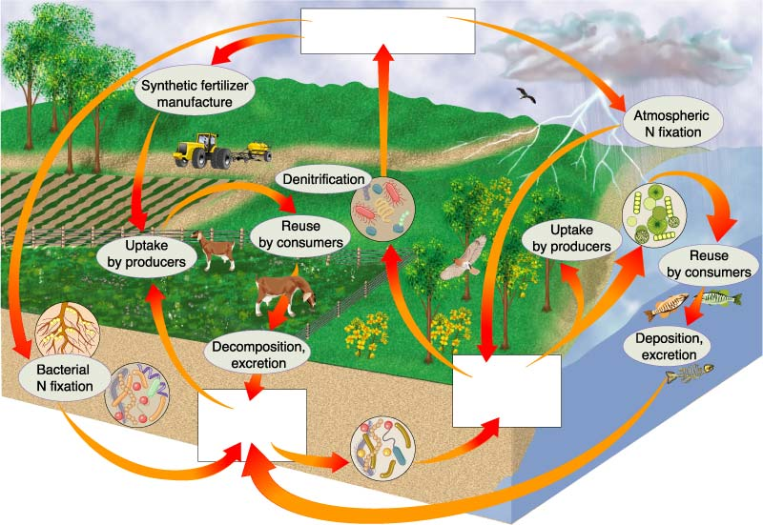
NITROGEN CYCLE
Section 3-3
N₂ in Atmosphere
NO₃⁻
and NO₂⁻
NH₃

Slide 16
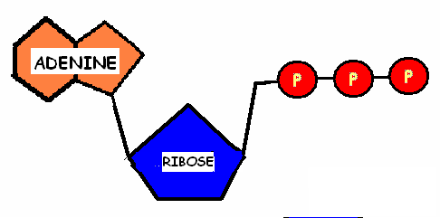
WHY IS NITROGEN IMPORTANT?
NITROGEN BASES
__________________make DNA and RNA
ATP
Adenine (nitrogen base) is used in _______
amino acids
Makes AMINO part of _________ (proteins)

Slide 17
79% of the atmosphere is made up of NITROGEN gas (N₂)
BUT we _____ use the nitrogen gas
we breathe!
The bond in N₂ gas is so
strong it can only be broken by
_______________
_______________
____________________
CAN’T
lightning
Volcanic activity
few special bacteria

Slide 18
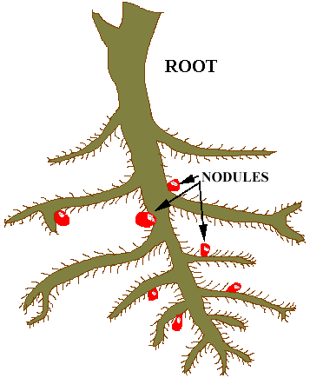
Bacteria that live ______________
and in _________ relationships with
plants called _________, take
nitrogen from the atmosphere and
turn it into ______________, a form
that is usable by plants.
THIS PROCESS
IS CALLED _________________
in the soil
symbiotic
legumes
AMMONIA (NH₃)
NITROGEN FIXATION

Slide 19
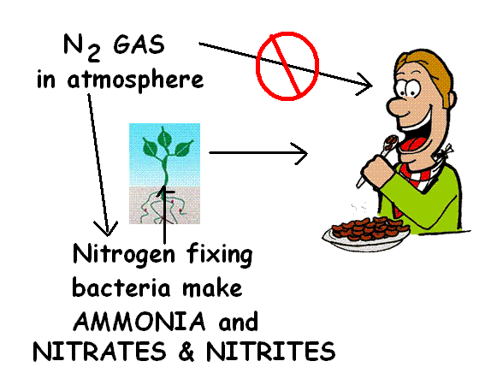
Other bacteria in the soil convert
ammonia into ________________
& _________________
which plants can also use.
The nitrogen we need for proteins,
ATP, and nucleic acids comes from
the ___________
___________
we breathe!
NITRATES (NO₃⁻ )
& NITRITES (NO₂⁻)
FOOD WE EAT
NOT THE AIR

Slide 20
NITROGEN CYCLE
Section 3-3
N₂ in Atmosphere
NO₃⁻
and NO₂⁻
NH₃

Slide 21
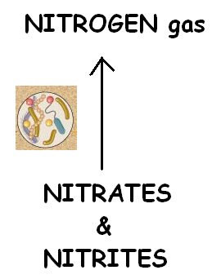
Bacteria that live ______________
also carry out the reverse process
___________ → _____________.
THIS PROCESS
IS CALLED _________________
in the soil
NITRATES
& NITRITES
NITROGEN GAS
DENITRIFICATION

Slide 22
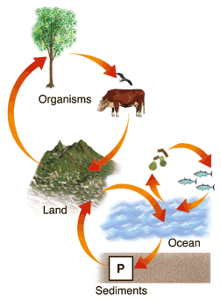
PHOSPHORUS CYCLE
Image from: Pearson Education Inc; Publishing as Pearson Prentice Hall
Phosphate moves
through food web
Producers absorb phosphate from soil and water
Phosphate returns to soil and water from waste or decomposition
Weathering wears away rocks and sediments and releases phosphate into soil and water
Sediments form “new land” to complete cycle

Slide 23
Phosphorus cycle
is only biogeochemical
cycle that does
NOT cycle through the ______________
atmosphere

Slide 24
WHY IS PHOSPHORUS IMPORTANT?
Makes DNA and RNA
Transfers energy as ATP
Makes phospholipids for cell membranes

