Slide 1

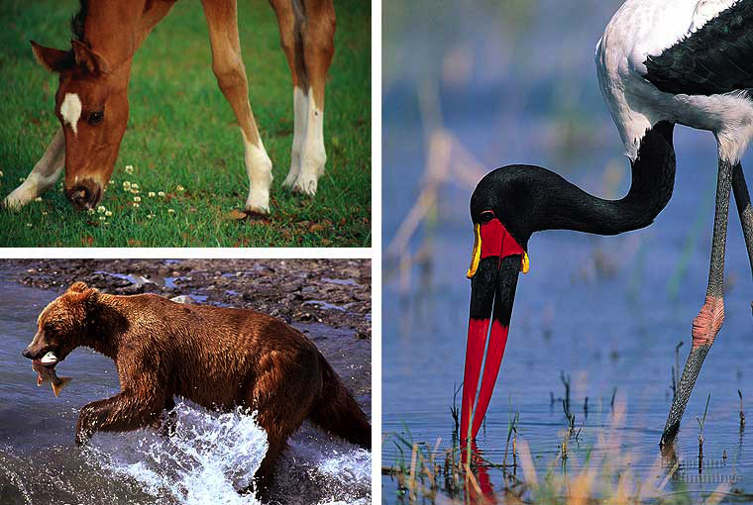
Animal Nutrition
Human Digestion

Slide 2
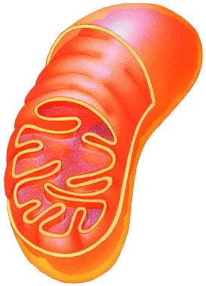
What do animals need to live?
Animals make energy using:
  food
  oxygen
Animals build bodies
using:
  food for raw materials
    amino acids, sugars,
    fats, nucleotides
  ATP energy for synthesis
food
ATP
O₂
mitochondria

Slide 3
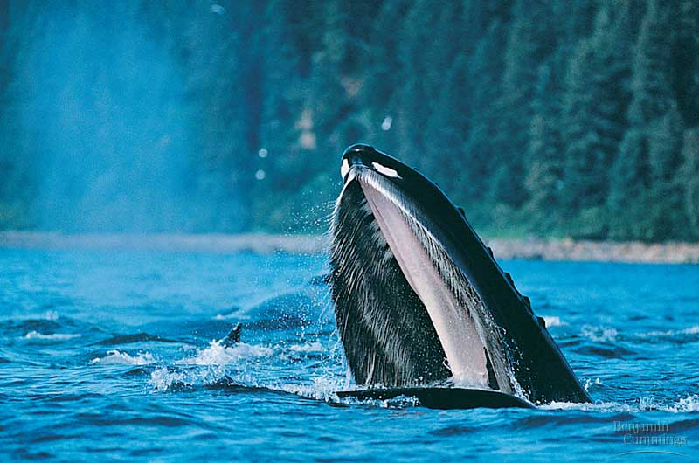
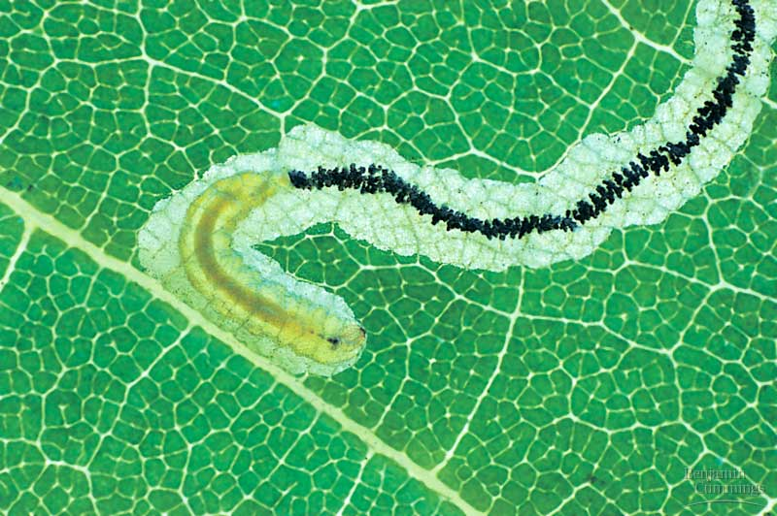
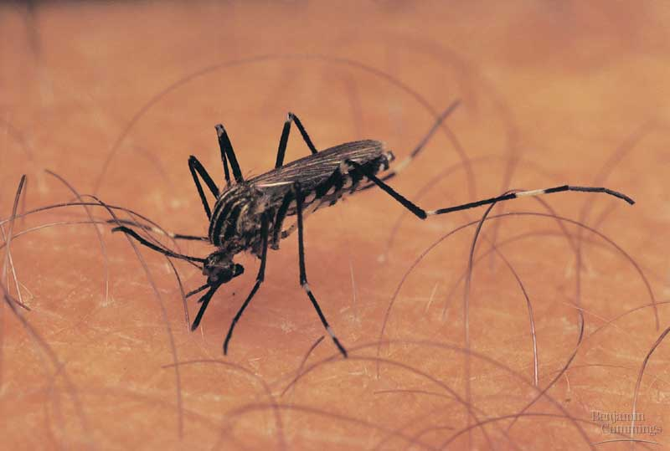
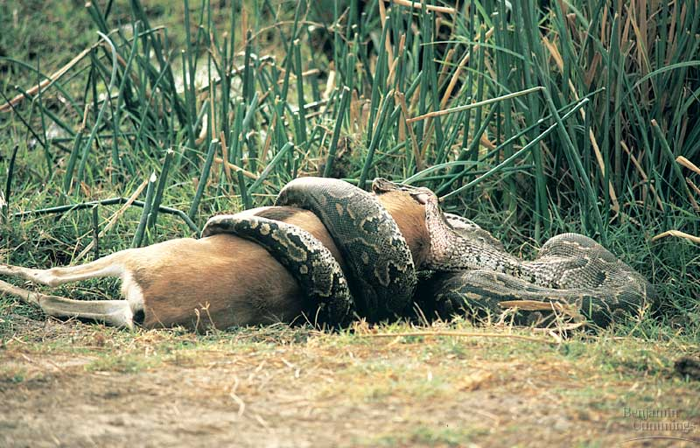
How do animals get their food?
filter feeding
living in your food
fluid feeding
bulk feeding

Slide 4
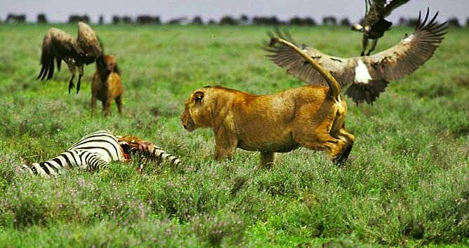
Different diets; different lives
All animals eat other organisms
  Herbivores
    eat mainly plants
      gorillas, cows,
      rabbits, snails
  Carnivores
    eat other animals
      sharks, hawks, spiders, snakes
  Omnivores
    eat animals & plants
      cockroaches, bears, raccoons, humans
      humans evolved as hunters, scavengers & gatherers

Slide 5
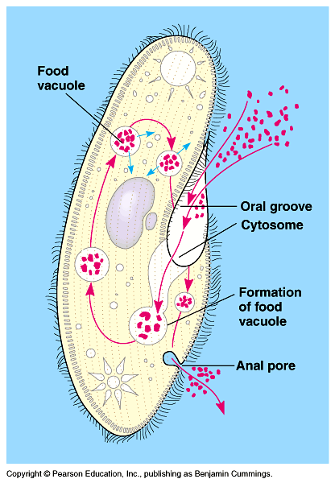
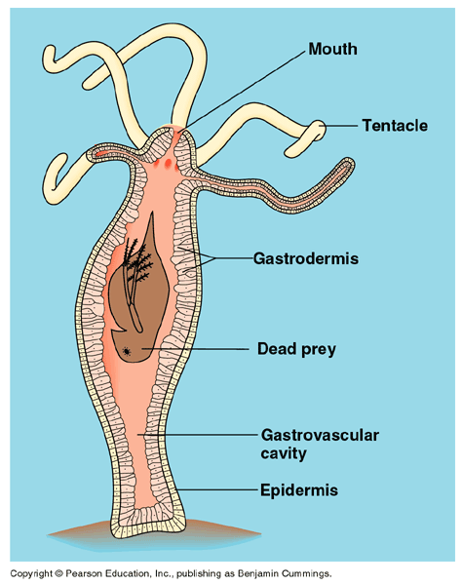
Getting & Using Food
Ingest
  taking in food
Digest
  mechanical digestion
    breaking up food into smaller pieces
  chemical digestion
    breaking down food into molecules small enough to be absorbed into cells
    enzymes
Absorb
  absorb nutrients across cell membranes
    diffusion
    active transport
Eliminate
  undigested material passes out of body
intracellular
digestion
extracellular
digestion

Slide 6
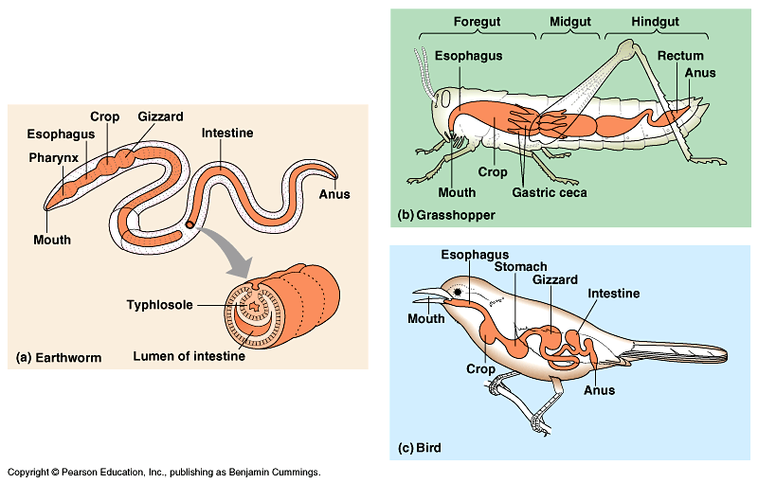
Digestive systems
Everybody’s got one!

Slide 7
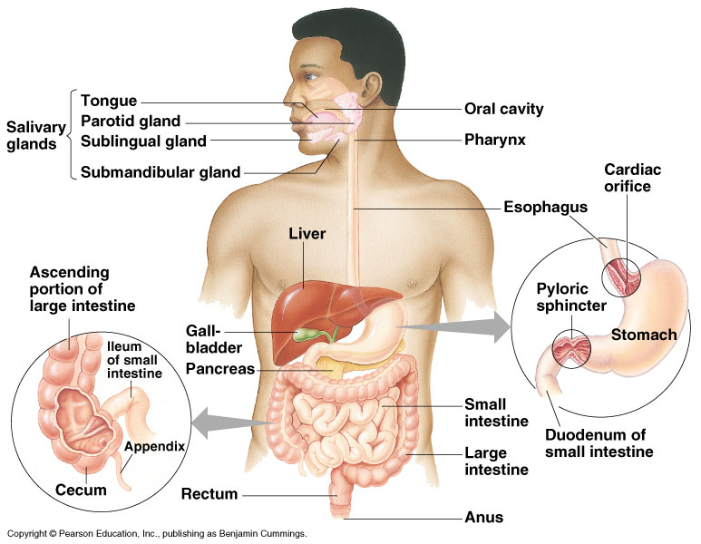
Human digestive system
Notes:
After chewing and swallowing, it takes 5 to 10 seconds for food to pass down the esophagus to the stomach, where it spends 2 to 6 hours being partially digested.
Final digestion and nutrient absorption occur in the small intestine over a period of 5 to 6 hours.
In 12 to 24 hours, any undigested material passes through the large intestine, and feces are expelled through the anus.

Slide 8
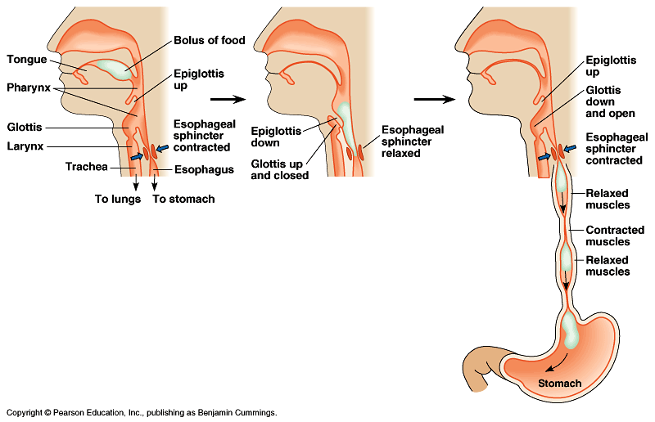
Mouth
Functions
  mechanical digestion
    teeth
      break up food
  chemical digestion (saliva)
    amylase enzyme
      digests starch
    mucus
      protects soft lining of digestive system
      lubricates food for easier swallowing
    buffers
      neutralizes acid to prevent tooth decay
    anti-bacterial chemicals
      kill bacteria that enter mouth with food

Slide 9
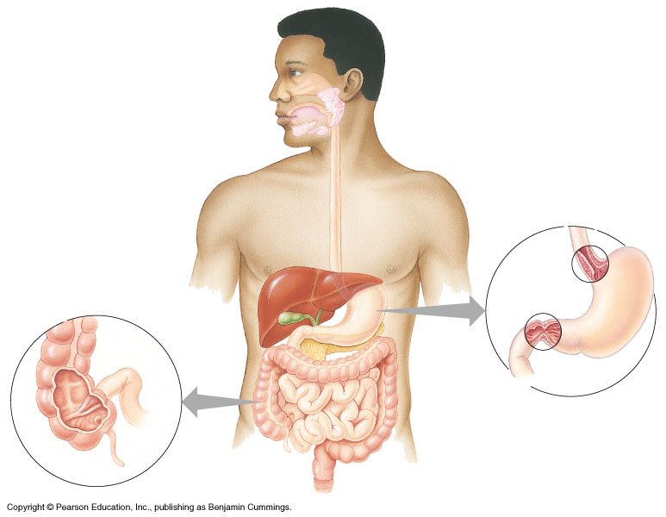
mouth
▪break up food
▪digest starch
▪kill germs
▪moisten food

Slide 10
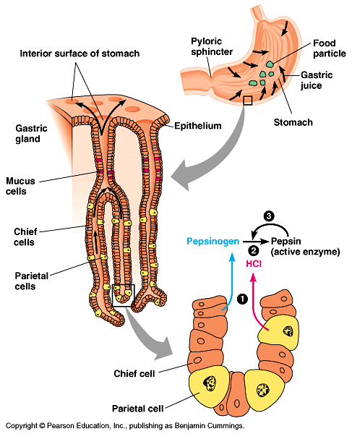
Stomach
Functions
  disinfect food
    hydrochloric acid = pH 2
      kills bacteria
  food storage
    can stretch to fit ~2L food
  digests protein
    pepsin enzyme
But the stomach is made out of protein!
What stops the stomach from digesting itself?
mucus secreted by stomach cells protects stomach lining
Notes:
Still, the epithelium is continually eroded, and the epithelium is completely replaced by mitosis every three days.
Gastric ulcers, lesions in the stomach lining, are caused by the acid-tolerant bacterium Heliobacter pylori.
Ulcers are often treated with antibiotics.
Pepsin is secreted in an inactive form, called pepsinogen by specialized chief cells in gastric pits.
Parietal cells, also in the pits, secrete hydrochloric acid which converts pepsinogen to the active pepsin only when both reach the lumen of the stomach, minimizing self-digestion.
Also, in a positive-feedback system, activated pepsin can activate more pepsinogen molecules.

Slide 11
mouth
▪break up food
▪digest starch
▪kill germs
▪moisten food
stomach
▪kills germs
▪break up food
▪digest proteins
▪store food
sphincter
sphincter

Slide 12
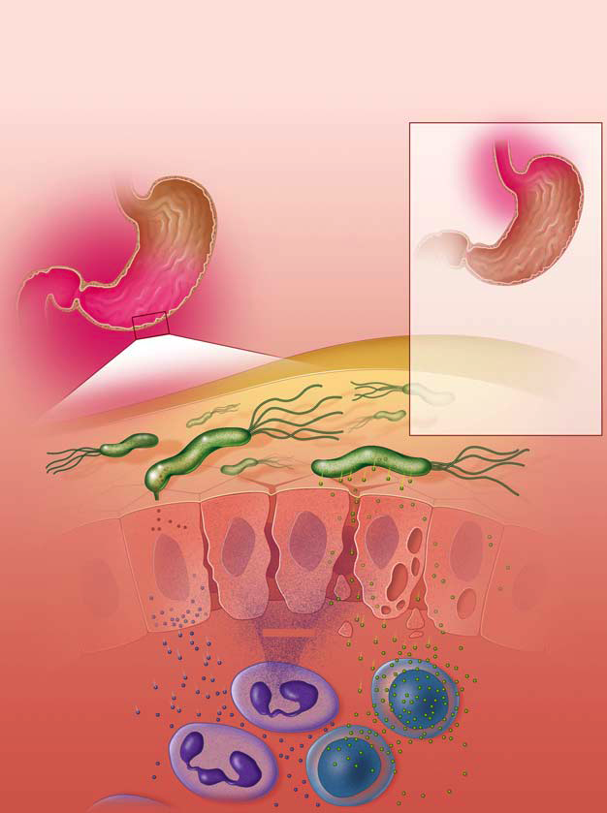
Ulcers
Colonized by
H. pylori
Free of
H. pylori
Used to think ulcers were caused by stress
  tried to control with antacids
Now know ulcers caused by bacterial infection of stomach
  H. pylori bacteria
  now cure with antibiotics
inflammation of stomach
inflammation of esophagus
H. pylori
inflammatory proteins
(CagA)
cell damaging proteins
(VacA)


cytokines
helper T cells
neutrophil cells
white blood cells

Slide 13
You’ve got company!
Living in the large intestine is a community of helpful bacteria
  Escherichia coli: E. coli
    digest cellulose
      digests fruits & vegetables
    produce vitamins
      vitamin K & B vitamins
    BUT generate gases
      by-product of bacterial metabolism
      methane, hydrogen sulfide
      STINKY!

Slide 14
mouth
▪break up food
▪digest starch
▪kill germs
▪moisten food
stomach
▪kills germs
▪break up food
▪digest proteins
▪store food
liver
▪produces bile
- stored in gall bladder
▪break up fats
small intestines
▪breakdown food
- proteins
- starch
- fats
▪absorb nutrients
pancreas
▪produces enzymes to
digest proteins & carbs
large intestines
absorb water
appendix

Slide 15
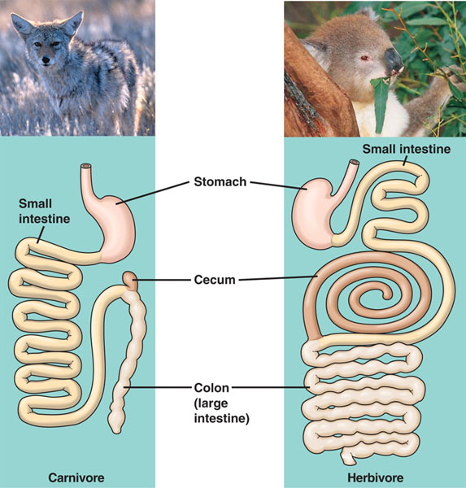
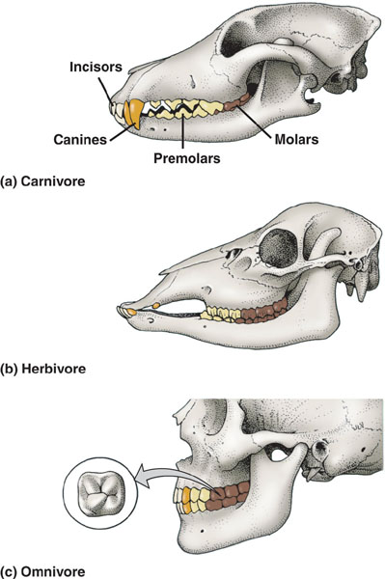
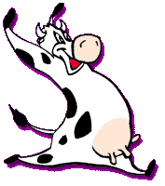
Different diets; different bodies
Adaptations of herbivore vs. carnivore
  teeth
  length of digestive system
  number & size of stomachs

Slide 16
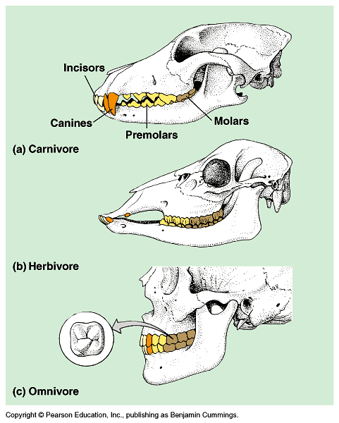
Teeth
Carnivore
  sharp ripping teeth
  “canines”
Herbivore
  wide grinding teeth
  molars
Omnivore
  both kinds of teeth

Slide 17
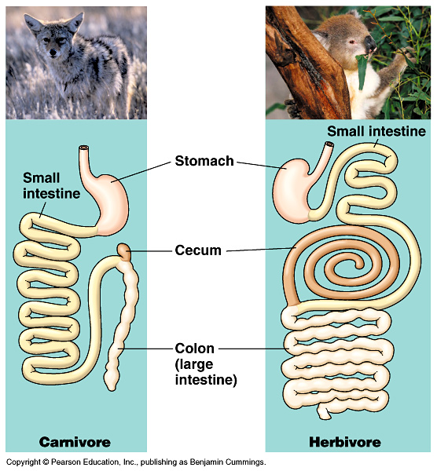
Length of digestive system
Herbivores & omnivores
  long digestive
  systems
  harder to digest cellulose (cell walls)
    bacteria in intestines help
Carnivores
  short digestive systems
  protein easier to
  digest than cellulose
appendix

Slide 18
Eating a balanced diet
What happens if an animal’s diet is missing an essential nutrient?
  deficiency diseases
    scurvy — vitamin C (collagen production)
    rickets — vitamin D (calcium absorption)
    blindness — vitamin A (retinol production)
    anemia — vitamin B₁₂ (energy production)
    kwashiorkor — protein

Slide 19
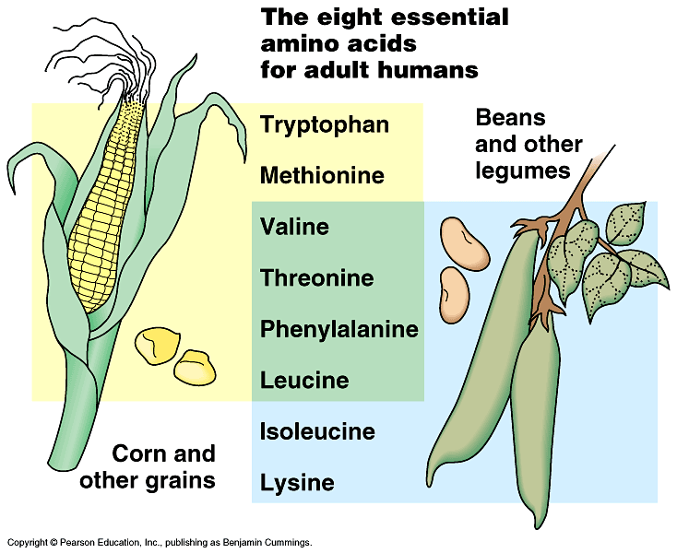
Vegetarian diets
Need to make sure you get enough protein
  20 amino acids to make protein
    12 amino acids humans can produce
    8 we have to eat = “essential amino acids”
  Grains (like corn) have 6 amino acids
    missing 2
  Beans (like soybean & red beans)
  have 6 amino acids
    missing different 2
    mix beans & grains
    for complete group of
    amino acids
      rice & beans
      taco/tortilla & beans
      tofu & rice
      peanut butter & bread

