Slide 1
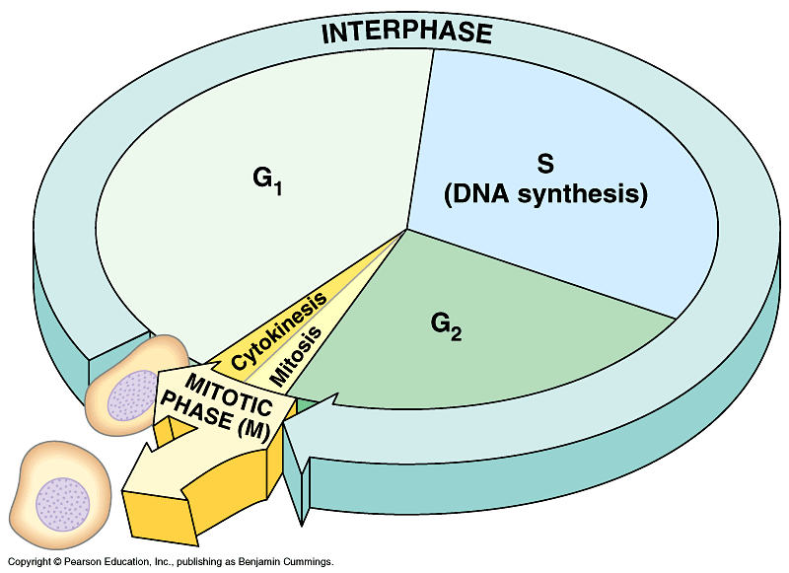

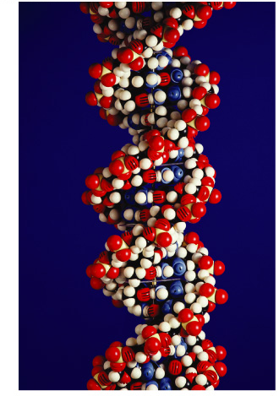
DNA Replication

Slide 2

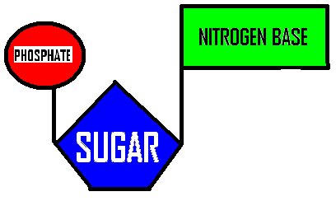
STRUCTURE OF NUCLEIC ACIDS
Built from
NUCLEOTIDE
SUBUNITS
NITROGEN BASES
CAN BE:
  ADENINE
  GUANINE
  CYTOSINE
  THYMINE
  URACIL
Sugar can be DEOXYRIBOSE (DNA)
RIBOSE (RNA)

Slide 3
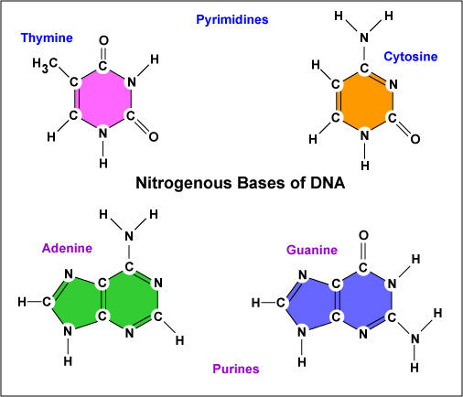
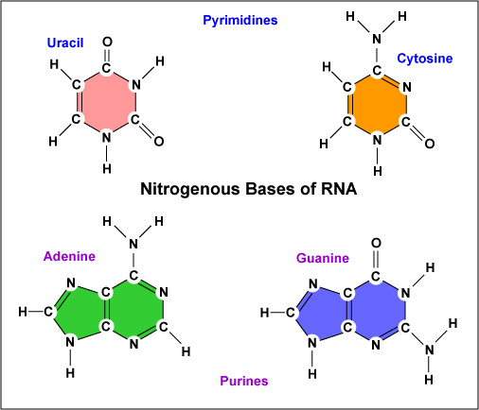
DNA has no URACIL RNA has no THYMINE
PURINES (A & G) have 2 RINGS
PYRIMIDINES (T, C, & U) have 1 RING

Slide 4
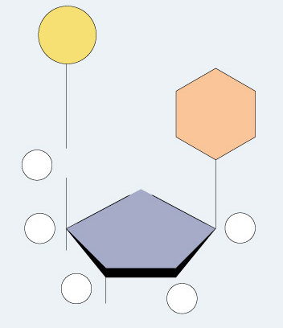
Directionality of DNA
You need to number the carbons!
  it matters!
nucleotide
PO₄
N base
5′
CH₂
O
4′
1′
ribose
3′
2′
OH

Slide 5
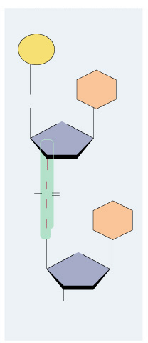
The DNA backbone
5′
PO₄
Made of phosphates and deoxyribose sugars
Phosphate on 5’ carbon
attaches to 3’ carbon of
next nucleotide
base
5′
CH₂
O
4′
C
1′
3′
2′
O
–O
P
O
O
base
5′
CH₂
O
4′
1′
3′
2′
OH
3′

Slide 6
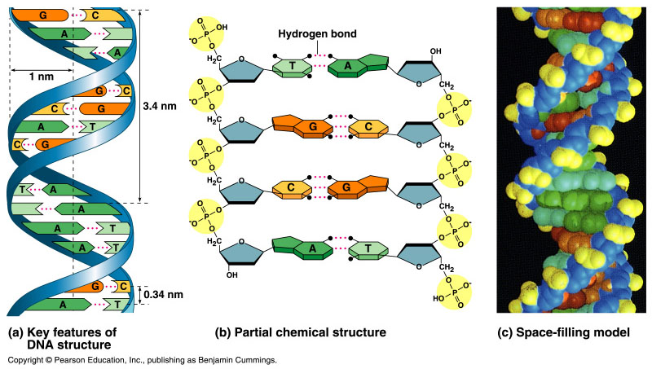
Double helix structure of DNA
“It has not escaped our notice that the specific pairing we have postulated immediately suggests a possible copying mechanism for the genetic material.” Watson & Crick

Slide 7
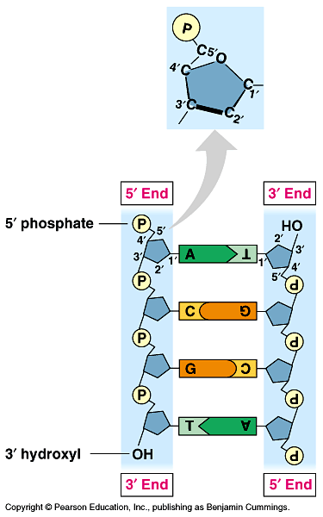
Anti-parallel strands
Nucleotides in DNA backbone are bonded from phosphate to sugar between 3′ & 5′ carbons
  DNA molecule has “direction”
  complementary strand runs in opposite direction
5′
3′
3′
5′

Slide 8
Bonding in DNA
hydrogen
bonds
5′
3′
covalent
phosphodiester
bonds
3′
5′
….strong or weak bonds?
How do the bonds fit the mechanism for copying DNA?

Slide 9
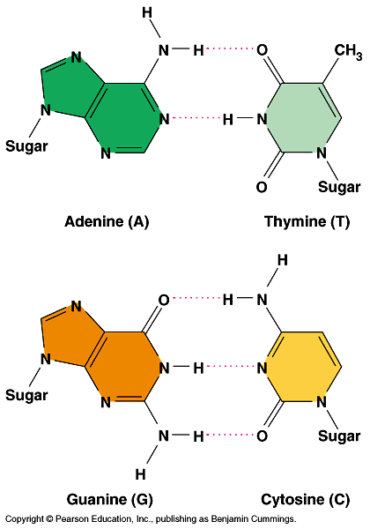
Base pairing in DNA
Purines
  adenine (A)
  guanine (G)
Pyrimidines
  thymine (T)
  cytosine (C)
Pairing
  A : T
    2 bonds
  C : G
    3 bonds

Slide 10
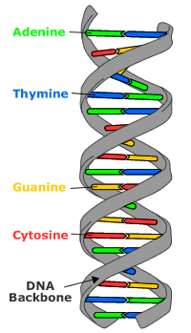
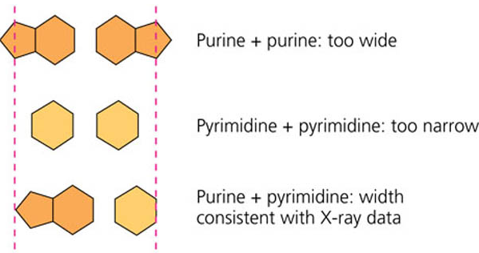
CHARGAFF’s RULES
Erwin Chargaff analyzed DNA from different organisms and found A = T G = C
Now know its because:
A always bonds with T
G always bonds with C
A Purine always bonds to a Pyrimidine

Slide 11
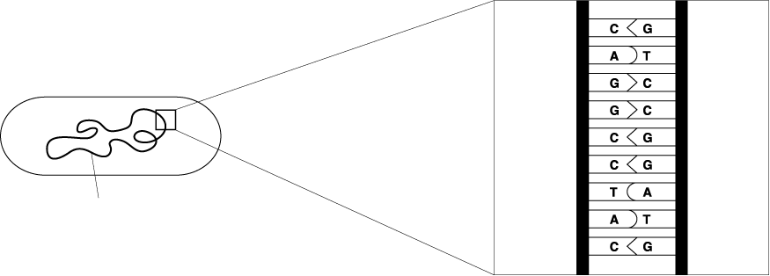
Chromosome Structure in Prokaryotes
Approximately 5 million base pairs
3,000 genes
Chromosome
E. coli bacterium
Bases on the chromosome
DNA molecule in bacteria
single DOUBLE STRANDED circular loop

Slide 12
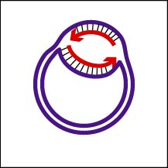
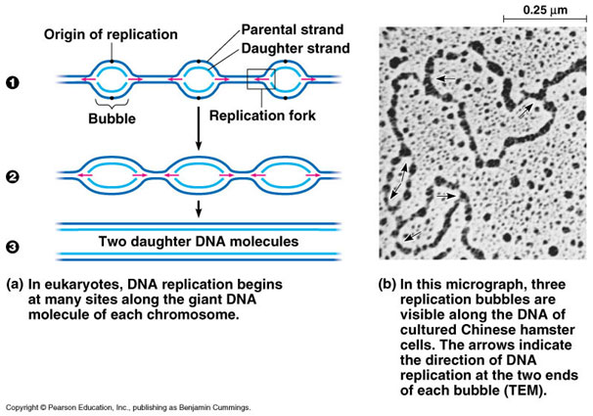
http://student.ccbcmd.edu/~gkaiser/biotutorials/dna/fg12.html
Starting place =
ORIGIN OF REPLICATION
Bacteria have one
Bacterial replication
Eukaryotes-
multiple origins

Slide 13
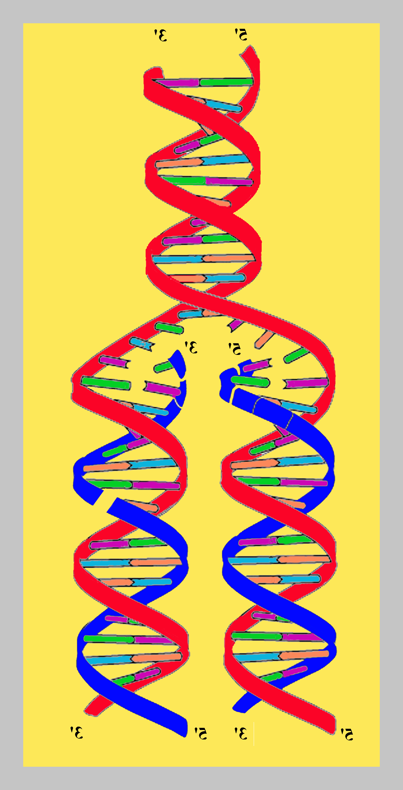
HOW NUCLEOTIDES ARE ADDED
DNA
REPLICATION FORK
DNA replication
Triphosphate addition
DNA replication 2
DNA replication/quiz

Slide 14
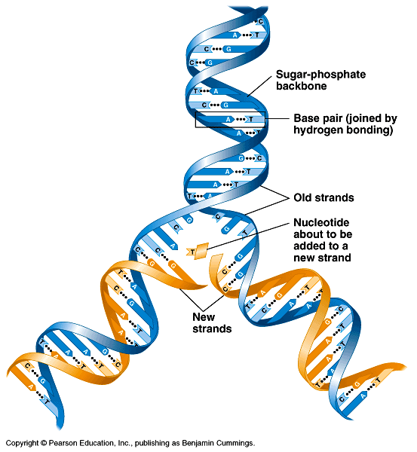
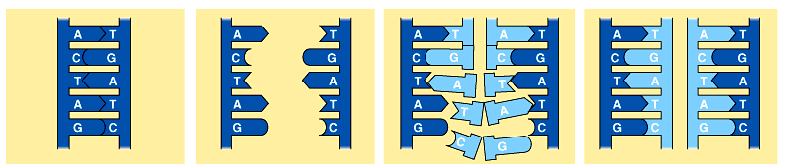
Copying DNA
Replication of DNA
  base pairing allows each strand to serve as a template for a new strand
  new strand is 1/2 parent template &
  1/2 new DNA
    semi-conservative
    copy process

Slide 15
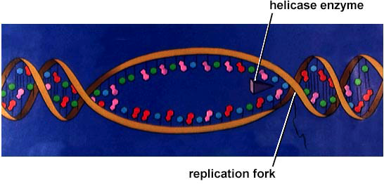
Replication: 1st step
DNA
REPLICATION FORK
Unwind DNA
  helicase enzyme
    unwinds part of DNA helix
    stabilized by single-stranded binding proteins
helicase
single-stranded binding proteins
replication fork

Slide 16
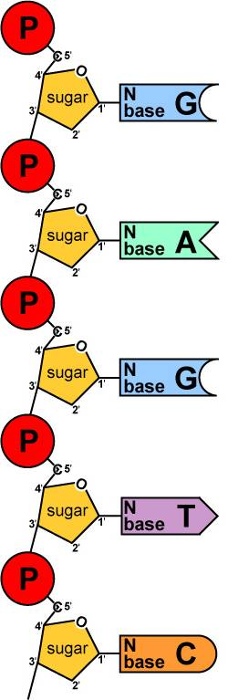
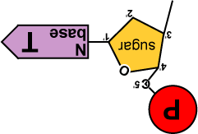
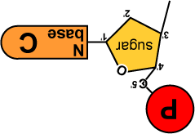
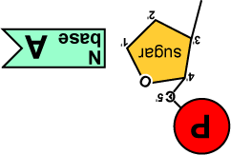
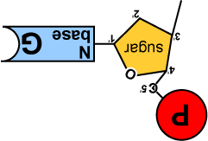
Replication: 2nd step
Build daughter DNA strand
  add new complementary bases
  DNA polymerase III
DNA
Polymerase III

Slide 17


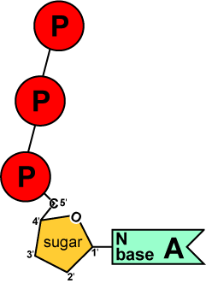
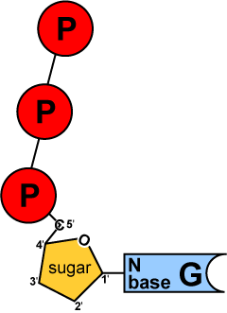
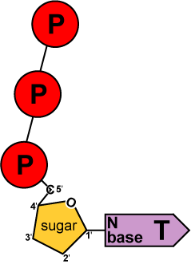
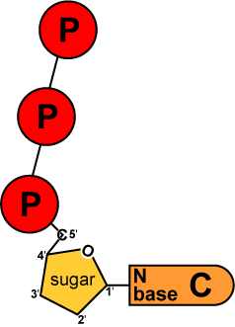
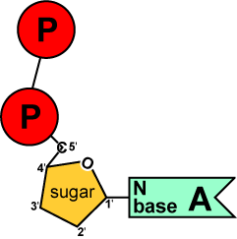
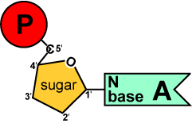
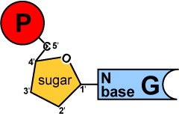
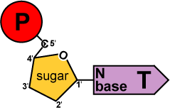
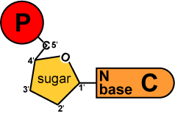
Energy of Replication
DNA replication
Where does energy for bonding usually come from?
We come
with our own
energy!
energy
You
remember
ATP!
Are there
other ways
to get energy
out of it?
energy
Are there
other energy
nucleotides?
You bet!
And we
leave behind a
nucleotide!
ATP
GTP
TTP
CTP
ADP
AMP
GMP
TMP
CMP
modified nucleotide

Slide 18
Energy of Replication
See animation
The nucleotides arrive as nucleoside triphosphates
  DNA bases with P–P–P
    P-P-P = energy for bonding
  DNA bases arrive with their own energy source for bonding
  bonded by enzyme: DNA polymerase III
ATP
GTP
TTP
CTP

Slide 19
Leading & Lagging strands
Okazaki
Limits of DNA polymerase III
  can only build onto 3′ end of an existing DNA strand
5′
✗
Okazaki fragments
5′
3′
3′
5′
3′
5′
5′
Lagging strand
3′
ligase
growing
replication fork
3′
5′
✓
Leading strand
3′
5′
Lagging strand
  Okazaki fragments
  joined by ligase
    “spot welder” enzyme
3′
DNA polymerase III
Leading strand
  continuous synthesis

Slide 20
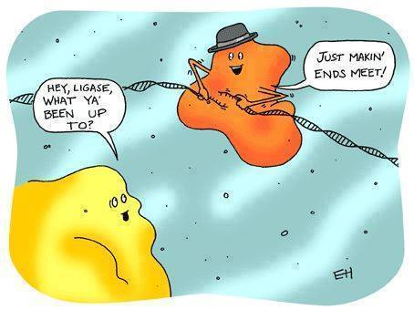

Slide 21
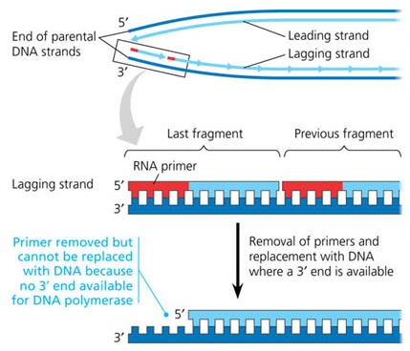
TELOMERES & TELOMERASE
Each
replication
shortens
DNA strand
Primer removed but
can’t be replaced with
DNA because no
3’ end available for
DNA POLYMERASE
Image from: AP BIOLOGY by Campbell and Reese 7th edition

Slide 22
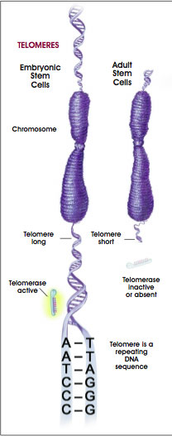
TELOMERES-repetitive sequences added to ends of genes to protect information in code
TELOMERASE can add to telomere segments in cells that must divide frequently
Shortening of telomeres may play a role in aging
Cells with increased telomerase activity which allows them to keep dividing
EX: Cells that give rise to sperm & eggs,
stem cells, cancer cells
ANIMATION

Slide 23
Fast & accurate!
It takes E. coli <1 hour to copy
5 million base pairs in its single chromosome
  divide to form 2 identical daughter cells
Human cell copies its 6 billion bases & divide into daughter cells in only few hours
  remarkably accurate
  only ~1 error per 100 million bases
  ~30 errors per cell cycle

Slide 24
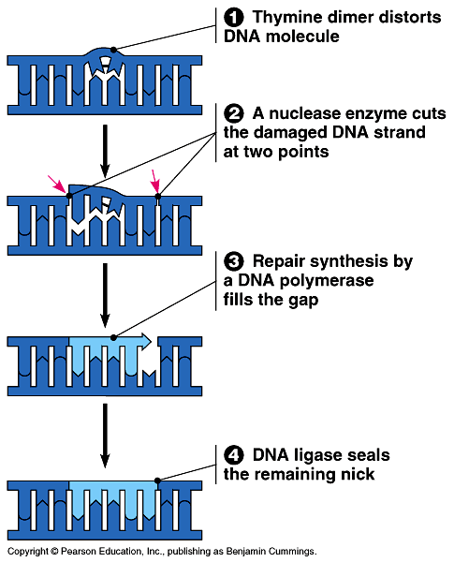
Editing & proofreading DNA
1000 bases/second =
lots of typos!
DNA polymerase I
  proofreads & corrects typos
  repairs mismatched bases
  removes abnormal bases
    repairs damage
    throughout life
  reduces error rate from
  1 in 10,000 to
  1 in 100 million bases

Slide 25
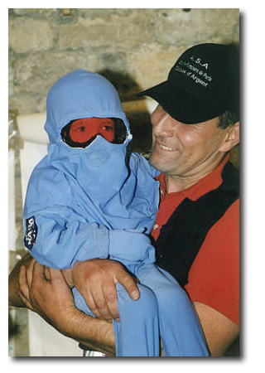
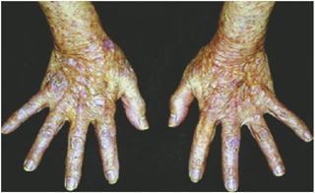
NUCLEOTIDE EXCISION REPAIR
Cells continually monitor DNA and make repairs
NUCLEASES-DNA cutting enzyme removes errors
DNA POLYMERASE AND LIGASE can fill in gap and repair using other strand
Xeroderma pigmentosum- genetic disorder
  mutation in DNA enzymes that repair UV damage in skin cells
  can’t go out in sunlight
  increased skin cancers/cataracts

