Slide 1
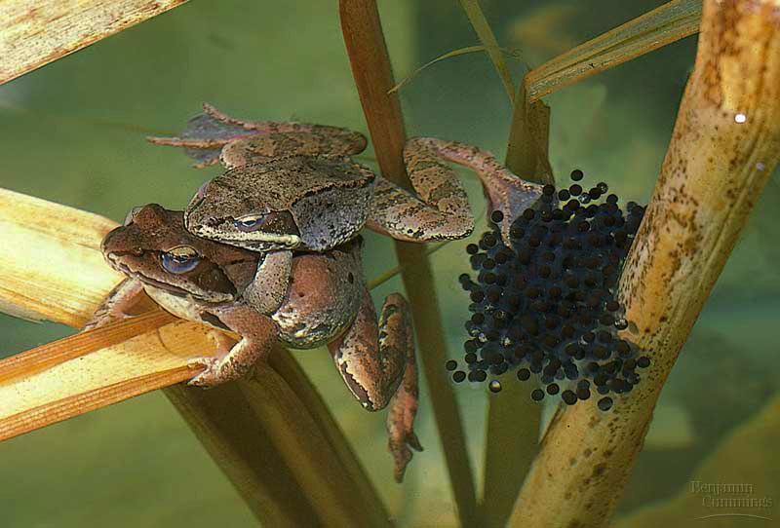
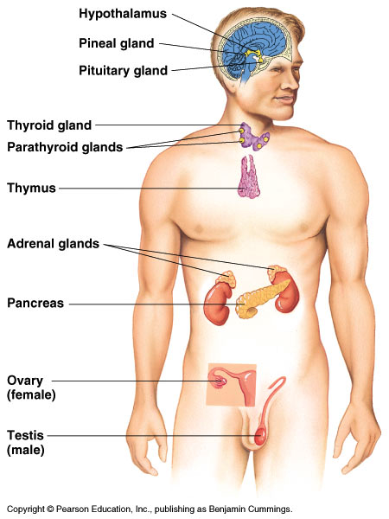
Endocrine System
Hormones & Homeostasis

Slide 2
Homeostasis
Homeostasis
maintaining internal balance in the body
organism must keep internal conditions stable even if environment changes
also called “dynamic equilibrium”
example: body temperature
humans:
too cold = shiver
too warm = sweat
lizard:
too cold = bask in sun
too warm = hide in shade

Slide 3
Regulation
How we maintain homeostasis
nervous system
nerve signals control body functions
endocrine system
hormones
chemical signals control body functions

Slide 4
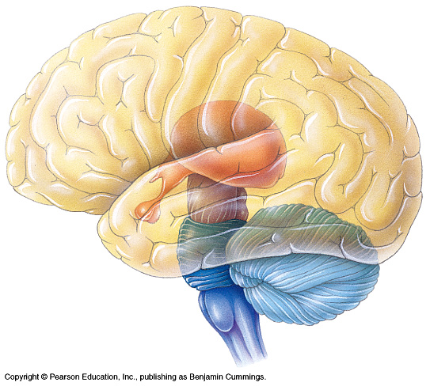
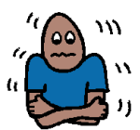
Controlling Body Temperature
Nervous System Control
Feedback
nerve signals
brain
sweat
dilates surface blood vessels
high
body temperature
low
constricts surface blood vessels
shiver
brain
nerve signals

Slide 5
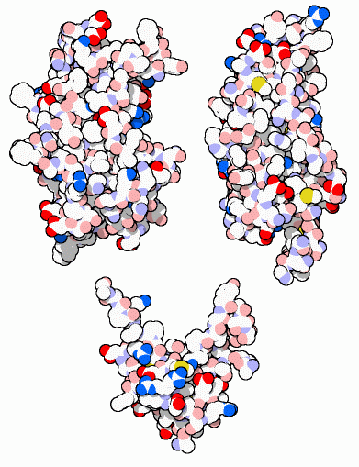
Hormones
Why are hormones needed?
chemical messages from one body part to cells in other parts of body
communication needed to coordinate whole body
maintaining homeostasis
growth hormones

Slide 6
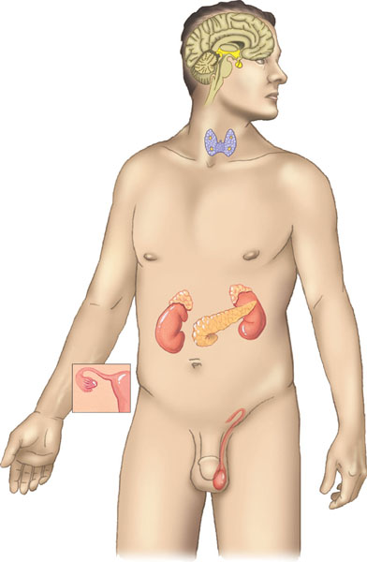
Endocrine System
Endocrine system releases hormones
glands which secrete (release) chemical signals into blood
chemicals cause changes in other parts of body
growth hormones
sex hormones
response hormones
metabolism hormones
and more….
Notes:
Hormones coordinate slower but longer–acting responses to stimuli such as stress, dehydration, and low blood glucose levels. Hormones also regulate long–term developmental processes by informing different parts of the body how fast to grow or when to develop the characteristics that distinguish male from female or juvenile from adult. Hormone–secreting organs, called endocrine glands, are referred to as ductless glands because they secrete their chemical messengers directly into extracellular fluid. From there, the chemicals diffuse into the circulation.

Slide 7
Responding to hormones
Lock and key system
hormone fits receptor on “target” cell
target cell
secreting cell
non- target cells
can’t read signal
can’t read signal

Slide 8
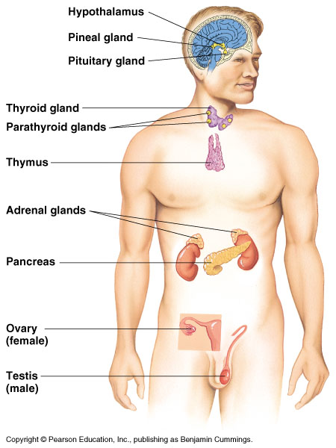
Glands
Pineal
melatonin
Pituitary
many hormones: master gland
Thyroid
thyroxine
Adrenal
adrenaline
Pancreas
insulin, glucagon
Ovary
estrogen
Testes
testosterone

Slide 9
Maintaining homeostasis
Feedback
hormone 1
gland
lowers body condition
high
specific body condition
low
raises body condition
gland
hormone 2

Slide 10
Negative Feedback
Response to changed body condition
if body is high or low from normal level
signal tells body to make changes that will bring body back to normal level
once body is back to normal level, signal is turned off
hormone 1
gland
lowers body condition
high
specific body condition

Slide 11
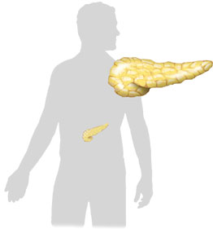
Regulation of Blood Sugar
Endocrine System Control
Feedback
insulin
body cells take up sugar from blood
liver stores sugar
reduces appetite
pancreas
high
liver
blood sugar level
(90mg/100ml)
low
liver releases sugar
triggers hunger
pancreas
liver
glucagon

