Slide 1
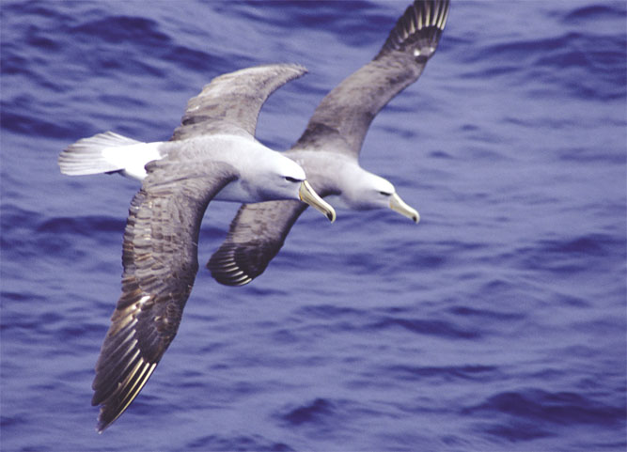
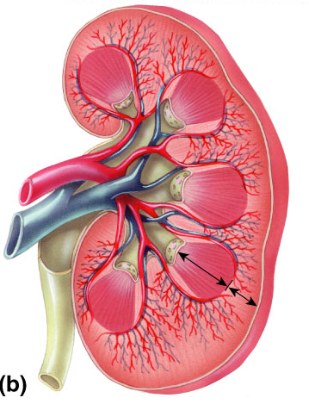
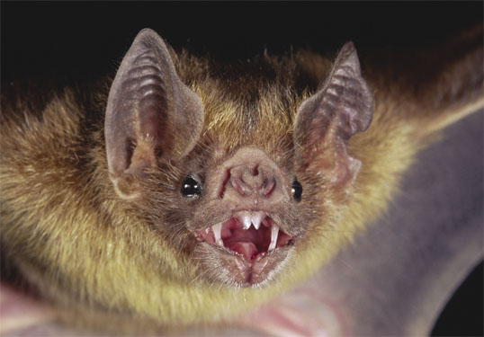
Excretory System Kidneys

Slide 2
What do animal cells do to stay alive?
Animal cells move material across the cell membrane by diffusion
nutrients in
from digestive system
fuels for energy in
from digestive system
oxygen in
from respiratory system
waste out
CO₂, urea from cells
to respiratory system, to excretory system
nutrients
sugar
CO₂
O₂
urea
sugar
nutrients
O₂

Slide 3
Unicellular → Multicellular
Warm, dilute
ocean waters
Warm, dilute
ocean waters
Unicellular
Multicellular
All cells in direct contact with environment
All cells can easily get nutrients in & waste out by diffusion
Internal cells not in direct contact with environment
Internal cells can’t get nutrients in & waste out
Need organ systems

Slide 4
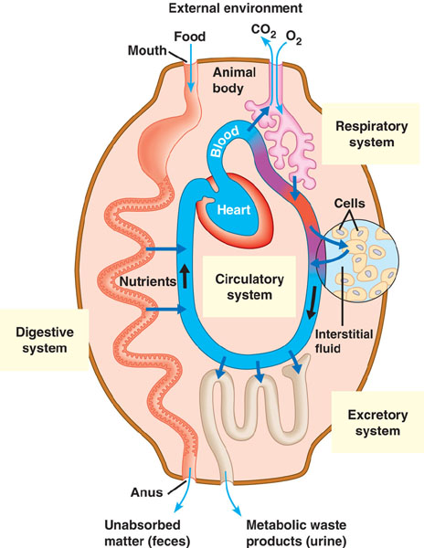
Keeping an animal alive
Had to evolve organ systems for:
getting materials in & around
digestive system
respiratory system
circulatory system
removing wastes
respiratory system
excretory system
Notes:
Transport epithelia in excretory organs often have the dual functions of maintaining water balance and disposing of metabolic wastes.
Transport epithelia in the gills of freshwater fishes actively pump salts from the dilute water passing by the gill filaments.

Slide 5
What liquid waste do we make?
Digesting protein makes poison
nitrogen waste = ammonia = poison
H
|
—C—
|
O
H
||
CO₂ ₊ H₂O
N
C—OH
H
H
NH₂ = ammonia

Slide 6
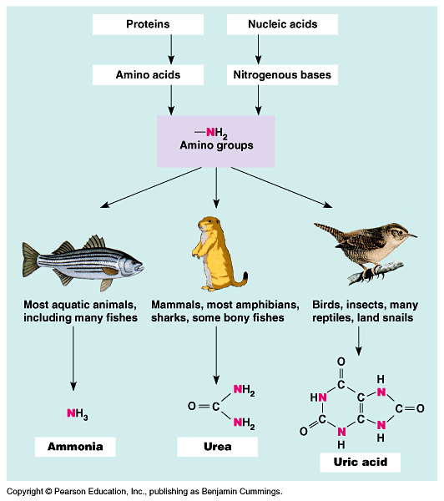
Nitrogen waste
The kind of waste you make depends on where you live
Freshwater
ammonia
Land
urea
Land egg layer
uric acid
Notes:
Mode of reproduction appears to have been important in choosing between these alternatives.
Soluble wastes can diffuse out of a shell-less amphibian egg (ammonia) or be carried away by the mother’s blood in a mammalian embryo (urea).
However, the shelled eggs of birds and reptiles are not permeable to liquids, which means that soluble nitrogenous wastes trapped within the egg could accumulate to dangerous levels (even urea is toxic at very high concentrations).
In these animals, uric acid precipitates out of solution and can be stored within the egg as a harmless solid left behind when the animal hatches.

Slide 7
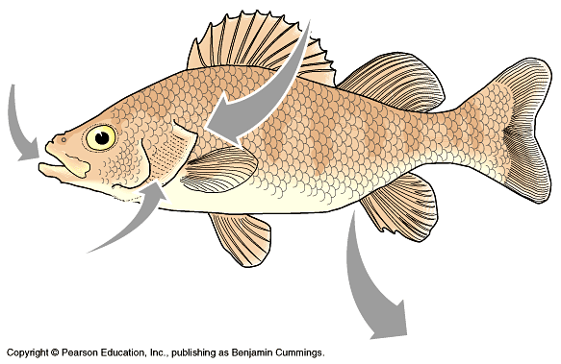
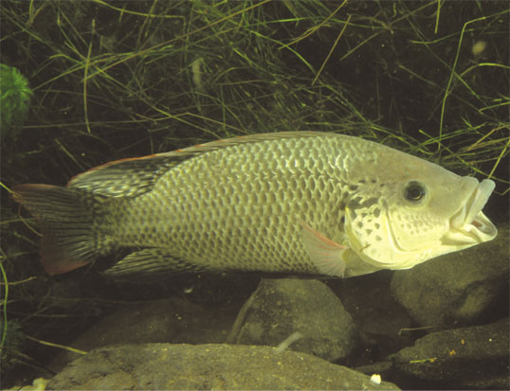
Nitrogen waste disposal in water
Freshwater animals
If you have a lot of water you can dilute the waste before it poisons you
excrete ammonia through gills and as urine
Notes:
If you have a lot of water you can urinate out a lot of dilute urine.
Predators track fish by sensing ammonia gradients in water.
Transport epithelia in the gills of freshwater fishes actively pump salts from the dilute water passing by the gill filaments.

Slide 8
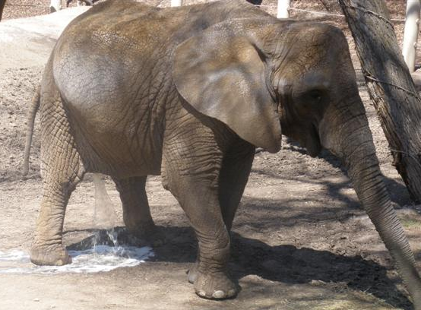
Nitrogen waste disposal on land
Land animals
need to save H₂O
evolved less poisonous waste product
urea
excrete urea & H₂O as urine
Notes:
The salt secreting glands of some marine birds, such as an albatross, secrete an excretory fluid that is much more salty than the ocean.
The salt-excreting glands of the albatross remove excess sodium chloride from the blood, so they can drink sea water during their months at sea.
The counter-current system in these glands removes salt from the blood, allowing these organisms to drink sea water during their months at sea.

Slide 9
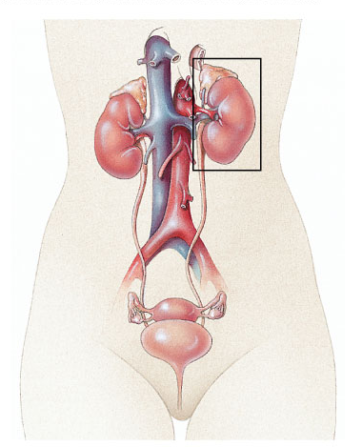
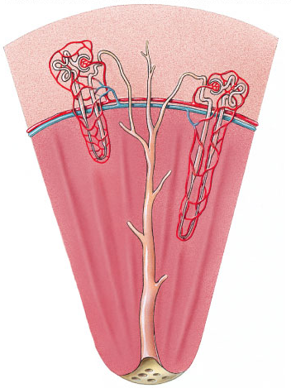
Human kidney
Mammals have a pair of bean-shaped kidneys
supplied with blood by a renal artery and a renal vein
Notes:
In humans, the kidneys account for less than 1% of body weight, but they receive about 20% of resting cardiac output

Slide 10
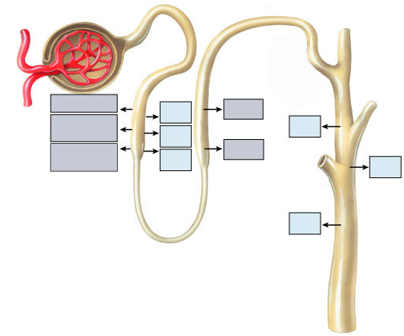
Bowman’s capsule
Proximal
tubule
Distal tubule
Glomerulus
Glucose
H₂O
Na⁺ Cl⁻
Amino
acids
H₂O
H₂O
H₂O
Na⁺ Cl⁻
Mg⁺⁺ Ca⁺⁺
H₂O
H₂O
Collecting
duct
Loop of Henle
kidney’s filtering unit

Slide 11
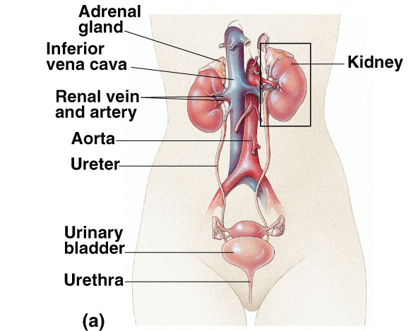
Bladder

Slide 12
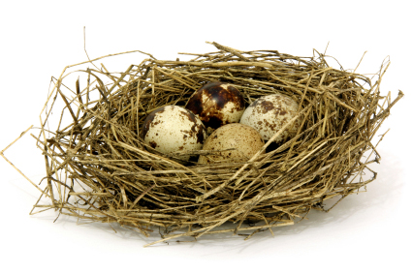
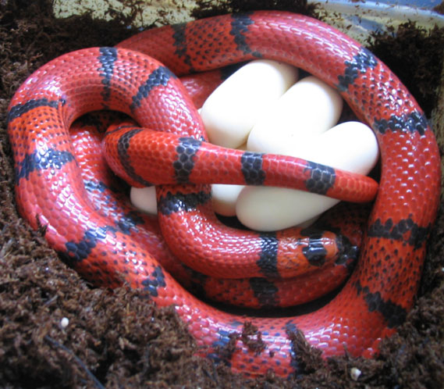
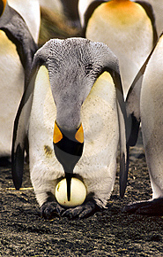
Nitrogen waste disposal in egg
Egg-laying land animals
no place to get rid of waste while in egg
needs waste that doesn’t dissolve in water inside egg
uric acid
stays a powder inside egg
birds, reptiles, insects
Notes:
But unlike either ammonia or urea, uric acid is largely insoluble in water and can be excreted as a semisolid paste with very small water loss.
While saving even more water than urea, it is even more energetically expensive to produce.
Uric acid and urea represent different adaptations for excreting nitrogenous wastes with minimal water loss.
The type of nitrogenous waste also depends on habitat.
For example, terrestrial turtles (which often live in dry areas) excrete mainly uric acid, while aquatic turtles excrete both urea and ammonia.
In some species, individuals can change their nitrogenous wastes when environmental conditions change.
For example, certain tortoises that usually produce urea shift to uric acid when temperature increases and water becomes less available.

Slide 13
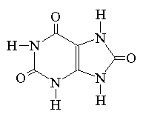
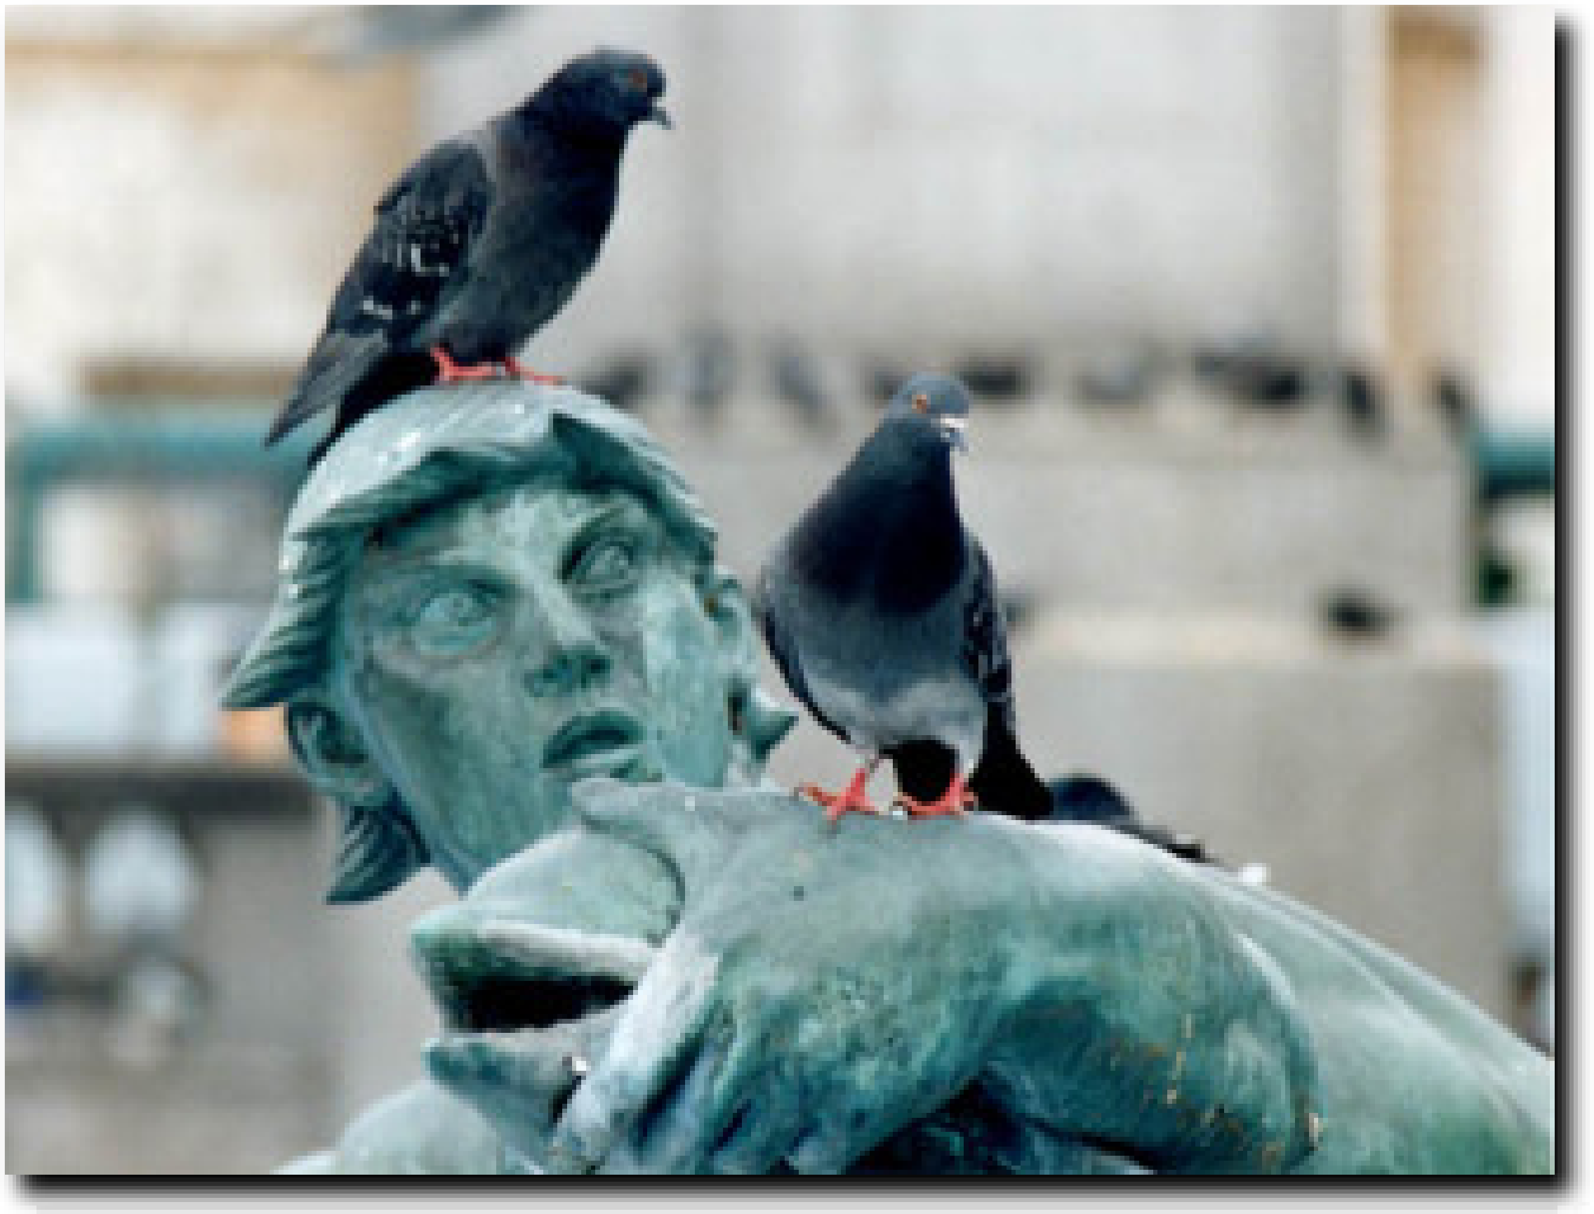
Uric acid
Bird & reptile waste
large molecule that doesn’t dissolve in water inside egg
stays as a white powder
doesn’t harm embryo in egg
adults excrete white paste not liquid waste
white bird poop is really their pee!
this is why male birds don’t have a penis!
Notes:
Birds don’t pee.
This is why male birds don’t have penises.
Both male and female birds have cloaca
(Greek for sewer)

Slide 14
So why do you humans have two kinds of waste?
nutrients
CO₂
O₂
urea

