Slide 1
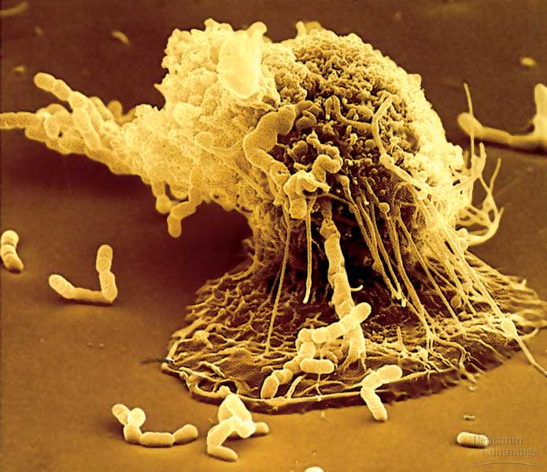
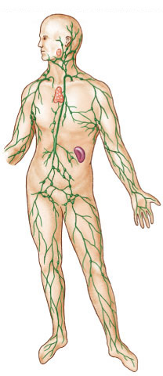
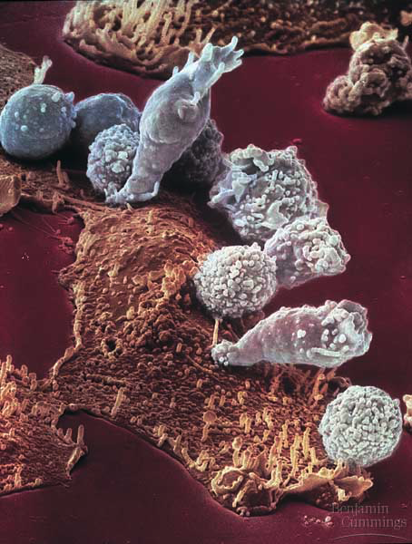
“Fighting the Enemy Within”
phagocytic leukocyte
Immune System
lymphocytes
attacking
cancer cell
lymph
system

Slide 2
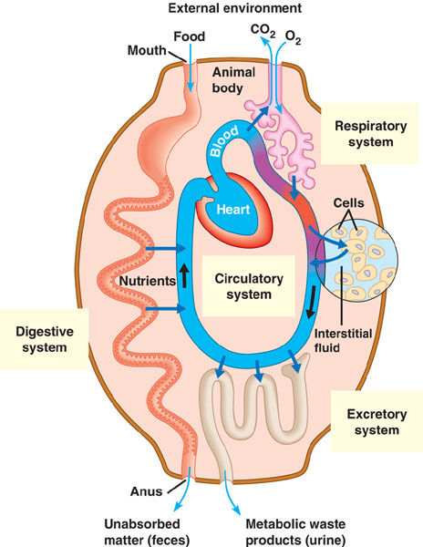
Avenues of attack
Points of entry
  digestive system
  respiratory system
  urinary system
  genitals
  break in skin
Pathways for attack
  circulatory system
  lymph system

Slide 3
Why an immune system?
Attack from the outside & inside
  lots of organisms want you for lunch!
  we are a tasty vitamin-packed meal
    cells are packages of proteins, carbohydrates & fats
    no cell wall
  animals must defend themselves against invaders
    viruses
      HIV, flu, cold, measles, chicken pox, SARS
    bacteria
      pneumonia, meningitis, tuberculosis
    fungi
      yeast
    protists
      amoeba, Lyme disease, malaria
  cancer cells
    abnormal body cells

Slide 4
How are invaders recognized?
Antigens
  chemical name tags on the surface of
  every cell
    “self” vs. “invader”
one of your
own cells
disease-causing
virus
disease-causing
bacteria
antigens say:
“I belong here”
antigens say:
“I am an invader”
antigens say:
“I am an invader”

Slide 5
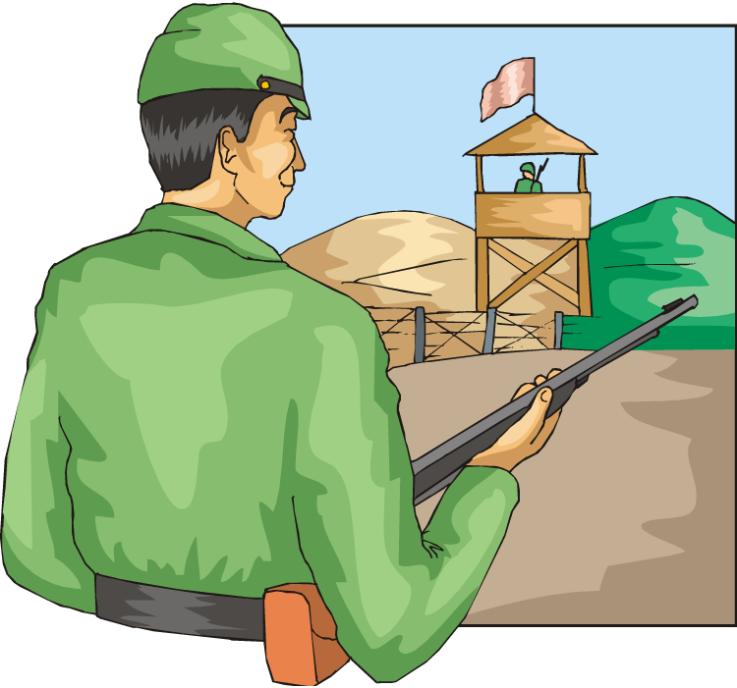
Lines of defense
Barriers
1st line:
  broad, external defense
    “walls & moats”
  skin & mucus membranes
2nd line:
  broad, internal defense
    “patrolling soldiers”
  phagocyte (eating) WBCs
3rd line:
  specific, acquired immunity
    “elite trained units”
  lymphocyte WBCs & antibodies
    B & T cells
Non-specific patrol
Immune system

Slide 6
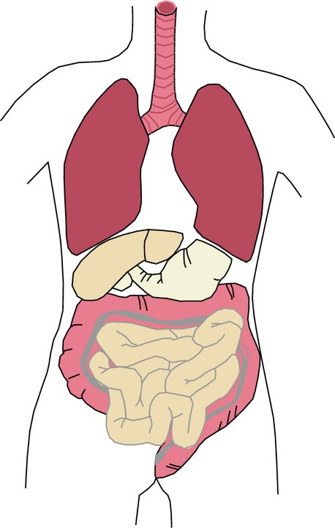
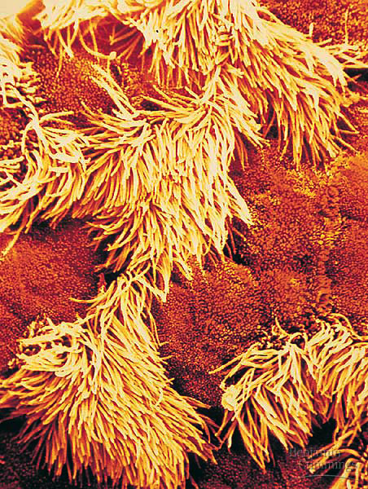
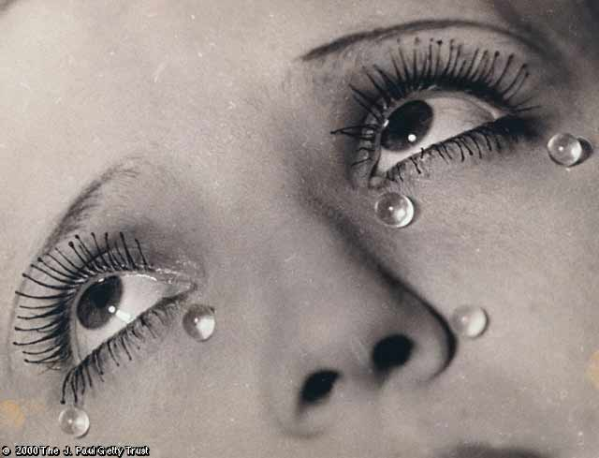
1st line: Physical Barriers
non-specific defense
external barriers
  skin & mucus membranes
  excretions
    sweat
    stomach acid
    tears
    mucus
    saliva
      “lick your wounds”
Lining of trachea:
ciliated cells & mucus secreting cells

Slide 7
2nd: Generalist, broad range patrols
Patrolling white blood cells
  attack invaders that get through the skin
    recognize invader by reading antigen
      surface name tag
  phagocyte cells
    macrophages
    “big eaters”
Macrophage “eating” bacteria

Slide 8
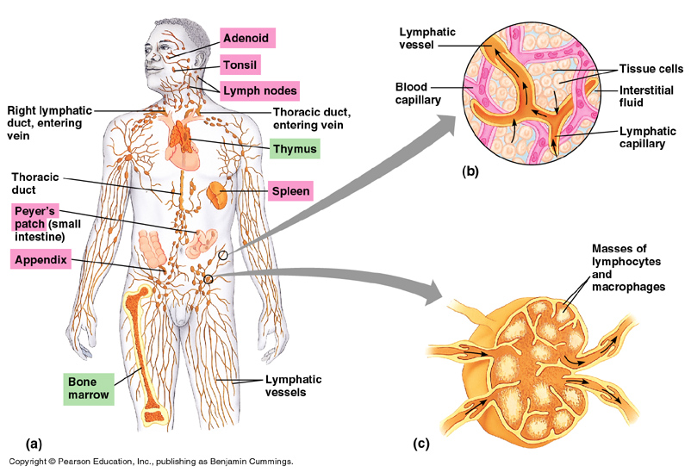
Lymph system
Production of white blood cells & traps “foreign” invaders
lymph vessels
(intertwined amongst blood vessels)
2nd “circulatory” system
lymph node

Slide 9
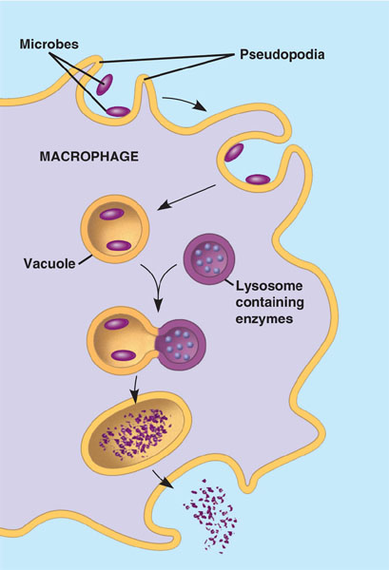
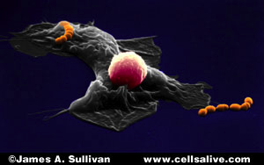
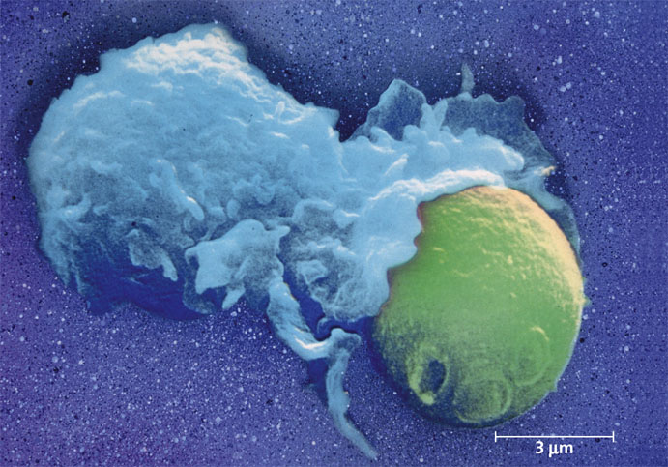
Phagocytes
macrophage
bacteria
white blood cells that eat
macrophage
yeast

Slide 10
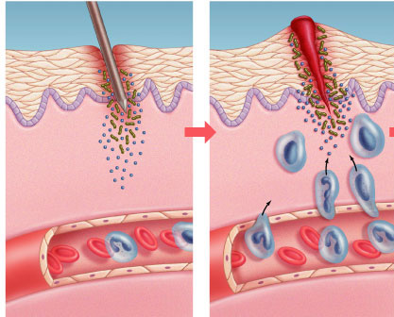
Why do injuries swell?
Inflammation
  injured cells release chemical signals
    histamines
      increases blood flow
      brings more white blood cells to fight bacteria
      brings more red blood cells & clotting factors to repair
Pin or splinter
Blood clot
Swelling
Bacteria
Chemical
alarm signals
Phagocytes
Blood vessel

Slide 11
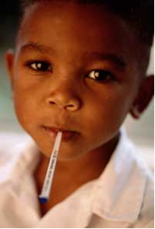
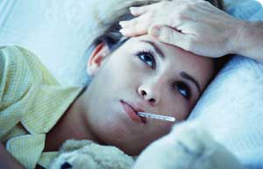
Fever
When a local response is not enough
  full body response to infection
  raises body temperature
  higher temperature helps in defense
    slows growth of germs
    helps macrophages
    speeds up repair of tissues
Notes:
Certain bacterial infections can induce an overwhelming systemic inflammatory response leading to a condition known as septic shock.
Characterized by high fever and low blood pressure, septic shock is the most common cause of death in U.S. critical care units.
Clearly, while local inflammation is an essential step toward healing, widespread inflammation can be devastating.

Slide 12
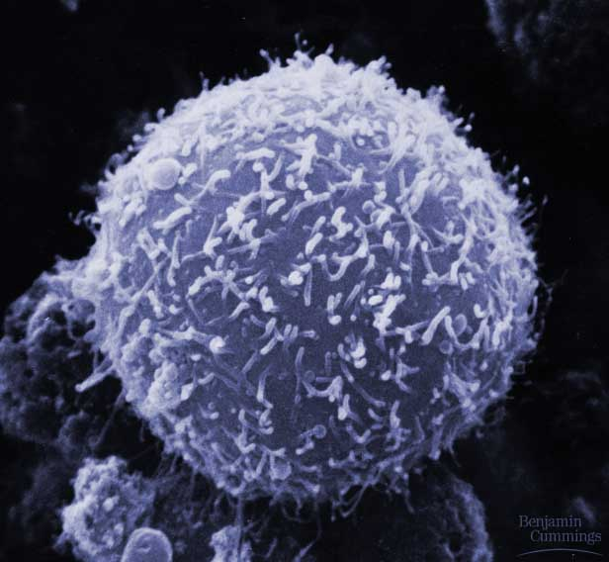
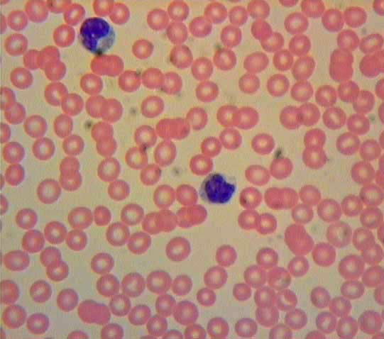
3rd line: Lymphocytes
B cell
Specific defense
  responds to specific invaders
    recognizes specific foreign antigens
    white blood cells
      B cells & antibodies
      T cells

Slide 13
B cells & antibodies
B cells
  white blood cells that attack
  invaders in blood
  mature in Bone marrow
Patrolling B cells
  make antibodies against invader immediately
Memory B cells
  remembers invader
  can make antibodies quickly the next time
    protects you from getting disease more than once

Slide 14
Antibodies
Proteins made by B cells that tag invaders in the blood so macrophages can eat them
  tag says “this is an invader” → gotcha!
    biological “handcuffs”
  antibody attaches to antigen of invader
Y
B cells
releasing antibodies
invading germs tagged with antibodies
Y
Y
Y
Y
Y
Y
Y
Y
Y
Y
Y
Y
Y
Y
Y
Y
macrophage
eating tagged invaders
Y
Y
Y
Y

Slide 15
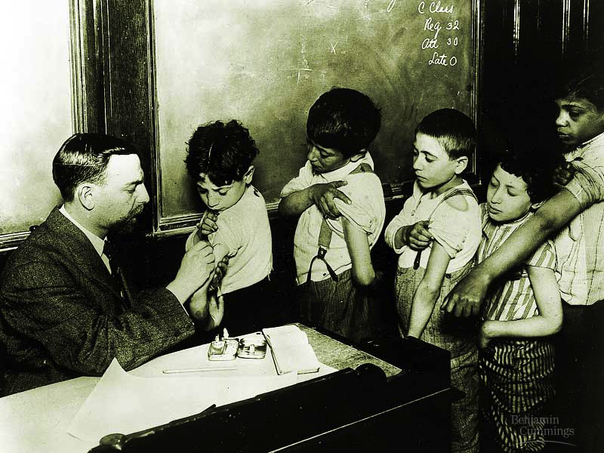
Vaccinations
Exposure to harmless version of germ
  stimulates immune system to produce
  antibodies to invader
  rapid response if
  future exposure
Most successful
against viral diseases

Slide 16
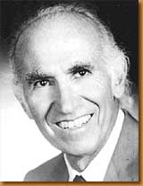
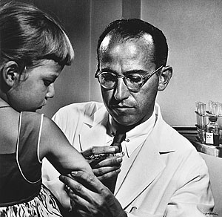
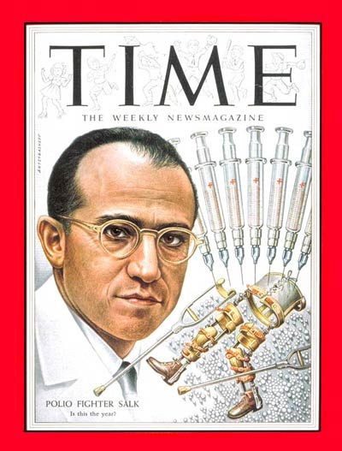
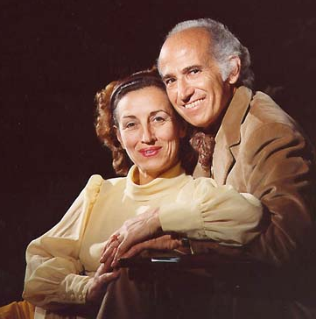
Jonas Salk
1914 – 1995
Developed first vaccine
  against polio
April 12, 1955
Notes:
Poliomyelitis (polio) is caused by a virus that enters the body through the mouth. The virus multiplies in the intestine and invades the nervous system. It can cause total paralysis in a matter of hours.
One in 200 infections leads to irreversible paralysis. Among those paralyzed, 5-10 percent die when their breathing muscles are immobilized.
Polio mainly affects children under age 5.

Slide 17
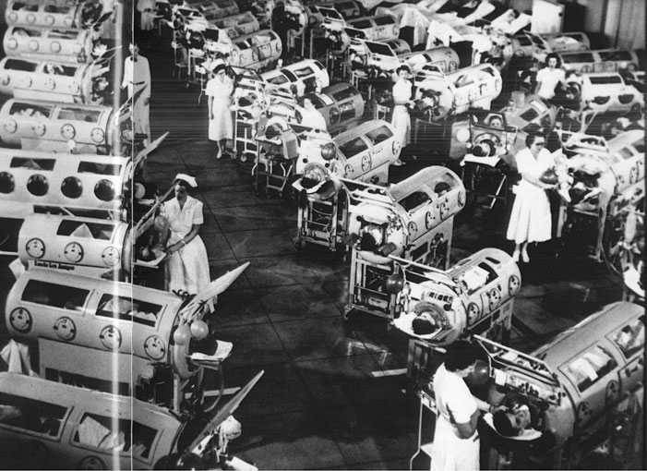
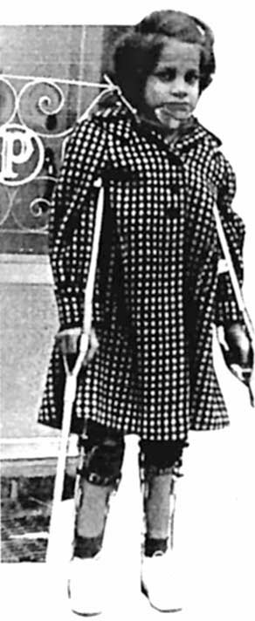
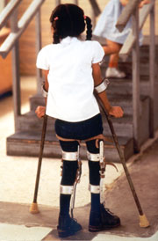
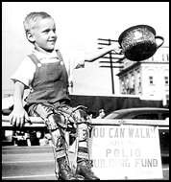
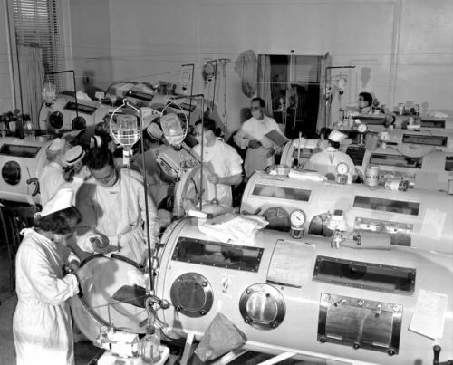
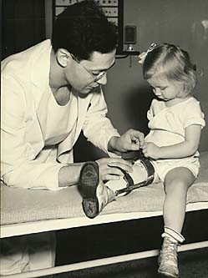
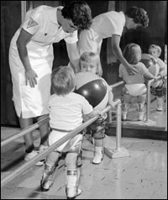
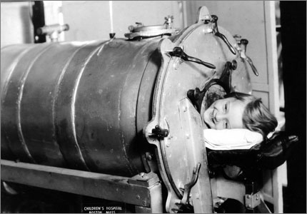
Polio epidemics
1994:
Americas polio free
Notes:
1916 The first major polio epidemic strikes in the United States; 27,000 people suffer paralysis and 6,000 die. Increasing numbers of outbreaks occur each year.
1921 Franklin D. Roosevelt is diagnosed with polio.
1928 Iron lungs are introduced to help patients with acute polio breathe.
1932 Franklin D. Roosevelt is elected President of the United States
1949 Dr. John Enders, Dr. Frederick Robbins and Dr. Thomas Weller develop a way to grow poliovirus in tissue culture, a breakthrough that aided in the creation of the polio vaccine. Their work earned the three scientists the Nobel Prize in physiology and medicine in 1954.
1952 The United States reports 57,628 polio cases -- the worst U.S. epidemic on record.
1979 The last U.S. case of polio caused by wild poliovirus is reported.
1988 Worldwide, polio continues to affect some 350,000 people in 125 countries.
1994 The Americas are certified polio-free.
2000 The Western Pacific region is certified polio-free.
2002 Europe is certified polio-free.

Slide 18
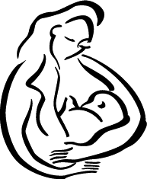
Protecting you from disease
Vaccinations
  advantage
    don’t get illness
    long term immunity
      produce antibodies for life
    works against many viruses
    & bacteria
  disadvantage
    not possible against all invaders
Breastfeeding
  mother’s milk gives baby
  antibodies & keeps baby healthy`
IMPORTANT
PROTECTION
antibodies pass from mother to baby in breast milk

Slide 19
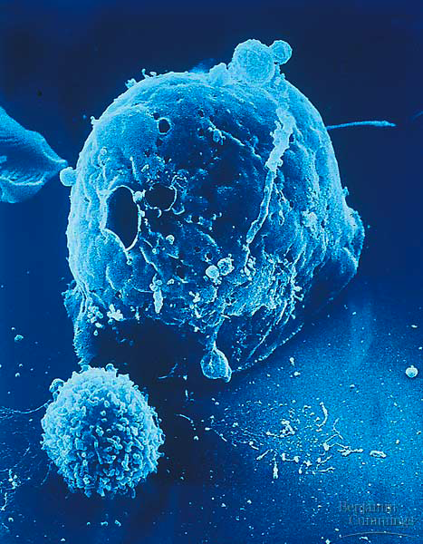
What if the attacker gets past the B cells in the blood & infects some of your cells?
You need trained assassins to kill off these infected cells!

Slide 20
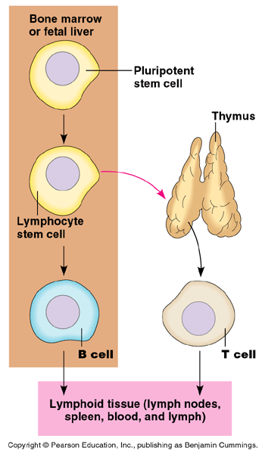
T cells
T cells mature in Thymus
Helper T cells
  sound the alarm for rest
  of immune system
Killer T cells
  destroy infected body cells
Memory T cells
  remembers invader & reacts against it again quickly

Slide 21
Thymus

Slide 22
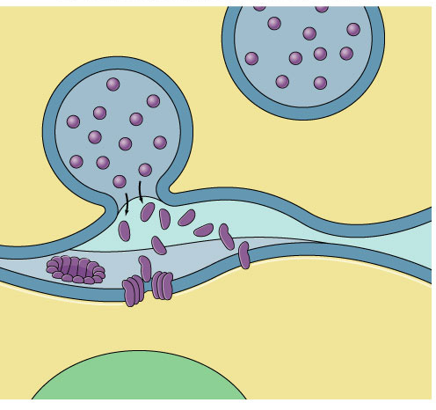
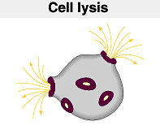
Attack of the Killer T cells
Killer T cells destroy infected body cells
  T cell binds to invaded cell
  secretes perforating protein
    punctures cell membrane of infected cell
    cell bursts
Killer T cell
vesicle
Perforin
punctures
cell membrane
cell
membrane
cell
membrane
invaded cell

Slide 23
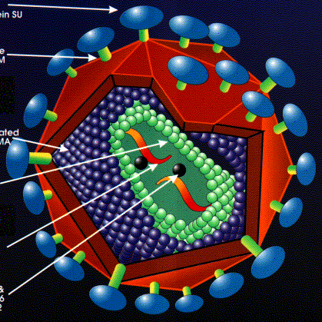
Diseases of the immune system
HIV: Human Immunodeficiency Virus
  infects helper T cells
  helper T cells can’t activate rest of immune system
    body doesn’t hear the alarm
AIDS:
Acquired ImmunoDeficiency Syndrome
  immune system is weakened
  infections by other diseases
  death from other invading
  diseases or cancer

Slide 24
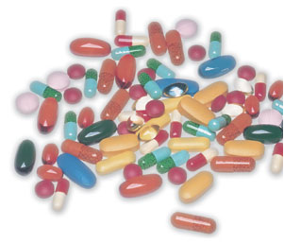
Curing you of disease
Antibiotics = medicine
  advantage
    kill bacteria that have successfully
    invaded you
      make you well after being sick
  disadvantage
    use only after sick
    only good against bacteria
    possible development of
    resistance by bacteria
    (if don’t use correctly)
    can get sick again

Slide 25
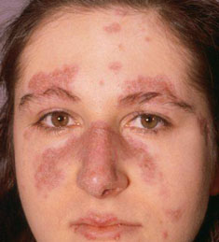
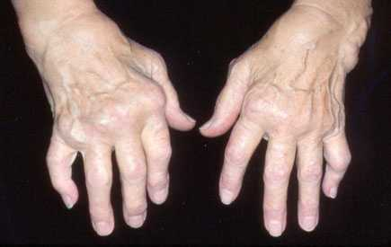
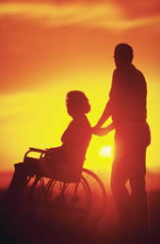
Immune system malfunctions
Auto-immune diseases
  immune system attacks own cells
    lupus
      antibodies attack many different body cells
    rheumatoid arthritis
      antibodies causing damage to
      cartilage & bone
    diabetes
      insulin-making cells of pancreas
      attacked & destroyed
    multiple sclerosis
      T cells attack myelin sheath of
      brain & spinal cord nerves
      fatal

Slide 26
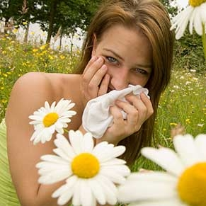
Immune system malfunctions
Allergies
  over-reaction to harmless compounds
    allergens
      proteins on pollen
      proteins from dust
      mites
      proteins in animal
      saliva
    body mistakenly
    thinks they are
    attackers

