Slide 1
MEIOSIS
JEOPARDY
S2C06 Jeopardy Review

Slide 2
Differences
Vocabulary
Mitosis OR Meiosis
Picture ID
More Vocab
100
100
100
100
100
200
200
200
200
200
300
300
300
300
300
400
400
400
400
400
500
500
500
500
500

Slide 3
Differences 100
Tell how spermatogenesis is different from oogenesis
A: What is spermatogenesis makes 4 functional sperm but oogenesis produces only “1 good egg” ?
S2C06 Jeopardy Review
http://www.life.uiuc.edu/plantbio/102/lectures/08mit&veg102.html

Slide 4
Differences 200
TRUE or FALSE
After prophase I, sister chromatids are identical
A: What is FALSE; crossing over exchanges the DNA so arms are different ?
S2C06 Jeopardy Review
http://www.life.uiuc.edu/plantbio/102/lectures/08mit&veg102.html

Slide 5
Differences 300
Tell how prophase I is different from
mitosis
A: What is synapsis & crossing over ?
S2C06 Jeopardy Review
http://www.life.uiuc.edu/plantbio/102/lectures/08mit&veg102.html

Slide 6
Differences 400
Tell something that happens during anaphase I that makes meiosis different from mitosis
A: What is segregation & independent assortment
S2C06 Jeopardy Review
http://www.life.uiuc.edu/plantbio/102/lectures/08mit&veg102.html

Slide 7
Differences 500
How is interphase I different from interphase II?
A: DNA is copied at interphase I
But Interphase II is skipped (DNA IS NOT COPIED)
S2C06 Jeopardy Review

Slide 8
Vocabulary 100
DNA and attached proteins that is
scrunched up in the nucleus of
dividing cells
A: What is CHROMOSOMES?
S2C06 Jeopardy Review

Slide 9
Vocabulary 200
This holds the 2 chromatid arms together in a chromosome.
A: What is a CENTROMERE ?
S2C06 Jeopardy Review

Slide 10
Vocabulary 300
Group of 4 chromatids that forms
during synapsis
A: What is a tetrad?
S2C06 Jeopardy Review

Slide 11
Vocabulary 400
Cells that have 2 copies of each chromosome
A: What is diploid?
S2C06 Jeopardy Review

Slide 12
Vocabulary 500
Production of mature egg cells
A: What is oogenesis ?
S2C06 Jeopardy Review

Slide 13
MITOSIS or MEIOSIS 100
Division in which genetic recombination happens
What is MEIOSIS?
S2C06 Jeopardy Review

Slide 14
MITOSIS or MEIOSIS 200
Type of cell division in which diploid cells are made
A: What is MITOSIS ?
S2C06 Jeopardy Review

Slide 15
MITOSIS or MEIOSIS 300
Type of cell division used by somatic cells to repair injuries
A: What is MITOSIS ?
S2C06 Jeopardy Review

Slide 16
MITOSIS or MEIOSIS 400
Type of cell division which produces 4 daughter cells that are different from each other and from the parent cell
A: What is MEIOSIS ?
S2C06 Jeopardy Review

Slide 17
MITOSIS or MEIOSIS 500
Type of cell division in which crossing over happens
A: What is MEIOSIS?
S2C06 Jeopardy Review

Slide 18
Picture ID 100
What these chromosomes are doing
A: What is synapsis?
S2C06 Jeopardy Review

Slide 19
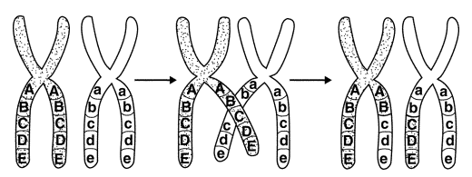
Picture ID 200
What these chromosomes are doing
A: What is crossing over ?
S2C06 Jeopardy Review

Slide 20
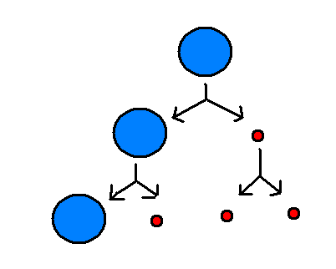
Picture ID 300
Name these small red cells
A: What are polar bodies?
S2C06 Jeopardy Review

Slide 21
Picture ID 400
Name this kind of cell division
A: What is mitosis?
S2C06 Jeopardy Review

Slide 22
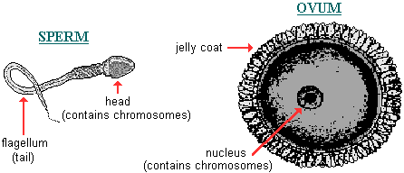
Picture ID 500
Another name for these cells
A: What are gametes ?
S2C06 Jeopardy Review

Slide 23
More Vocab 100
DNA and attached proteins that is spread out in the nucleus of non-dividing cells
A: What is chromatin ?
S2C06 Jeopardy Review

Slide 24
More Vocab 200
Programmed cell death; “Cell suicide” for the good of the organism.
A: What is apoptosis?
S2C06 Jeopardy Review

Slide 25
More Vocab 300
Also called a 1n cell
A: What is haploid?
S2C06 Jeopardy Review

Slide 26
More Vocab 400
The 2 identical arms that make up a chromosome
A: What are CHROMATIDS?
S2C06 Jeopardy Review

Slide 27
More Vocab 500
Matching up of homologous chromosomes pairs
A: What is synapsis?
S2C06 Jeopardy Review

