Slide 1
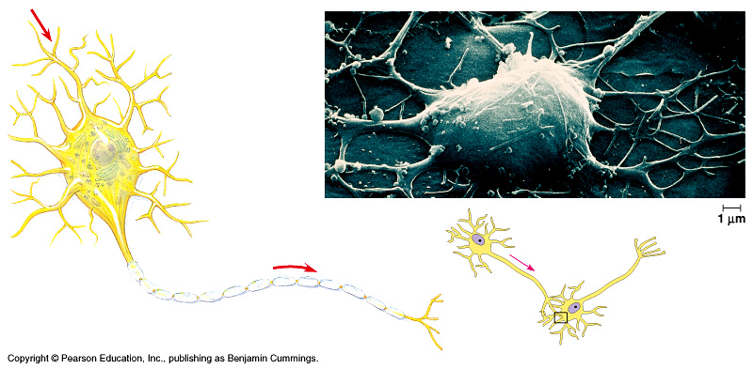
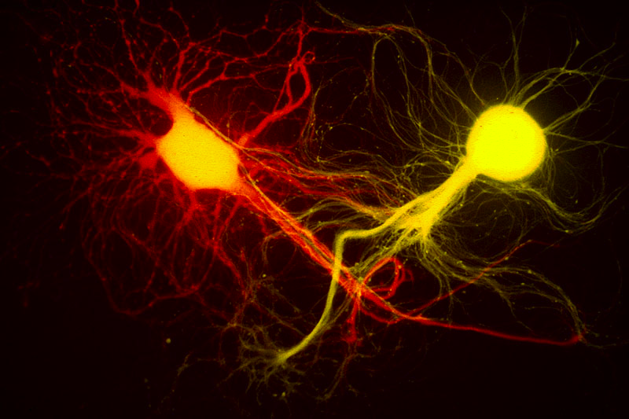
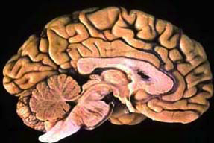
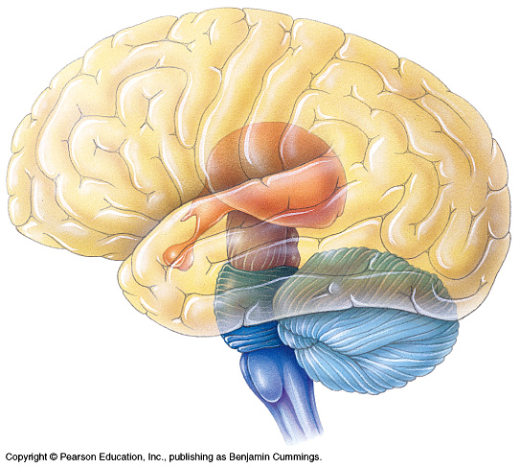

Nervous System
Notes:
Every time you move a muscle & every time you think a thought, your nerve cells are hard at work. They are processing information: receiving signals, deciding what to do with them, & dispatching new messages off to their neighbors. Some nerve cells communicate directly with muscle cells, sending them the signal to contract. Other nerve cells are involved solely in the bureaucracy of information, spending their lives communicating only with other nerve cells. But unlike our human bureaucracies, this processing of information must be fast in order to keep up with the ever-changing demands of life.

Slide 2

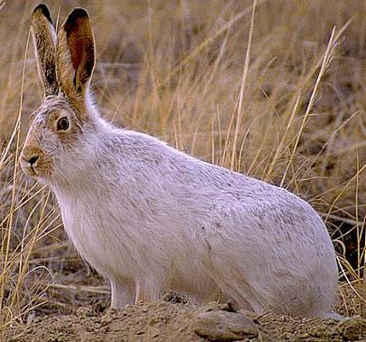
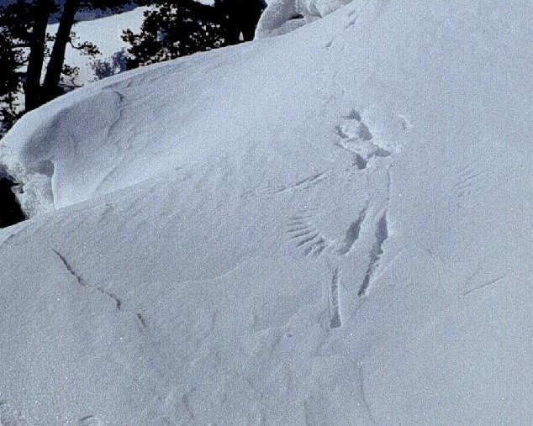
Why do animals need a nervous system?
Because the world is always coming at you!

Slide 3
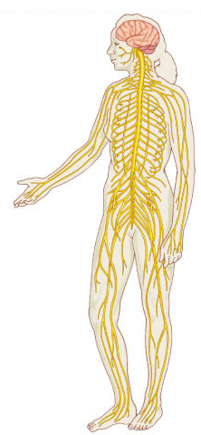
Nervous System
cerebrum
cerebellum
spinal cord
cervical
nerves
Central nervous system
  brain & spinal chord
Peripheral nervous system
  nerves from senses
  nerves to muscles
thoracic
nerves
lumbar
nerves
femoral
nerve
sciatic
nerve
tibial
nerve

Slide 4
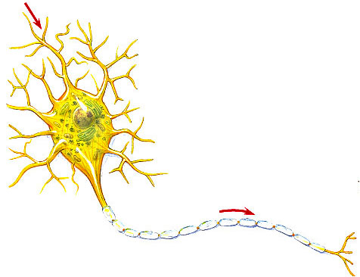
Nervous system cells
Neuron
  a nerve cell
signal
direction
dendrites
cell body
axon
signal direction
synapse

Slide 5
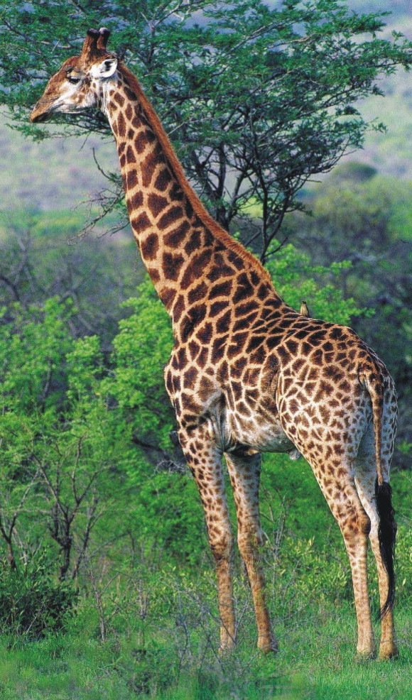
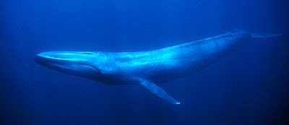
Fun facts about neurons
Most specialized cell in
animals
Longest cell
  blue whale neuron
    10-30 meters
  giraffe axon
    5 meters
  human neuron
    1-2 meters
Nervous system allows for
1 millisecond response time

Slide 6
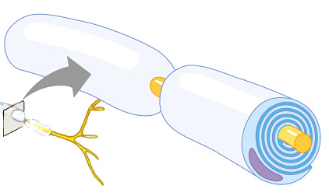
Myelin coating
signal
direction
Axon coated with insulation made of myelin cells
  speeds signal
    signal hops from node to node
  330 mph vs. 11 mph
myelin coating
Multiple Sclerosis
  immune system (T cells) attacks myelin coating
  loss of signal

Slide 7
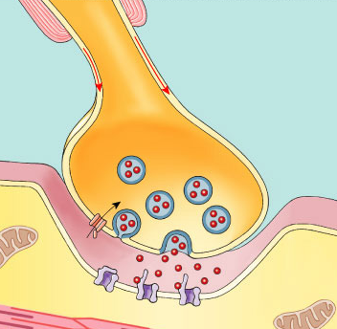
Synapse
Junction between nerve cells
  1st cell releases chemical to trigger next cell
  where drugs affect nervous system
synapse

Slide 8
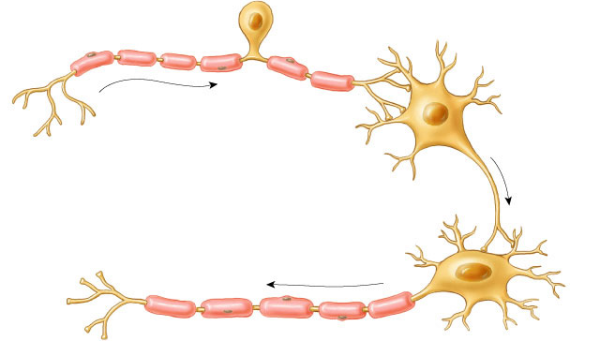
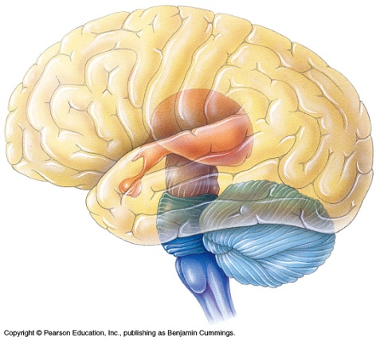
Types of neurons
sensory neuron
(from senses)
interneuron
(brain & spinal chord)
motor neuron
(to muscle)

Slide 9
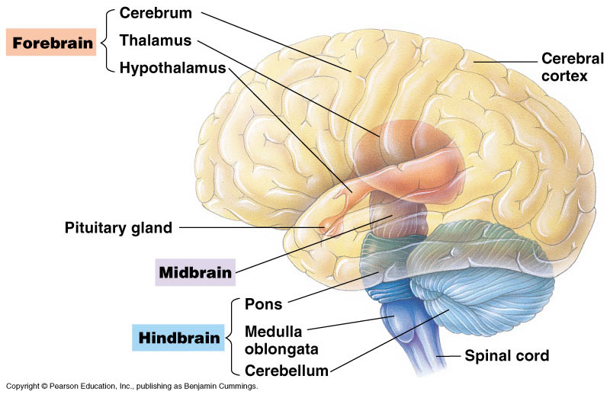
Human brain

Slide 10
Primitive brain
The “lower brain”
  medulla oblongata
  pons
  cerebellum
Functions
  basic body functions
    breathing, heart, digestion, swallowing, vomiting
  homeostasis
  coordination of movement

Slide 11
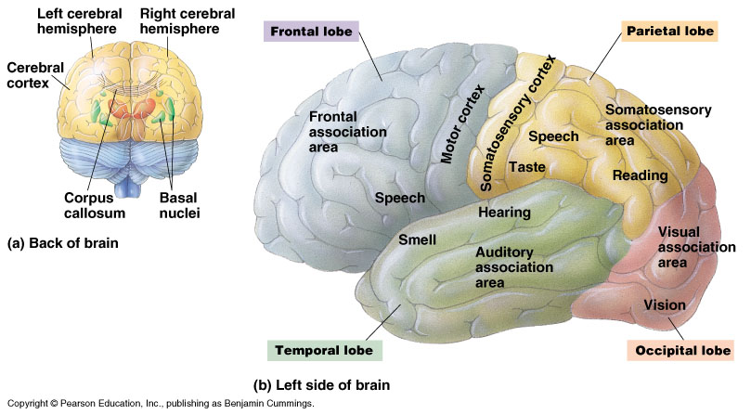
Higher brain
Cerebrum
  2 hemispheres
  left = right side of
  body
  right = left side of
  body
Corpus callosum
  connection
  between 2 hemispheres

Slide 12
Division of Brain Function
Left hemisphere
  “logic side”
  language, math, logic operations, vision & hearing details
  fine motor control
Right hemisphere
  “creative side”
  pattern recognition, spatial
  relationships, non-verbal
  ideas, emotions, multi-tasking

Slide 13
Cerebrum specialization
Regions specialized for different functions
Lobes
  frontal
    speech,
    control of emotions
  temporal
    smell, hearing
  occipital
    vision
  parietal
    speech, taste
    reading
frontal
parietal
occipital
temporal

Slide 14
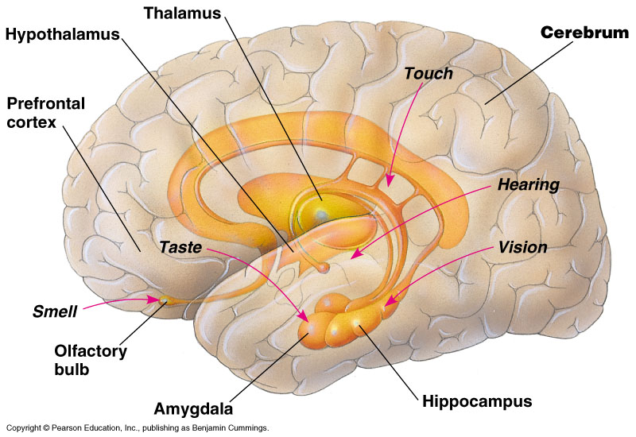
Limbic system
Controls basic emotions (fear, anger), involved in emotional bonding, establishes emotional memory

Slide 15
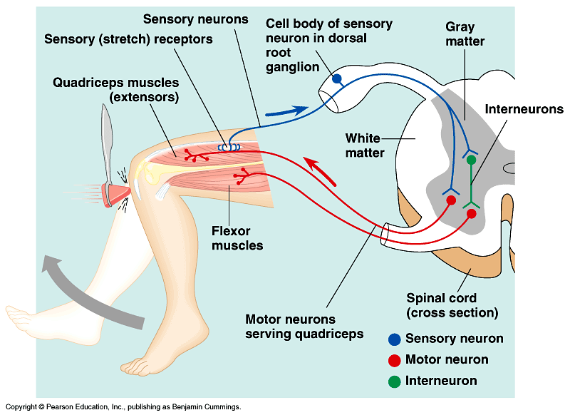
Simplest Nerve Circuit
Reflex, or automatic response
rapid response
  automated
signal only goes to spinal cord
  no higher level processing
advantage
  essential actions
  don’t need to think or make decisions about
    blinking
    balance
    pupil dilation
    startle

