Slide 1
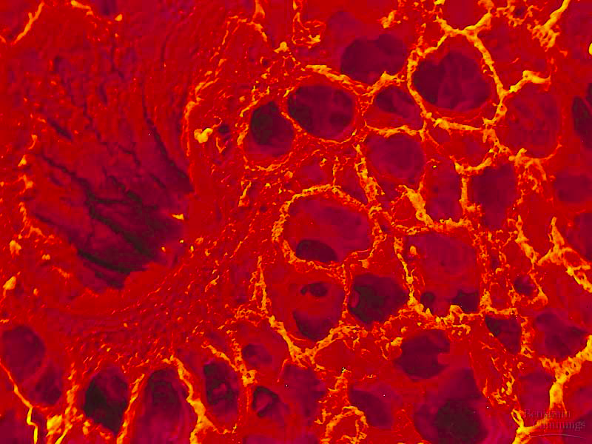
Respiratory System

Slide 2
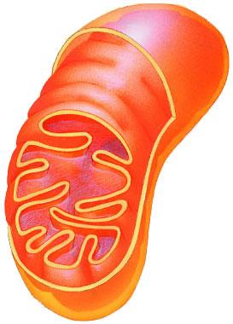
Why do we need a respiratory system?
Need O₂ in
for cellular respiration
make ATP
Need CO₂ out
waste product
food
O₂
ATP
CO₂

Slide 3
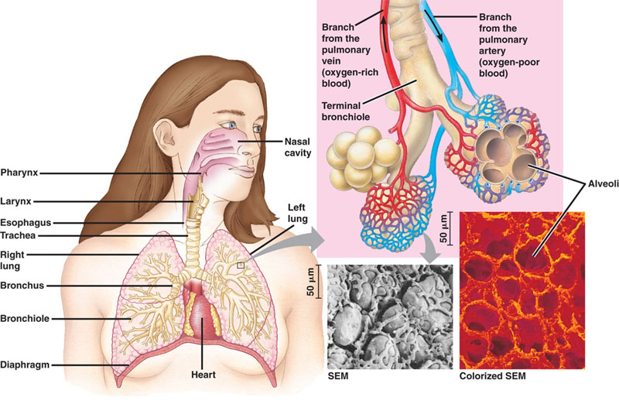
Lungs
capillaries
(circulatory system)
trachea
bronchi
bronchioles
alveoli
alveoli

Slide 4
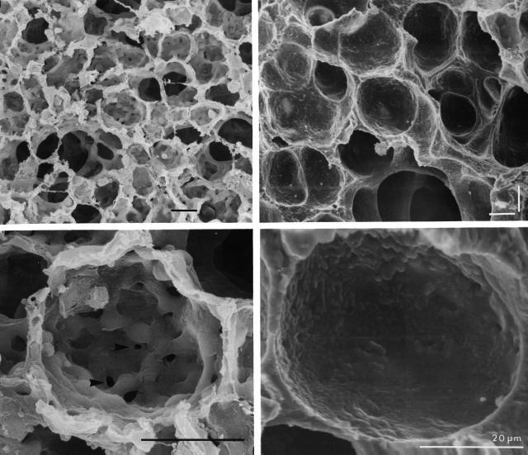
Lungs
Structure
spongy texture
high surface area
more absorption of O₂
alveoli
small air sacs
moist lining
mucus traps dust, pollen, particles
covered by cilia
hair-like extensions of cells
move mucus upward to clear out lungs

Slide 5
Moving gases into bloodstream
Inhale
O₂ passes from alveoli to blood
by diffusion
Exhale
CO₂ passes from blood to alveoli
by diffusion
capillaries
(circulatory system)

Slide 6
Gas exchange: Diffusion of gases
Gases move by diffusion from high to low concentration
capillaries are thin-walled tubes of circulatory system
alveoli are thin-walled sacs of respiratory system
capillaries in lungs
capillaries in muscle
O₂
O₂
O₂
O₂
CO₂
CO₂
CO₂
CO₂
blood
lungs
blood
body

Slide 7
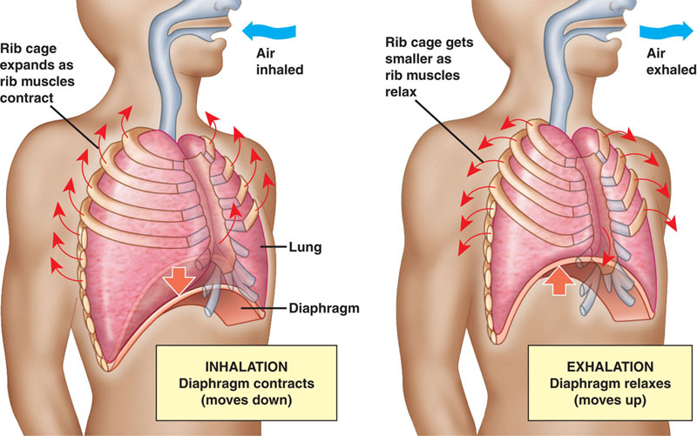
Negative pressure breathing
Diaphragm moves down & expands chest cavity pulls air into lungs
inhale
exhale

Slide 8
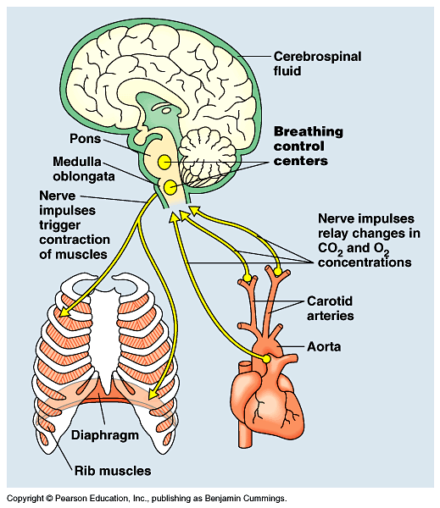
Automatic Brain Control
You don’t have to think to breathe!
Primitive parts of brain coordinate breathing
medulla & pons
measure blood pH
↑CO₂ = ↓pH (acid)
coordinate breathing, heart rate & body’s need for energy

Slide 9
Breathing and Homeostasis
ATP
Homeostasis
keeping the internal environment of the body balanced
need to balance O₂ in and CO₂ out
need to balance energy (ATP) production
Exercise
breathe faster
need more ATP
bring in more O₂ & remove more CO₂
Disease
poor lung or heart function = breathe faster
need to work harder to bring in O₂ & remove CO₂
O₂
CO₂

Slide 10
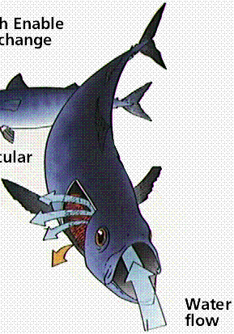
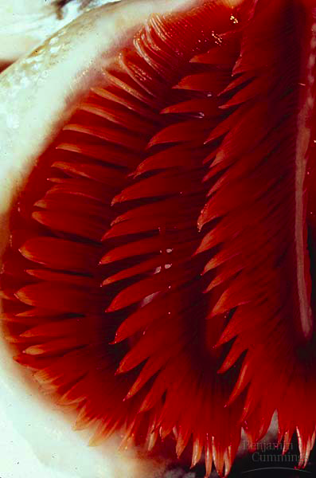
Gills: getting O₂ out of water
Gills are gas exchange membranes outside of the body
thin tissue
high surface area
must stay wet
lots of blood vessels
gas exchange
O₂ into blood
CO₂ out to water
water
gills

