Slide 1
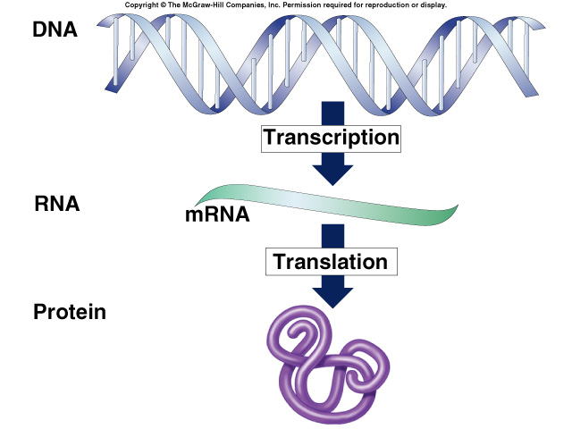
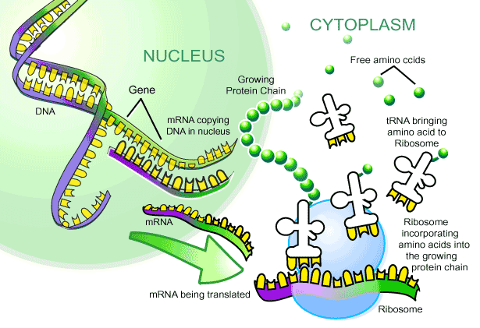
From Gene
to Protein
How Genes
Work

Slide 2
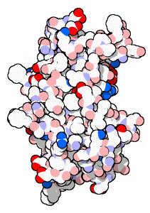
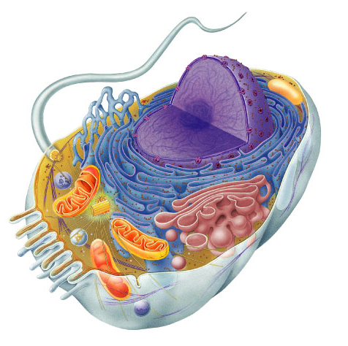
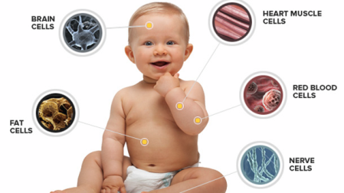
What do genes code for?
How does DNA code for cells & bodies?
  how are cells and bodies made from the instructions in DNA
DNA
proteins
cells
bodies

Slide 3
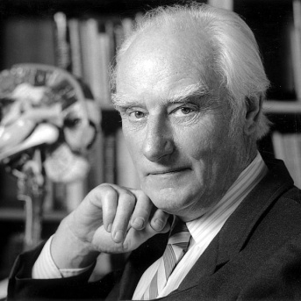
The “Central Dogma”
Flow of genetic information in a cell
  How do we move information from DNA to proteins?
transcription
translation
DNA
RNA
protein
trait
replication
Notes:
To get from the chemical language of DNA to the chemical language of proteins requires 2 major stages:
transcription and translation

Slide 4
Metabolism taught us about genes
Inheritance of metabolic diseases
  suggested that genes coded for enzymes
  each disease (phenotype) is caused by non-functional gene product
    lack of an enzyme
    Tay sachs
    PKU (phenylketonuria)
    albinism
metabolic pathway
disease
disease
disease
disease
A
✗
B
✗
C
✗
D
✗
E
enzyme 1
enzyme 2
enzyme 3
enzyme 4

Slide 5
Transcription
from
DNA nucleic acid language
to
RNA nucleic acid language

Slide 6
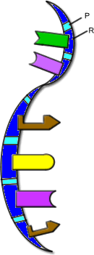
RNA
ribose sugar
N-bases
  uracil instead of thymine
  U : A
  C : G
single stranded
lots of RNAs
  mRNA, tRNA, rRNA, siRNA…
transcription
DNA
RNA

Slide 7
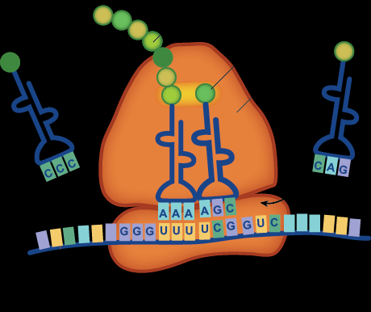
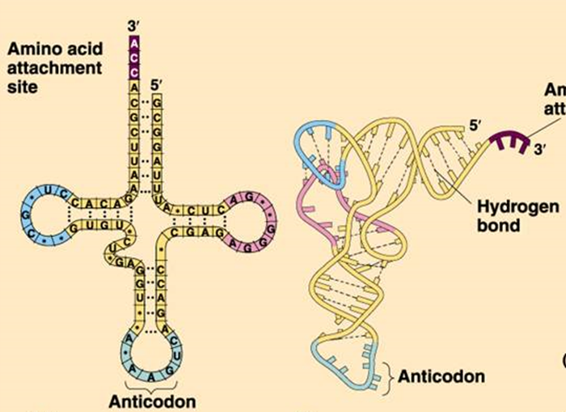
3 KINDS OF RNA HELP WITH INFO TRANSFER FOR PROTEIN SYNTHESIS
RIBOSOMAL RNA (rRNA)
TRANSFER RNA (tRNA)
MESSENGER RNA (mRNA)

Slide 8
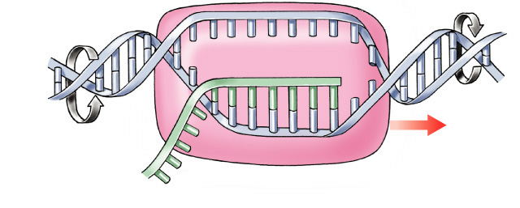
Transcription
Making mRNA
  transcribed DNA strand = template strand
  untranscribed DNA strand = coding strand
    same sequence as RNA
  synthesis of complementary RNA strand
    transcription bubble
  enzyme
    RNA polymerase
coding strand
3′
5′
A
G
A
G
C
A
T
C
G
T
A
A
A
G
T
T
C
T
C
A
T
C
C
A
G
T
DNA
G
A
T
3′
A
C
T
5′
T
G
G
C
A
U
C
G
U
T
3′
C
G
T
A
G
C
A
unwinding
rewinding
mRNA
RNA polymerase
template strand
build RNA 5′→3′
5′

Slide 9
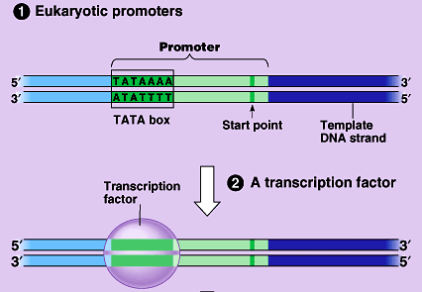
Which gene is read?
Promoter region
  binding site before beginning of gene
  TATA box binding site
  binding site for RNA polymerase
  & transcription
  factors
Enhancer region
  binding site far
  upstream of gene
    turns transcription
    on HIGH

Slide 10
Matching bases of DNA & RNA
A
Match RNA bases to DNA bases on one of the DNA strands
C
G
U
G
A
U
G
U
C
U
C
G
A
A
C
U
A
G
A
C
U
5'
A
3'
RNA
polymerase
G
A
C
C
T
G
G
T
A
C
A
G
C
T
A
G
T
C
A
T
C
G
T
A
C
C
G
T

Slide 11
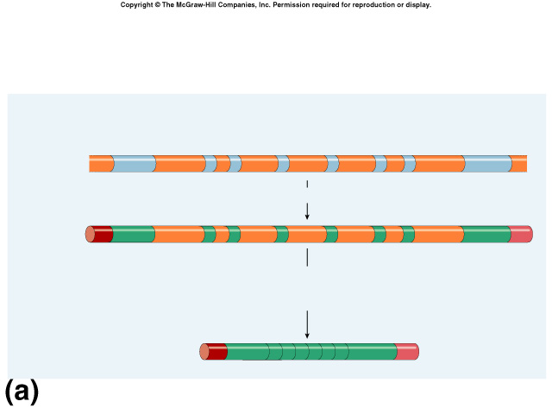
Eukaryotic genes have junk!
Eukaryotic genes are not continuous
  exons = the real gene
    expressed / coding DNA
  introns = the junk
    inbetween sequence
intron = noncoding (inbetween) sequence
eukaryotic DNA
exon = coding (expressed) sequence

Slide 12
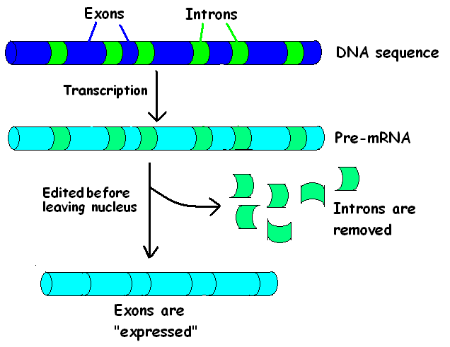
mRNA’s require EDITING before use
Message in NOT CONTINUOUS
INTRONS are removed

Slide 13
mRNA splicing
Post-transcriptional processing
  eukaryotic mRNA needs work after transcription
  primary transcript = pre-mRNA
  mRNA splicing
    edit out introns
  make mature mRNA transcript
intron = noncoding (inbetween) sequence
~10,000 bases
eukaryotic DNA
exon = coding (expressed) sequence
pre-mRNA
primary mRNA
transcript
~1,000 bases
mature mRNA
transcript
spliced mRNA
Notes:
eukaryotic RNA is about 10% of eukaryotic gene.

Slide 14
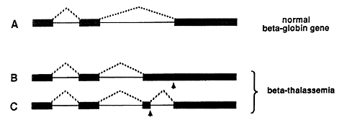
Discovery of exons/introns
1977 | 1993
Richard Roberts
Philip Sharp
CSHL
adenovirus
MIT
common cold
beta-thalassemia
Notes:
Beta thalassemia is an inherited blood disorder that reduces the production of hemoglobin. Symptoms of beta thalassemia occur when not enough oxygen gets to various parts of the body due to low levels of hemoglobin and a shortage of red blood cells (anemia).
Signs and symptoms of thalassemia major appear in the first 2 years of life. Infants have life-threatening anemia and become pale and listless. They also have a poor appetite, grow slowly, and may develop yellowing of the skin and whites of the eyes (jaundice). The spleen, liver, and heart may be enlarged, and bones may be deformed. Adolescents with thalassemia major may experience delayed puberty.
Thalassemia is a quantitative problem of too few globins synthesized, whereas sickle-cell anemia is a qualitative problem of synthesis of an incorrectly functioning globin.

Slide 15
Splicing must be accurate
No room for mistakes!
  a single base added or lost throws off the reading frame
AUGCGGCTATGGGUCCGAUAAGGGCCAU
AUGCGGUCCGAUAAGGGCCAU
AUG|CGG|UCC|GAU|AAG|GGC|CAU
Met|Arg|Ser|Asp|Lys|Gly|His
AUGCGGCTATGGGUCCGAUAAGGGCCAU
AUGCGGGUCCGAUAAGGGCCAU
AUG|CGG|GUC|CGA|UAA|GGG|CCA|U
Met|Arg|Val|Arg|STOP|

Slide 16
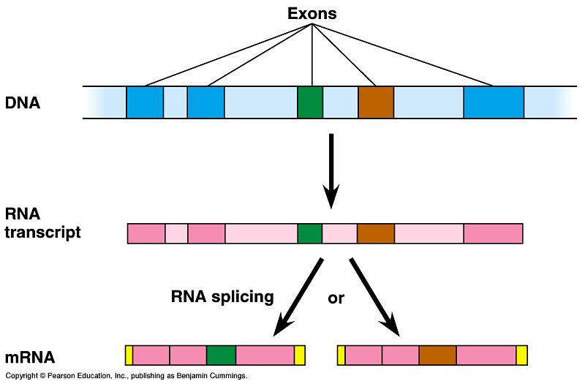
Alternative splicing
Alternative mRNAs produced from same gene
  when is an intron not an intron…
  different segments treated as exons

Slide 17
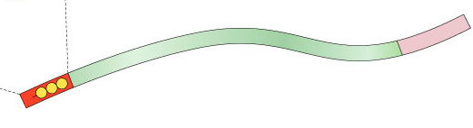
More post-transcriptional processing
Need to protect mRNA on its trip from nucleus to cytoplasm
  enzymes in cytoplasm attack mRNA
    protect the ends of the molecule
    add 5′ GTP cap
    add poly-A tail
      longer tail, mRNA lasts longer: produces more protein
3' poly-A tail
3'
A
A
A
A
A
mRNA
50-250 A’s
5' cap
P
P
P
5'
G
Notes:
eukaryotic RNA is about 10% of eukaryotic gene.

Slide 18
Translation
from
nucleic acid language
to
amino acid language

Slide 19
How does mRNA code for proteins?
DNA
TACGCACATTTACGTACGCGG
4
ATCG
mRNA
AUGCGUGUAAAUGCAUGCGCC
4
AUCG
?
protein
Met Arg Val Asn Ala Cys Ala
20
How can you code for 20 amino acids with only 4 nucleotide bases (A,U,G,C)?

Slide 20
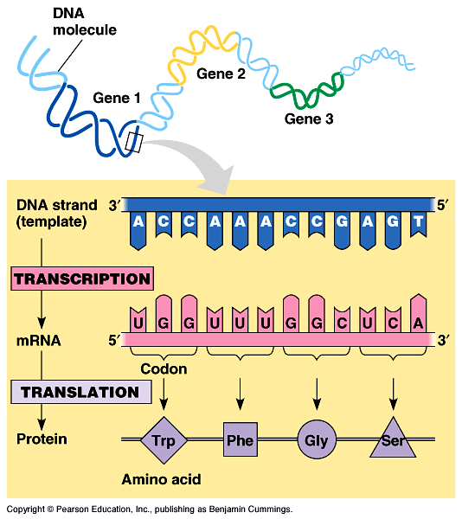
mRNA codes for proteins in triplets
DNA
TACGCACATTTACGTACGCGG
codon
AUGCGUGUAAAUGCAUGCGCC
mRNA
AUGCGUGUAAAUGCAUGCGCC
mRNA
?
protein
Met Arg Val Asn Ala Cys Ala

Slide 21
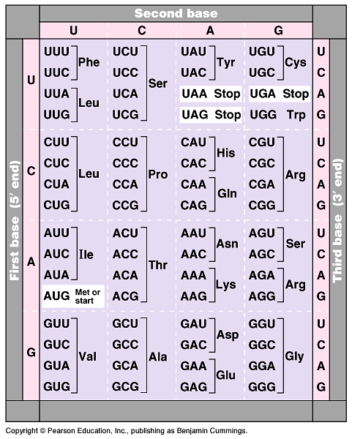
The code
Code for ALL life!
  strongest support for a common origin for all life
Code is redundant
  several codons for each amino acid
  3rd base “wobble”
Start codon
  AUG
  methionine
Stop codons
  UGA, UAA, UAG
Notes:
Strong evidence for a single origin in evolutionary theory.

Slide 22
How are the codons matched to amino acids?
3′
5′
DNA
TACGCACATTTACGTACGCGG
5′
3′
mRNA
AUGCGUGUAAAUGCAUGCGCC
codon
3′
5′
UAC
GCA
tRNA
CAU
anti-codon
Met
amino
acid
Arg
Val

Slide 23
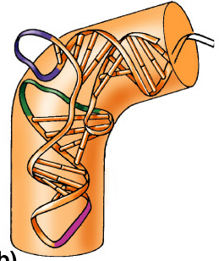
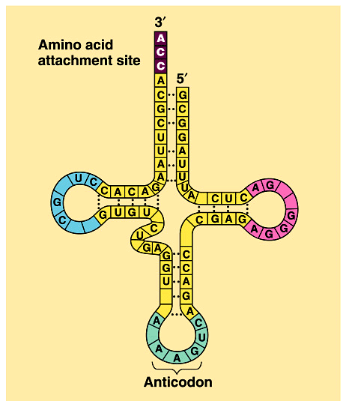
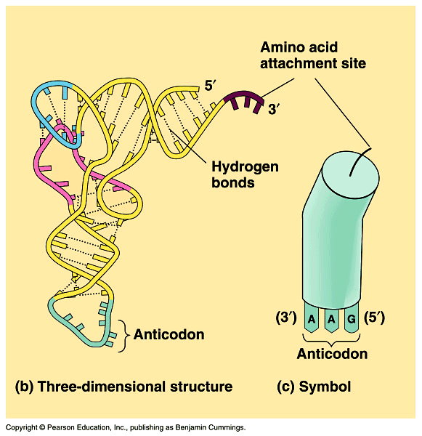
Transfer RNA structure
“Clover leaf” structure
  anticodon on “clover leaf” end
  amino acid attached on 3′ end

Slide 24
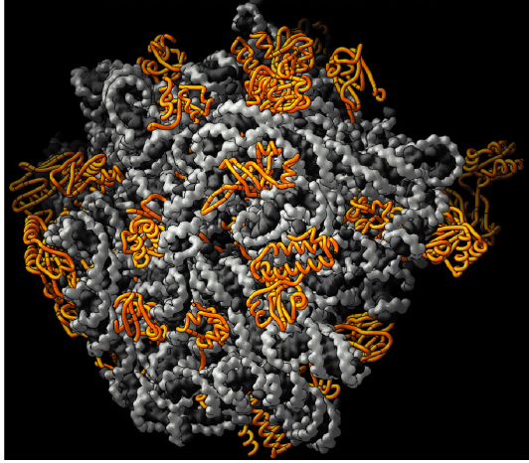
Ribosomes
Protein synthesis/quiz
Facilitate coupling of
tRNA anticodon to
mRNA codon
  organelle or enzyme?
Structure
  ribosomal RNA (rRNA) & proteins
  2 subunits
    large
    small
E
P
A

Slide 25
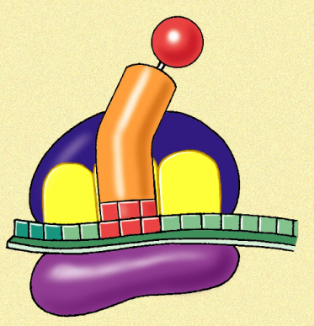
Ribosomes
Protein synthesis 2
A site (aminoacyl-tRNA site)
  holds tRNA carrying next amino acid to be added to chain
P site (peptidyl-tRNA site)
  holds tRNA carrying growing polypeptide chain
E site (exit site)
  empty tRNA
  leaves ribosome
  from exit site
Met
5'
U
A
C
A
U
G
E
P
A
3'

Slide 26
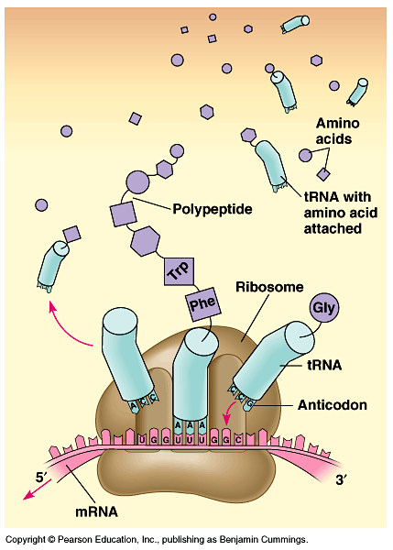
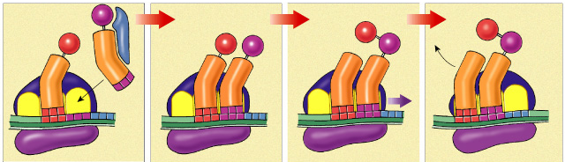
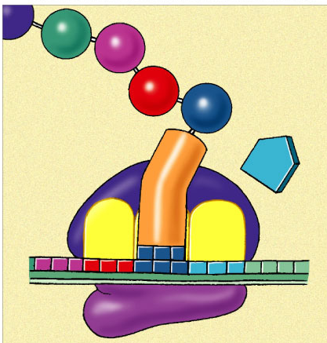
Building a polypeptide
How translation works
Initiation
  brings together mRNA, ribosome subunits, initiator tRNA
Elongation
  adding amino acids based on codon sequence
Termination
  end codon
3
2
1
Leu
Val
Ser
release
factor
Met
Met
Ala
Met
Met
Leu
Leu
Leu
Trp
tRNA
A
C
G
U
A
C
U
A
C
G
A
C
U
A
C
G
A
C
A
U
A
C
G
A
C
U
5'
A
U
G
C
U
G
A
A
U
5'
A
U
G
C
U
G
A
A
U
5'
A
U
G
C
U
G
A
U
5'
A
U
G
C
U
G
A
A
3'
A
C
C
mRNA
3'
3'
3'
U
G
G
U
A
A
3'
E
P
A

Slide 27
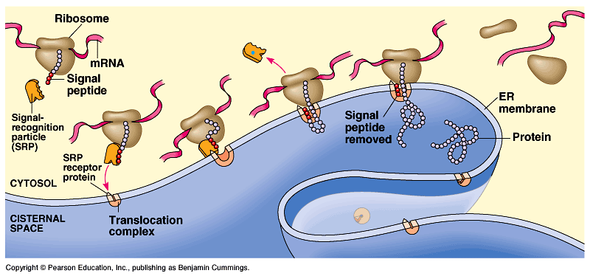
Protein targeting
Destinations:
  secretion
  nucleus
  mitochondria
  chloroplasts
  cell membrane
  cytoplasm
  etc…
Signal peptide
  address label
start of a secretory pathway

Slide 28
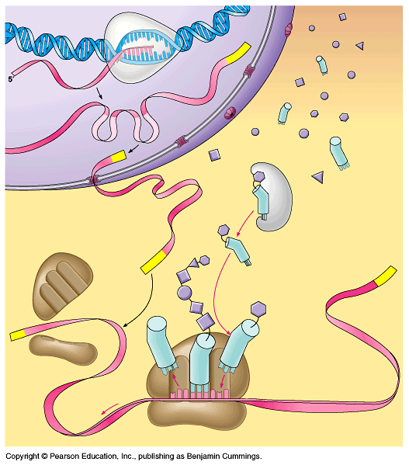
RNA polymerase
DNA
Can you tell the story?
amino
acids
exon
intron
tRNA
pre-mRNA
5' GTP cap
mature mRNA
aminoacyl tRNA
synthetase
poly-A tail
large ribosomal subunit
3'
polypeptide
5'
tRNA
small ribosomal subunit
E
P
A
ribosome

Slide 29
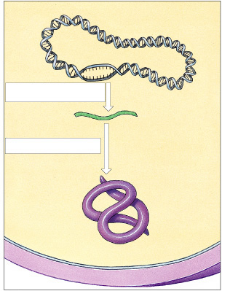
Protein Synthesis in Prokaryotes
Bacterial chromosome
Transcription
mRNA
Cell
membrane
Cell wall

Slide 30
Prokaryote vs. Eukaryote genes
Prokaryotes
  DNA in cytoplasm
  circular chromosome
  naked DNA
  no introns
Eukaryotes
  DNA in nucleus
  linear chromosomes
  DNA wound on histone proteins
  introns vs. exons
intron = noncoding (inbetween) sequence
eukaryotic
DNA
exon = coding (expressed) sequence
Notes:
Walter Gilbert hypothesis:
Maybe exons are functional units and introns make it easier for them to recombine, so as to produce new proteins with new properties through new combinations of domains.
Introns give a large area for cutting genes and joining together the pieces without damaging the coding region of the gene…. patching genes together does not have to be so precise.

Slide 31
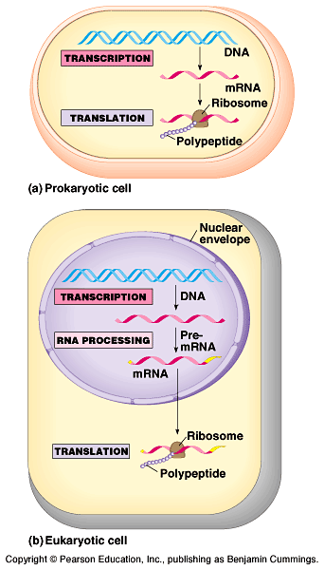
Translation: prokaryotes vs. eukaryotes
SEE PROCESSING VIDEO
Differences between prokaryotes & eukaryotes
  time & physical separation between processes
    takes eukaryote ~1 hour
    from DNA to protein
  no RNA processing

Slide 32
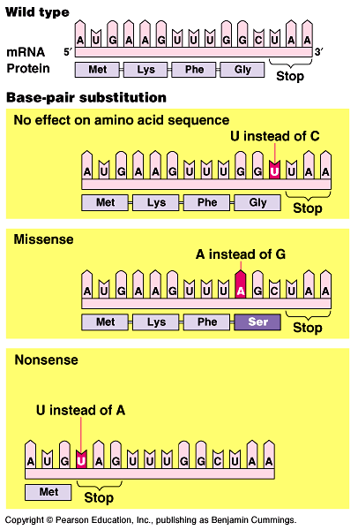
Mutations
Point mutations
  single base change
  base-pair substitution
    silent mutation
      no amino acid change
      redundancy in code
    missense
      change amino acid
    nonsense
      change to stop codon

Slide 33
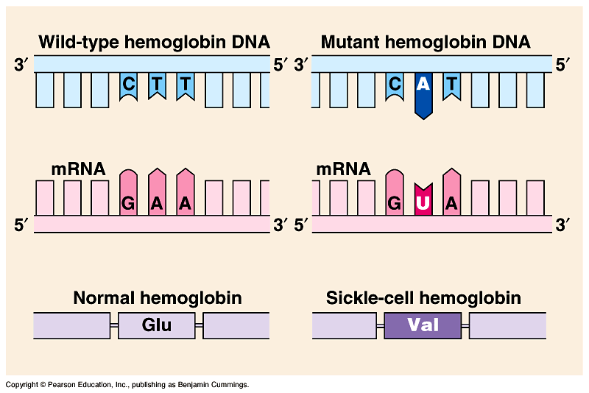
Point mutation leads to Sickle cell anemia
What kind of mutation?

Slide 34
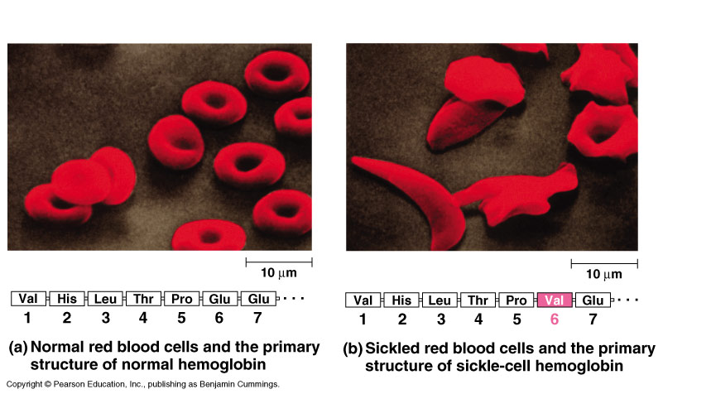
Sickle cell anemia

Slide 35
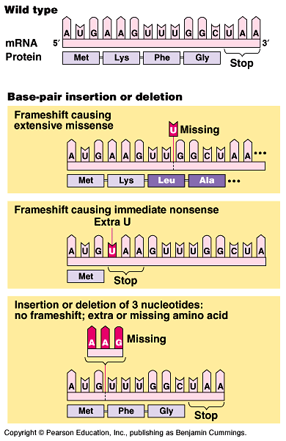
Mutations
Frameshift
  shift in the reading frame
    changes everything “downstream”
  insertions
    adding base(s)
  deletions
    losing base(s)
  More damaging at
  beginning of gene than at end

Slide 36
DNA → DNA ____________
DNA → RNA ____________
RNA→ Protein ___________

